Slide 1
NAME THESE TOYS

Slide 2
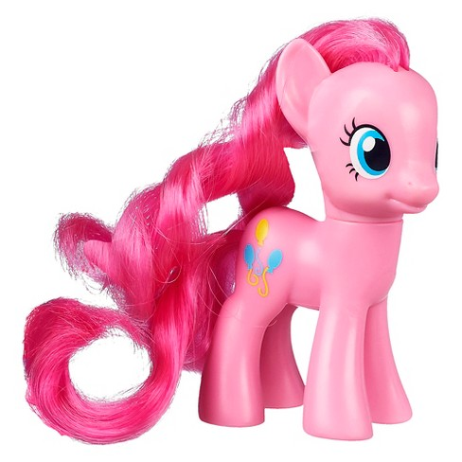
Question 1:

Slide 3
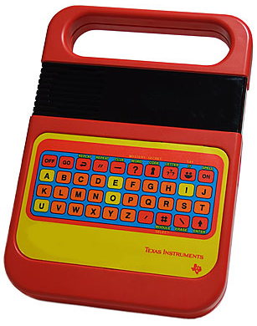
Question 2:

Slide 4
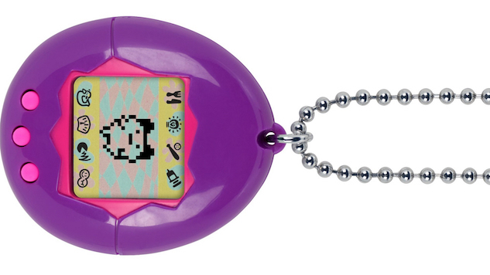
Question 3:

Slide 5
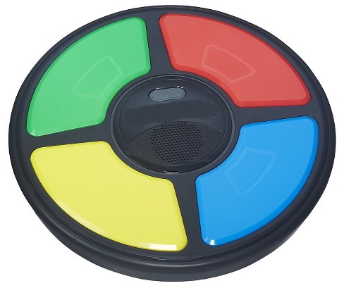
Question 4:

Slide 6
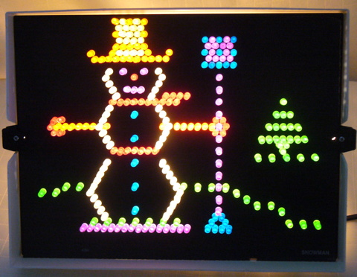
Question 5:

Slide 7
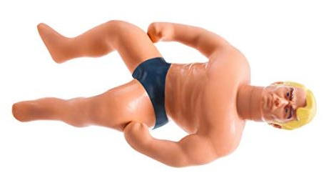
Question 6:

Slide 8
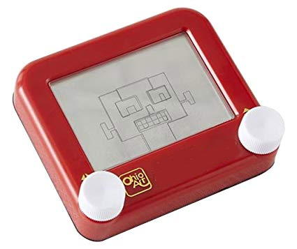
Question 7:

Slide 9
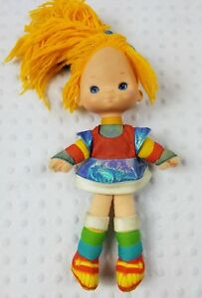
Question 8:

Slide 10
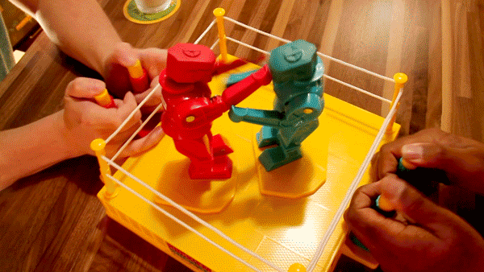
Question 9:

Slide 11
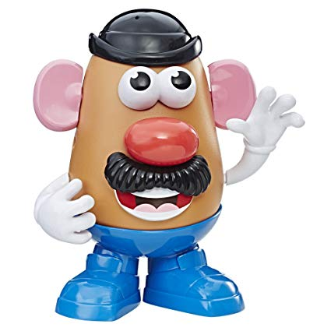
Question 10:

Slide 12
ANSWERS WILL BE PROVIDED SHORTLY

Slide 13
Question 1:
MY LITTLE PONY

Slide 14
Question 2:
SPEAK AND SPELL

Slide 15
Question 3:
TAMAGOTCHI

Slide 16
Question 4:
SIMON

Slide 17
Question 5:
LITE BRIGHT

Slide 18
Question 6:
STRETCH ARMSTRONG

Slide 19
Question 7:
ETCH A SKETCH

Slide 20
Question 8:
RAINBOW BRITE

Slide 21
Question 9:
ROCK 'EM SOCK 'EM ROBOTS

Slide 22
Question 10:
MR. POTATO HEAD

