Slide 1
WHICH IS THE CIA AND WHICH IS THE FBI?

Slide 2


Question 1:
WHICH OF THESE SEALS BELONGS TO THE CIA?

Slide 3
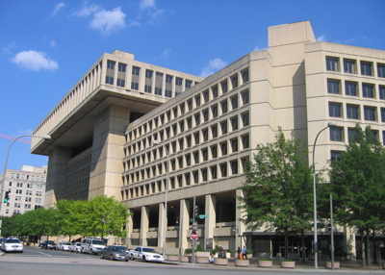
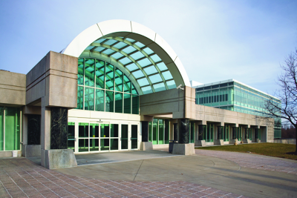
Question 2:
WHICH OF THESE BUILDINGS IS THE FBI HEADQUARTERS?

Slide 4
Question 3:
WAS THE CIA FORMED IN 1908 OR 1947?

Slide 5
Question 4:
WHICH HAS A HIGHER BUDGET, THE CIA OR FBI?

Slide 6
Question 5:
OF CHRISTOPHER WRAY AND GINA HASPEL, WHICH ONE HEADS THE FBI?

Slide 7
Question 6:
WHICH OF THE 3 WORDS "FEDERAL", "BUREAU", OR "INVESTIGATION" WAS MISSING FROM THE ORIGINAL NAME OF THE FBI?

Slide 8
Question 7:
WHICH OF THE 3 WORDS "CENTRAL", "INTELLIGENCE", OR "AGENCY" WAS IN THE ORIGINAL NAME OF THE CIA?

Slide 9
Question 8:
WHICH EMPLOYEE IS MORE LIKELY TO DIE ON THE JOB, CIA OR FBI?

Slide 10
Question 9:
WHICH AGENCY REQUIRES LONGER TRAINING OF ALL EMPLOYEES, THE CIA OR FBI?

Slide 11
Question 10:
MOST STATES HAVE ONE FBI FIELD OFFICE, BUT FLORIDA HAS THREE. IN WHAT CITIES ARE THEY LOCATED?

Slide 12
ANSWERS WILL BE PROVIDED SHORTLY

Slide 13
Question 1:
WHICH OF THESE SEALS BELONGS TO THE CIA?
ONE ON THE LEFT

Slide 14
Question 2:
WHICH OF THESE BUILDINGS IS THE FBI HEADQUARTERS?
ONE ON THE LEFT

Slide 15
Question 3:
WAS THE CIA FORMED IN 1908 OR 1947?
1947

Slide 16
Question 4:
WHICH HAS A HIGHER BUDGET, THE CIA OR FBI?
CIA

Slide 17
Question 5:
OF CHRISTOPHER WRAY AND GINA HASPEL, WHICH ONE HEADS THE FBI?
CHRISTOPHER WRAY

Slide 18
Question 6:
WHICH OF THE 3 WORDS "FEDERAL", "BUREAU", OR "INVESTIGATION" WAS MISSING FROM THE ORIGINAL NAME OF THE FBI?
FEDERAL

Slide 19
Question 7:
WHICH OF THE 3 WORDS "CENTRAL", "INTELLIGENCE", OR "AGENCY" WAS IN THE ORIGINAL NAME OF THE CIA?
INTELLIGENCE

Slide 20
Question 8:
WHICH EMPLOYEE IS MORE LIKELY TO DIE ON THE JOB, CIA OR FBI?
FBI

Slide 21
Question 9:
WHICH AGENCY REQUIRES LONGER TRAINING OF ALL EMPLOYEES, THE CIA OR FBI?
CIA

Slide 22
Question 10:
MOST STATES HAVE ONE FBI FIELD OFFICE, BUT FLORIDA HAS THREE. IN WHAT CITIES ARE THEY LOCATED?
MIAMI, TAMPA & JACKSONVILLE

