Slide 1
IDENTIFY THESE CAR MODELS (THANKS MARGIE)

Slide 2
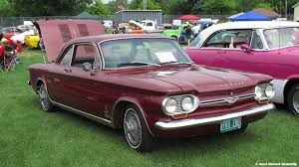
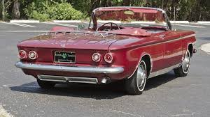
Question 1:

Slide 3
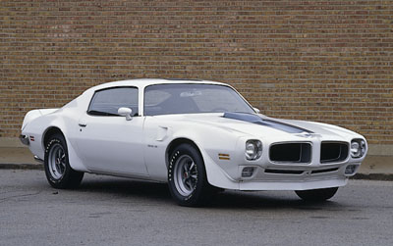
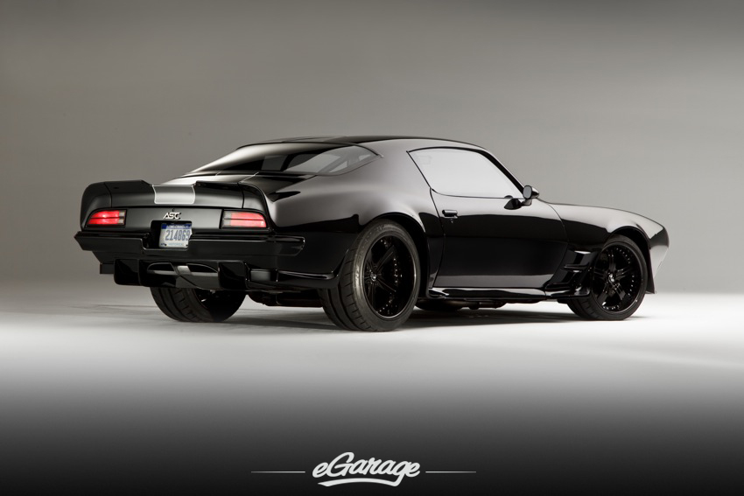
Question 2:

Slide 4
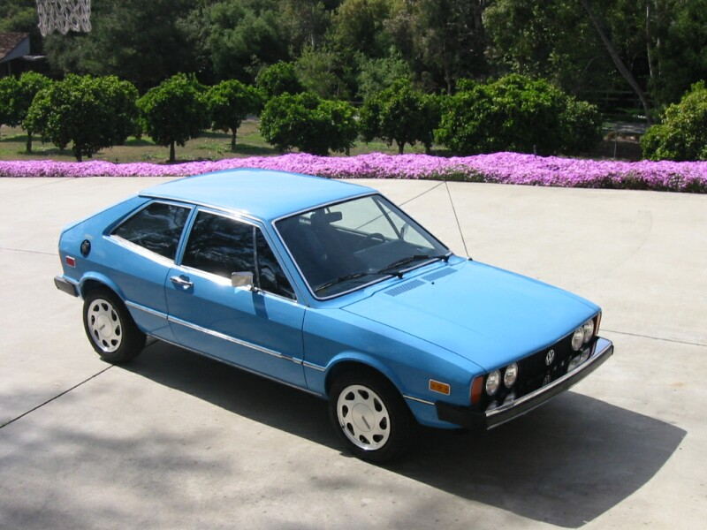
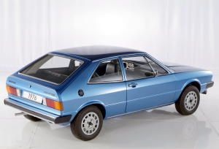
Question 3:

Slide 5
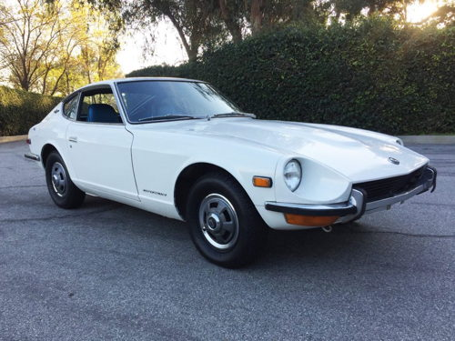
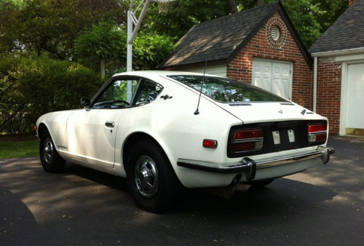
Question 4:

Slide 6
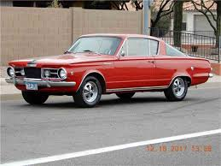
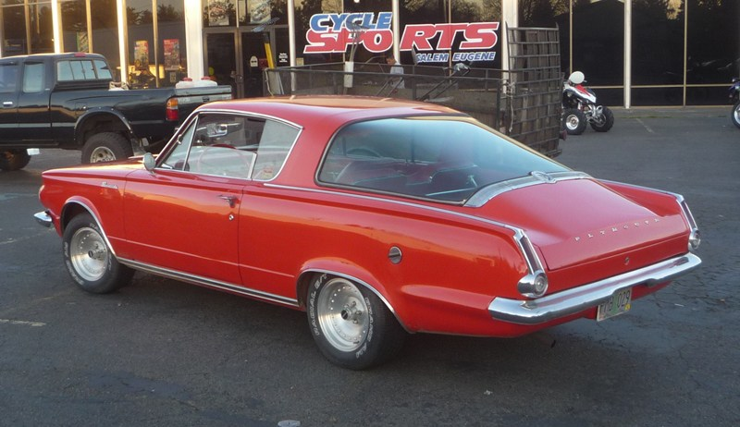
Question 5:

Slide 7
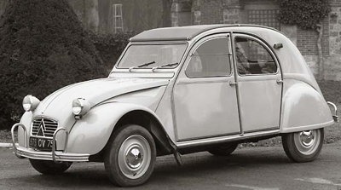
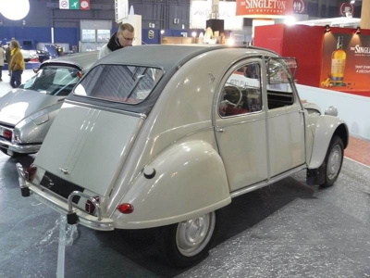
Question 6:

Slide 8
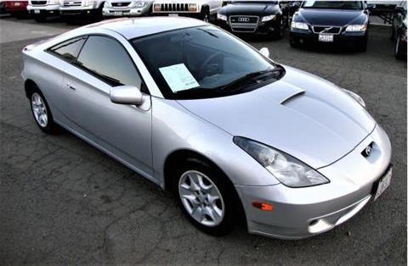
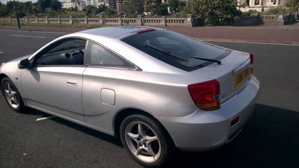
Question 7:

Slide 9
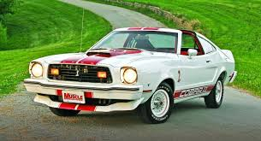
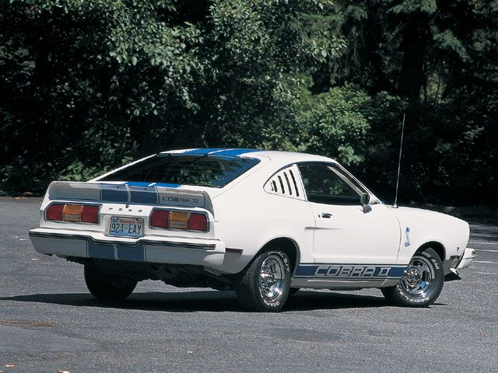
Question 8:

Slide 10
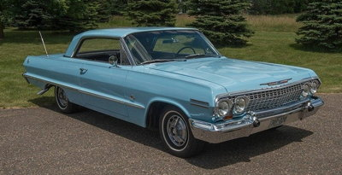
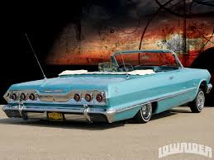
Question 9:

Slide 11
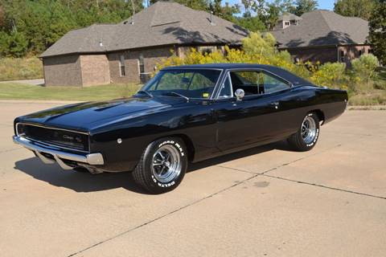
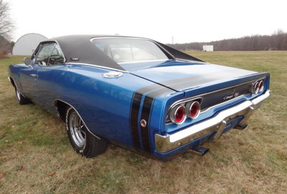
Question 10:

Slide 12
ANSWERS WILL BE PROVIDED SHORTLY

Slide 13
Question 1:
CHEVY CORVAIR

Slide 14
Question 2:
PONTIAC FIREBIRD

Slide 15
Question 3:
VOLKSWAGEN SCIROCCO

Slide 16
Question 4:
DATSUN 240Z

Slide 17
Question 5:
PLYMOUTH BARRACUDA

Slide 18
Question 6:
CITROEN DEUXCHEVAUX

Slide 19
Question 7:
TOYOTA CELICA

Slide 20
Question 8:
FORD MUSTANG

Slide 21
Question 9:
CHEVY IMPALA

Slide 22
Question 10:
DODGE CHARGER

