Slide 1
SCIENCE FORMULAS

Slide 2
Question 1:
WHO IS RESPONSIBLE FOR THE FORMULA E=mc²?

Slide 3
Question 2:
WHAT IS THE NAME OF THE EQUATION PV=nRT?

Slide 4
Question 3:
WHAT IS THE NAME OF THE FORMULA ∆x•∆p ≥ h/2n ?

Slide 5
Question 4:
WHAT DOES THE FORMULA Gm₁m₂/r² CALCULATE?

Slide 6
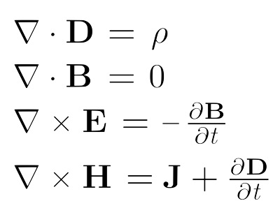
Question 5:
WHOSE EQUATIONS ARE THESE?

Slide 7
Question 6:
WHAT DOES THE FORMULA 2π√(L/g) CALCULATE?

Slide 8
Question 7:
WHAT IS THE FORMULA F=ma KNOWN AS?

Slide 9
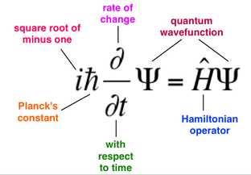
Question 8:
THE NAME OF THIS FORMULA?

Slide 10
Question 9:
WHAT FORMULA IS KNOWN AS OHM'S LAW?

Slide 11
Question 10:
WHAT IS THE FORMULA 1/u + 1/v = 1/f USUALLY CALLED?

Slide 12
ANSWERS WILL BE PROVIDED SHORTLY

Slide 13
Question 1:
WHO IS RESPONSIBLE FOR THE FORMULA E=mc²?
ALBERT EINSTEIN

Slide 14
Question 2:
WHAT IS THE NAME OF THE EQUATION PV=nRT?
IDEAL GAS LAW

Slide 15
Question 3:
WHAT IS THE NAME OF THE FORMULA ∆x•∆p ≥ h/2n ?
HEISENBERG UNCERTAINTY PRINCIPLE

Slide 16
Question 4:
WHAT DOES THE FORMULA Gm₁m₂/r² CALCULATE?
GRAVITATIONAL FORCE

Slide 17
Question 5:
WHOSE EQUATIONS ARE THESE?
JAMES CLERK MAXWELL

Slide 18
Question 6:
WHAT DOES THE FORMULA 2π√(L/g) CALCULATE?
PERIOD OF A PENDULUM

Slide 19
Question 7:
WHAT IS THE FORMULA F=ma KNOWN AS?
NEWTON'S SECOND LAW

Slide 20
Question 8:
THE NAME OF THIS FORMULA?
SCHRÖDINGER'S EQUATION

Slide 21
Question 9:
WHAT FORMULA IS KNOWN AS OHM'S LAW?
V=IR (VOLTAGE = CURRENT . RESISTANCE)

Slide 22
Question 10:
WHAT IS THE FORMULA 1/u + 1/v = 1/f USUALLY CALLED?
LENS FORMULA

