Slide 1
IDENTIFY THESE FICTIONAL SPACECRAFT OR THE TV SHOW OR FILM EACH CAME FROM

Slide 2
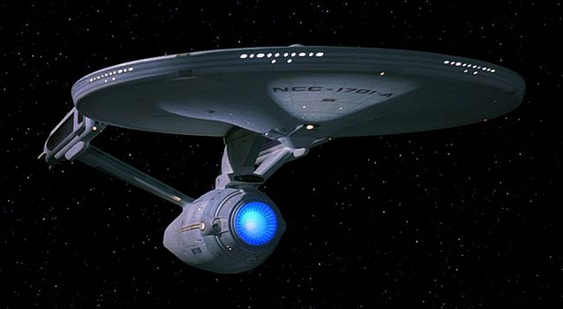
Question 1:

Slide 3
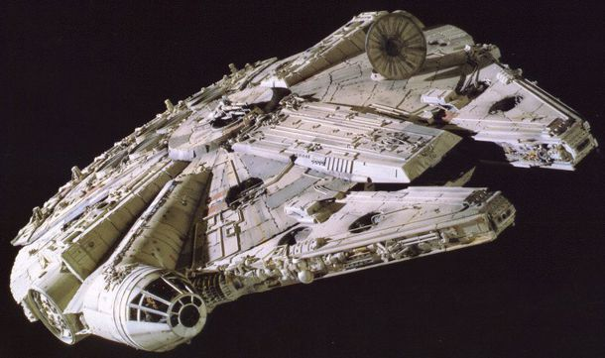
Question 2:

Slide 4
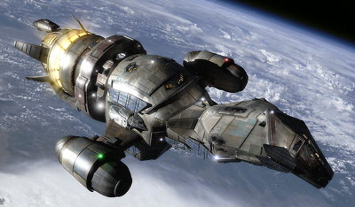
Question 3:

Slide 5
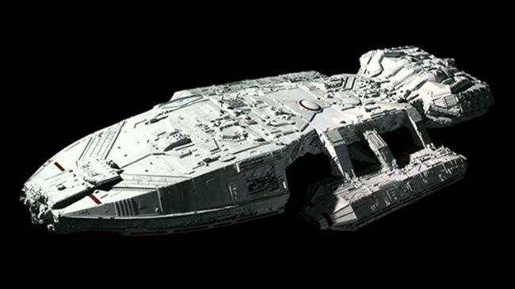
Question 4:

Slide 6

Question 5:

Slide 7
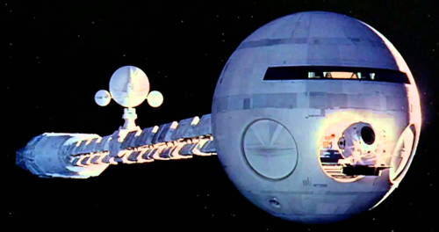
Question 6:

Slide 8
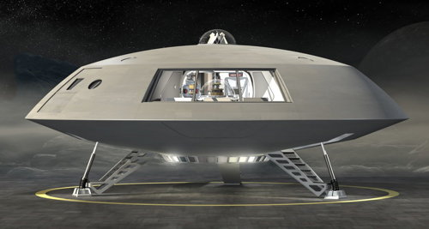
Question 7:

Slide 9
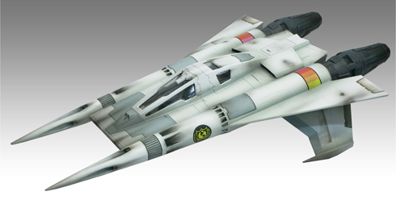
Question 8:

Slide 10
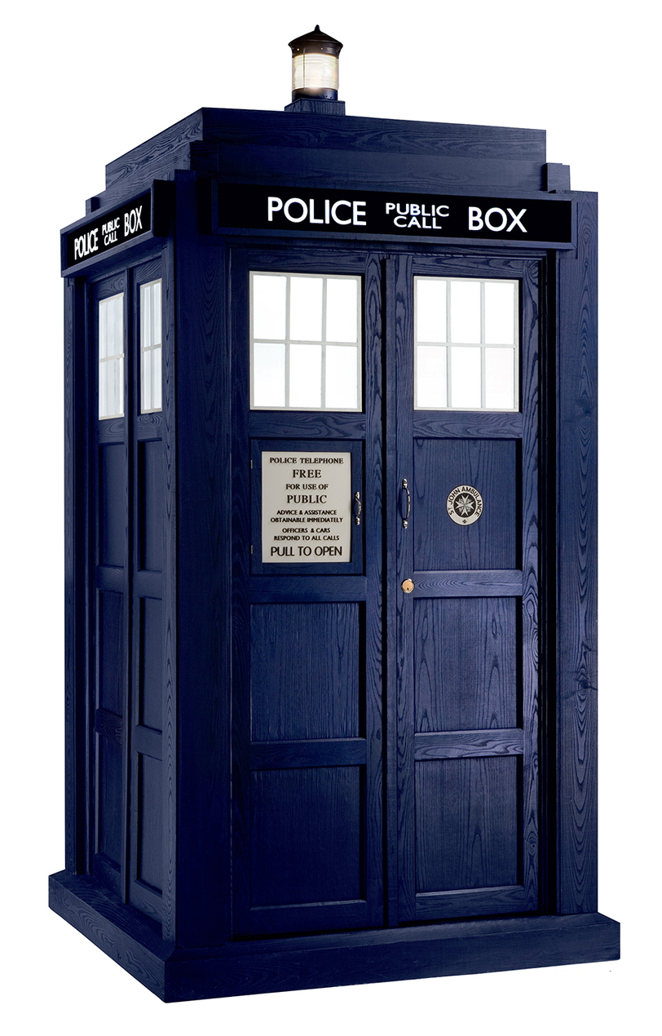
Question 9:

Slide 11
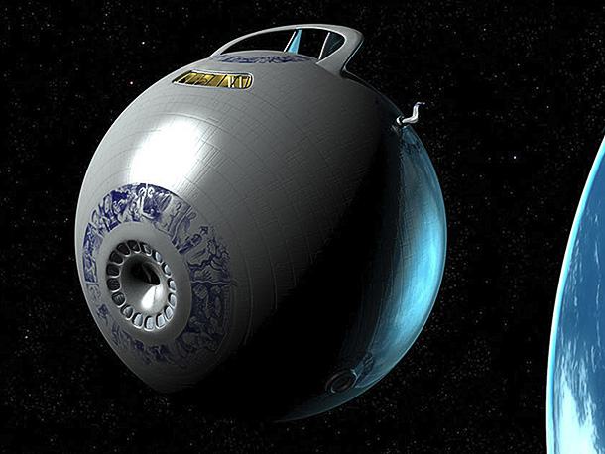
Question 10:

Slide 12
ANSWERS WILL BE PROVIDED SHORTLY

Slide 13
Question 1:
USS ENTERPRISE / STAR TREK

Slide 14
Question 2:
MILLENNIUM FALCON / STAR WARS

Slide 15
Question 3:
SERENITY / FIREFLY

Slide 16
Question 4:
BATTLESTAR GALACTICA

Slide 17
Question 5:
PLANET EXPRESS SHIP / FUTURAMA

Slide 18
Question 6:
DISCOVERY ONE / 2001: A SPACE ODYSSEY

Slide 19
Question 7:
JUPITER 2 / LOST IN SPACE

Slide 20
Question 8:
THUNDERFIGHTER / BUCK ROGERS IN THE 25TH CENTURY

Slide 21
Question 9:
TARDIS / DOCTOR WHO

Slide 22
Question 10:
HEART OF GOLD / HITCHHIKER'S GUIDE TO THE GALAXY

