Slide 1
IDENTIFY THESE ROBOTS

Slide 2
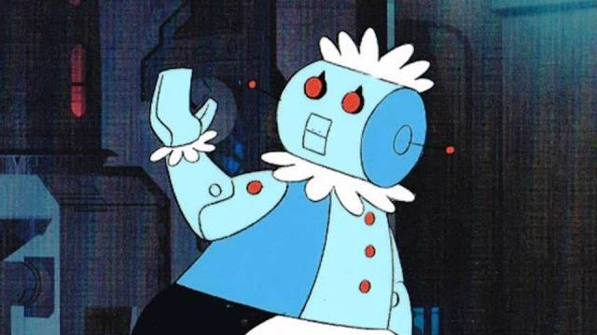
Question 1:

Slide 3
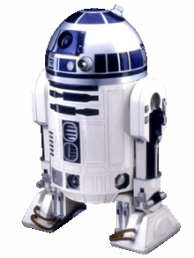
Question 2:

Slide 4
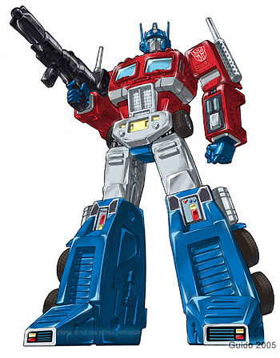
Question 3:

Slide 5
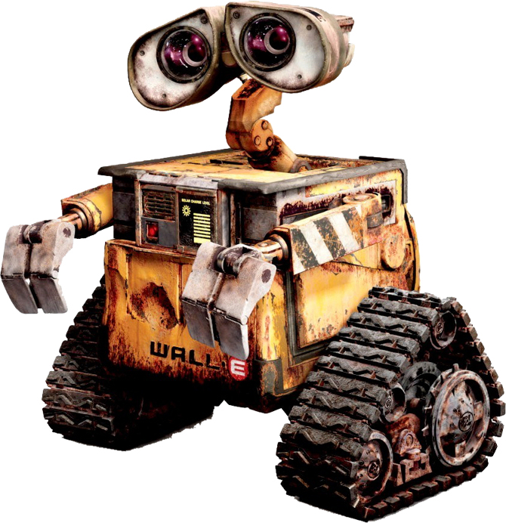
Question 4:

Slide 6
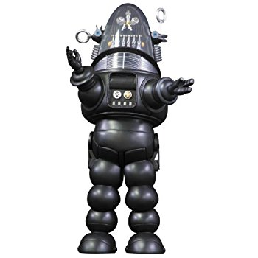
Question 5:

Slide 7
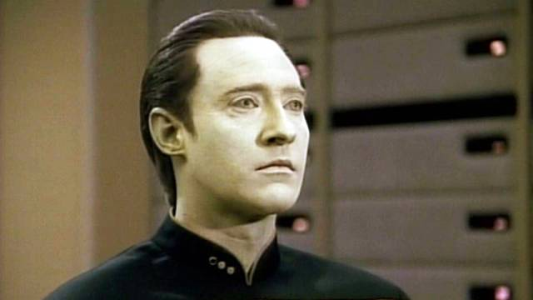
Question 6:

Slide 8
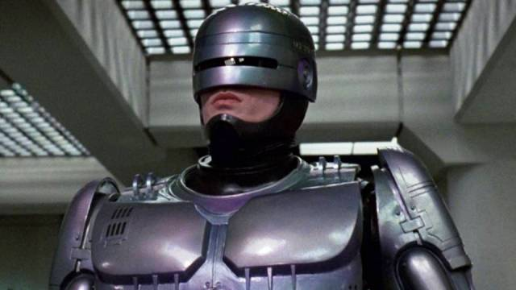
Question 7:

Slide 9
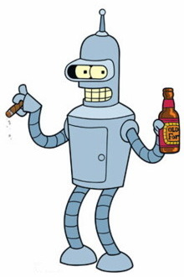
Question 8:

Slide 10
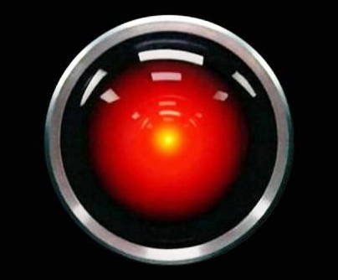
Question 9:

Slide 11
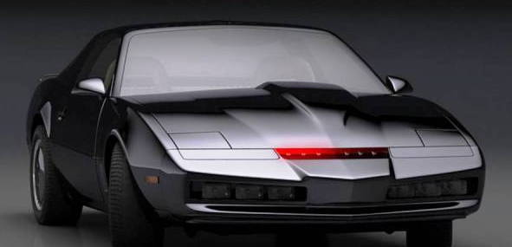
Question 10:

Slide 12
ANSWERS WILL BE PROVIDED SHORTLY

Slide 13
Question 1:
ROSIE ("THE JETSONS")

Slide 14
Question 2:
R2-D2 ("STAR WARS")

Slide 15
Question 3:
OPTIMUS PRIME ("TRANSFORMERS")

Slide 16
Question 4:
WALL–E

Slide 17
Question 5:
ROBBY ("THE FORBIDDEN PLANET")

Slide 18
Question 6:
DATA ("STAR TREK: TNG")

Slide 19
Question 7:
ROBOCOP

Slide 20
Question 8:
BENDER ("FUTURAMA")

Slide 21
Question 9:
HAL-9000 ("2001: A SPACE ODYSSEY")

Slide 22
Question 10:
KITT ("KNIGHT RIDER")

