Slide 1
SYMBOLS

Slide 2

Question 1:
THIS SYMBOL IS FOR A ZODIAC SIGN. WHICH ONE?

Slide 3

Question 2:
THIS IS AN ALCHEMIST SYMBOL. WHAT DOES IT STAND FOR, GOLD, SILVER, OR COPPER?

Slide 4
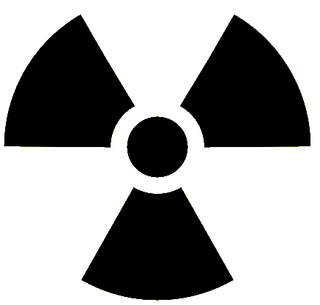
Question 3:
WHAT DANGER DOES THIS SYMBOL REPRESENT?

Slide 5
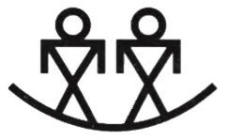
Question 4:
WHAT DOES THIS NATIVE AMERICAN SYMBOL MEAN? TRIBE, FAMILY, OR BROTHERS?

Slide 6

Question 5:
THIS SYMBOL APPEARS ON JAPANESE MAPS. WHAT DOES IT REPRESENT?

Slide 7
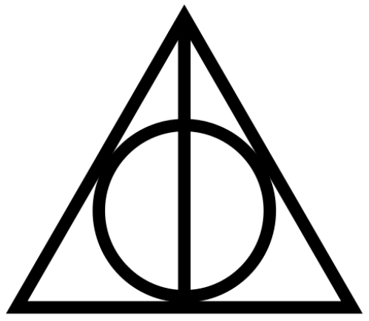
Question 6:
WHAT DOES THIS REPRESENT IN THE HARRY POTTER BOOKS?

Slide 8
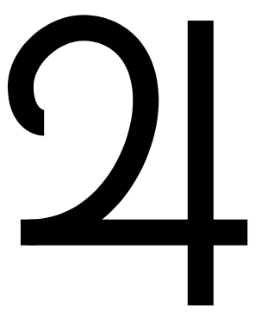
Question 7:
THIS SYMBOL REPRESENTS ONE OF THE PLANETS. WHICH ONE?

Slide 9
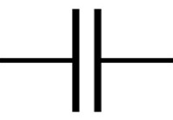
Question 8:
WHAT DOES THIS SYMBOL MEAN IN AN ELECTRICAL WIRING DIAGRAM?

Slide 10

Question 9:
WHAT DOES THIS WEATHER SYMBOL MEAN?

Slide 11

Question 10:
WHAT DOES THIS MATH SYMBOL MEAN?

Slide 12
ANSWERS WILL BE PROVIDED SHORTLY

Slide 13
Question 1:
THIS SYMBOL IS FOR A ZODIAC SIGN. WHICH ONE?
LIBRA

Slide 14
Question 2:
THIS IS AN ALCHEMIST SYMBOL. WHAT DOES IT STAND FOR, GOLD, SILVER, OR COPPER?
GOLD

Slide 15
Question 3:
WHAT DANGER DOES THIS SYMBOL REPRESENT?
RADIOACTIVITY

Slide 16
Question 4:
WHAT DOES THIS NATIVE AMERICAN SYMBOL MEAN? TRIBE, FAMILY, OR BROTHERS?
BROTHERS

Slide 17
Question 5:
THIS SYMBOL APPEARS ON JAPANESE MAPS. WHAT DOES IT REPRESENT?
HOSPITAL

Slide 18
Question 6:
WHAT DOES THIS REPRESENT IN THE HARRY POTTER BOOKS?
THE DEATHLY HALLOWS

Slide 19
Question 7:
THIS SYMBOL REPRESENTS ONE OF THE PLANETS. WHICH ONE?
JUPITER

Slide 20
Question 8:
WHAT DOES THIS SYMBOL MEAN IN AN ELECTRICAL WIRING DIAGRAM?
CAPACITOR

Slide 21
Question 9:
WHAT DOES THIS WEATHER SYMBOL MEAN?
HURRICANE

Slide 22

Question 10:
WHAT DOES THIS MATH SYMBOL MEAN?
PROPORTIONAL TO

