Slide 1
NAME THE COUNTRIES THAT CONTAIN THESE SYMBOLS ON THEIR FLAGS

Slide 2

Question 1:
STARTS WITH A

Slide 3

Question 2:
STARTS WITH B

Slide 4

Question 3:
STARTS WITH C

Slide 5

Question 4:
STARTS WITH C

Slide 6

Question 5:
STARTS WITH E

Slide 7

Question 6:
STARTS WITH K

Slide 8
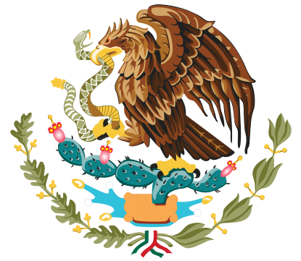
Question 7:
STARTS WITH M

Slide 9

Question 8:
STARTS WITH M

Slide 10
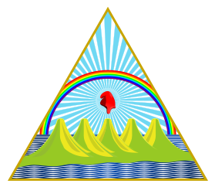
Question 9:
STARTS WITH N

Slide 11

Question 10:
STARTS WITH S

Slide 12
ANSWERS WILL BE PROVIDED SHORTLY

Slide 13
Question 1:
STARTS WITH A
ALBANIA

Slide 14
Question 2:
STARTS WITH B
BARBADOS

Slide 15
Question 3:
STARTS WITH C
CANADA

Slide 16
Question 4:
STARTS WITH C
CAMBODIA

Slide 17
Question 5:
STARTS WITH E
EGYPT

Slide 18
Question 6:
STARTS WITH K
KYRGYZSTAN

Slide 19
Question 7:
STARTS WITH M
MEXICO

Slide 20
Question 8:
STARTS WITH M
MONGOLIA

Slide 21
Question 9:
STARTS WITH N
NICARAGUA

Slide 22
Question 10:
STARTS WITH S
SLOVAKIA

