Slide 1
WHAT CATEGORY OF THINGS HAVE THESE FLAGS?

Slide 2

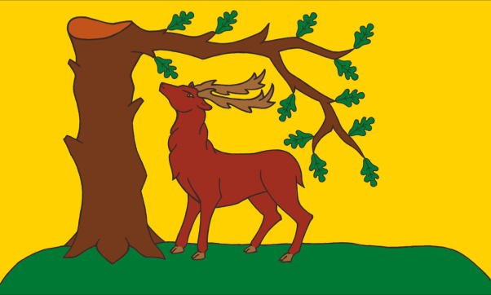
Question 1:

Slide 3


Question 2:

Slide 4


Question 3:

Slide 5



Question 4:

Slide 6


Question 5:

Slide 7
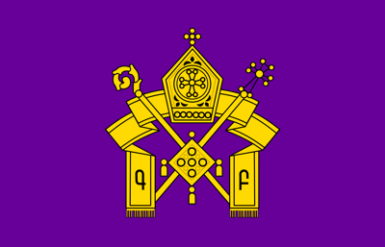

Question 6:

Slide 8


Question 7:

Slide 9


Question 8:

Slide 10


Question 9:

Slide 11


Question 10:

Slide 12
ANSWERS WILL BE PROVIDED SHORTLY

Slide 13
Question 1:
ENGLISH COUNTIES

Slide 14
Question 2:
COUNTRY NAVAL ENSIGNS

Slide 15
Question 3:
AUTO RACING

Slide 16
Question 4:
INTERNATIONAL CODE OF SIGNALS

Slide 17
Question 5:
SEXUAL ORIENTATION

Slide 18
Question 6:
RELIGIONS

Slide 19
Question 7:
NATIVE AMERICAN TRIBES

Slide 20
Question 8:
U.S. ARMED FORCES

Slide 21
Question 9:
U.S. CITIES

Slide 22
Question 10:
NAZIS

