Slide 1
Minimal Matchstick Graphs
With Small Degree Sets
Erich Friedman
Stetson University
1/25/06

Slide 2
Matchstick Challenge
Pick up 12 matchsticks from the box at the front of the room.
Arrange them on the table so that:
  They do not overlap
  Both ends of every matchstick touch exactly two other matchstick ends
It CAN be done!

Slide 3
Definitions
A graph is a collection of vertices (points) and edges (lines).
A planar graph is a graph whose edges do not cross.
A matchstick graph is a planar graph where every edge has length 1.

Slide 4
Definitions
The degree of a vertex is the number of edges coming out of it.
The degree set of a graph is the set of the degrees of the vertices.
Ex: The degree set of the graph to the right is {1,2,4}.

Slide 5
The General Problem
For a given set S, what is the matchstick graph with the smallest number of vertices that has degree set S?

Slide 6
Previous Results
In 1994, the problem for singleton sets S was studied by Hartsfield and Ringel.
The smallest matchstick graphs for S={0}, {1}, {2}, and {3} are shown below.

Slide 7
Previous Results
The smallest known matchstick graph for S={4}, the Harborth graph, is shown below.
It contains 52 vertices, and has not been proved minimal.
There is no S={5} matchstick graph.

Slide 8
Our Problem
We consider only two element degree sets.
We call a matchstick graph with degree set S={m,n} a {m,n} graph.
What are the smallest {m,n} graphs for various values of m and n?

Slide 9
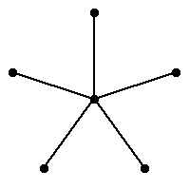
{0,n} and {1,n} Graphs
The smallest {0,n} graph is the union of the smallest {0} graph and the smallest {n} graph.
The smallest {1,n} graph is a star with n+1 vertices.

Slide 10
Parity Observation
If m is even and n is odd, then the smallest {m,n} graph contains at least 2 vertices of degree n.
This is because the total of all the degrees of a graph is even, since each edge contributes 2 to the total.

Slide 11
{2,n} Graphs For Small n
When n≤10 is even, the smallest {2,n} graph is n/2 triangles sharing a vertex.
When n≤9 is odd, the smallest {2,n} graph is two triangles sharing an edge with (n-3)/2 triangles touching each endpoint of the shared edge.

Slide 12
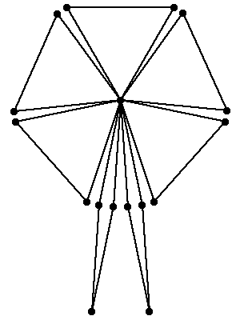
{2,n} Graphs For Large Even n
When n≥12 is even, the smallest {2,n} graph is the smallest {2,10} graph with (n-10)/2 additional thin diamonds touching the center vertex.

Slide 13
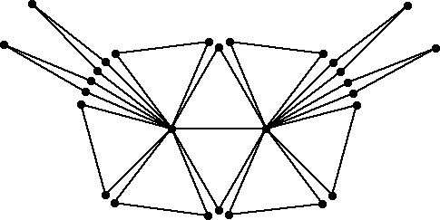
{2,n} Graphs For Large Odd n
When n≥11 is odd, the smallest {2,n} graph is the smallest {2,9} graph with (n-9)/2 additional thin diamonds touching both center vertices.

Slide 14
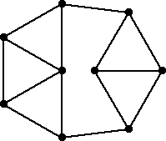
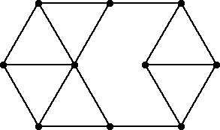
{3,n} Graphs For Small n
The smallest known {3,4} and {3,5} graphs are shown below.
These and further graphs in this talk have not been proved minimal.

Slide 15
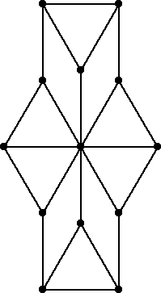
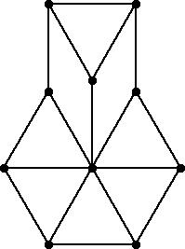
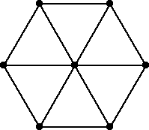
{3,n} Graphs For Medium n
For 6≤n≤12, the smallest known {3,n} graph is a hexagon wheel graph with (n-6) triangles replaced with pieces of pie.

Slide 16
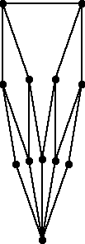
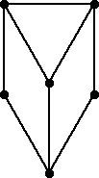

{3,n} Graphs For Large n
For n≥12, we can build a {3,n} graph from pieces like those below.
The piece with k levels adds 2^{k-1} to the central degree.

Slide 17
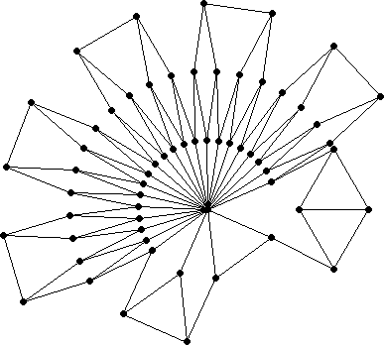
{3,n} Graphs For Large n
Write n-1 as powers of 2, and use those pieces around a center vertex.
Ex: Since 23 = 4+4+4+4+4+2+1, we get this {3,24} graph.

Slide 18
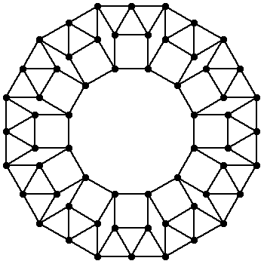
{4,n} Graphs For Small n
The smallest known {4,n} graphs for some n are modifications of this {4} graph, a tiling of a dodecagon.

Slide 19
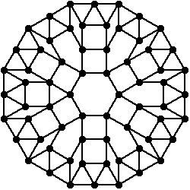
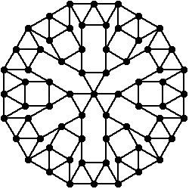
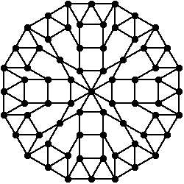
{4,n} Graphs For Small n
The smallest known {4,5},{4,6}, and {4,8} graphs are shown below.

Slide 20
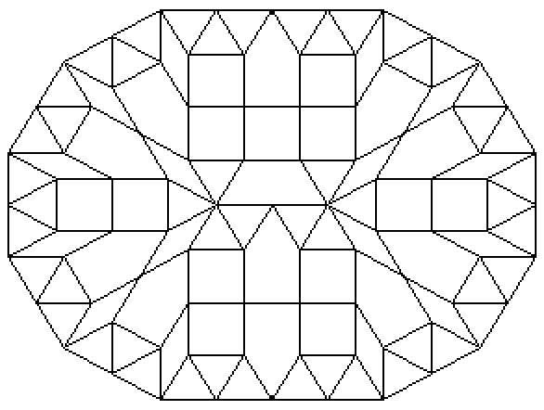
Smallest Known {4,7} Graph
The smallest known {4,7} graph, found by Gavin Theobald, is a variation of this idea.

Slide 21
Utilizing Strings
We have already made use of strings where every vertex has degree 2 or 3.

Slide 22

Utilizing Strings
Below are two strings where every vertex has degree 4.
The first one uses fewer vertices, but the second one can bend at hinges.

Slide 23
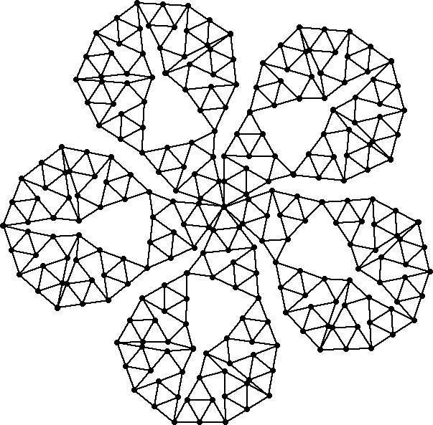
Non-Minimal {4,10} Graph
Here is my first attempt at a {4,10} graph.
It has 5-fold symmetry and 260 vertices.

Slide 24
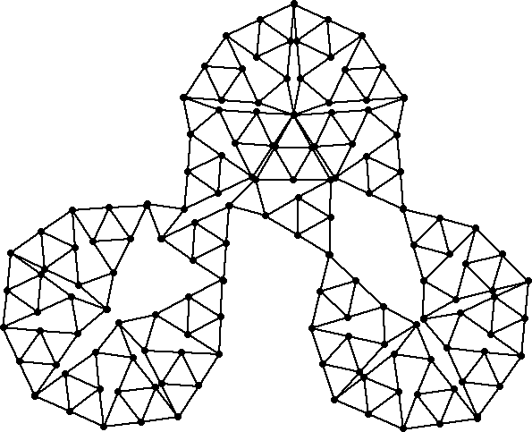
Smallest Known {4,10} Graph
Here is a modification using only 140 vertices.
It is the smallest known {4,10} graph.

Slide 25
Non-Minimal {4,9} Graphs
The following slides show my attempts at a {4,9} graph.
In each case, the number of vertices is given.

Slide 26
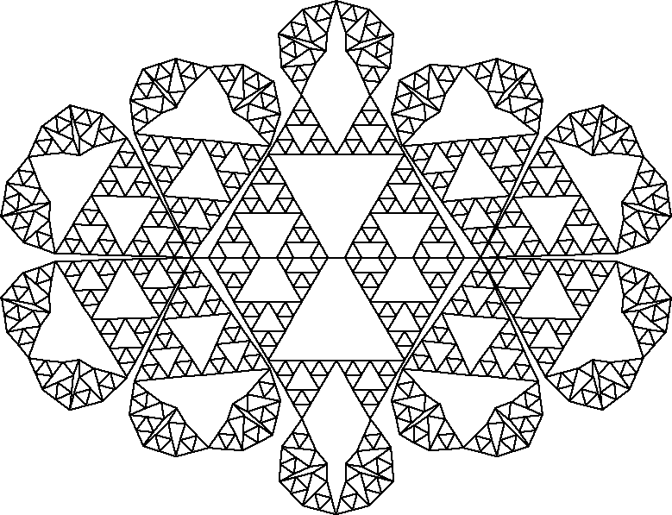
Non-Minimal {4,9} Graphs
908 vertices

Slide 27
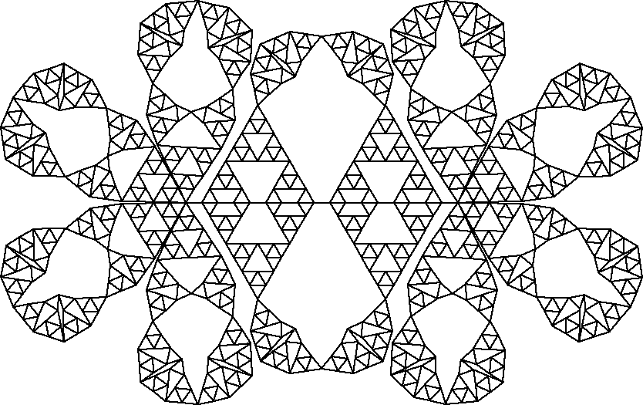
Non-Minimal {4,9} Graphs
806 vertices

Slide 28
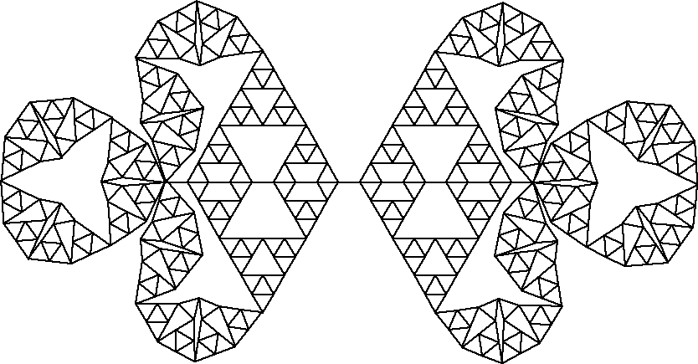
Non-Minimal {4,9} Graphs
404 vertices

Slide 29
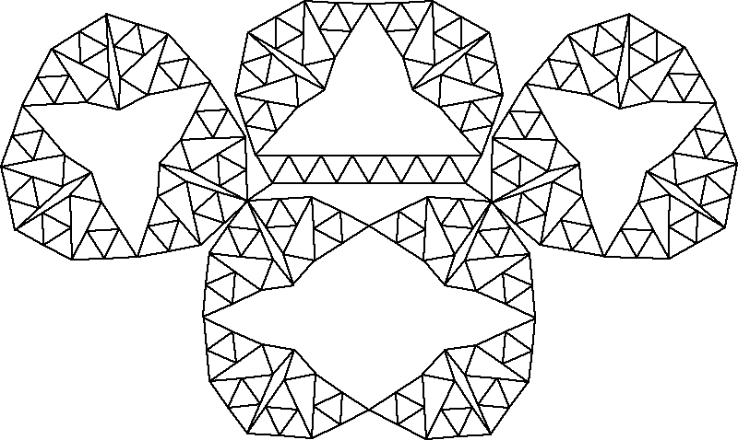
Non-Minimal {4,9} Graphs
262 vertices

Slide 30
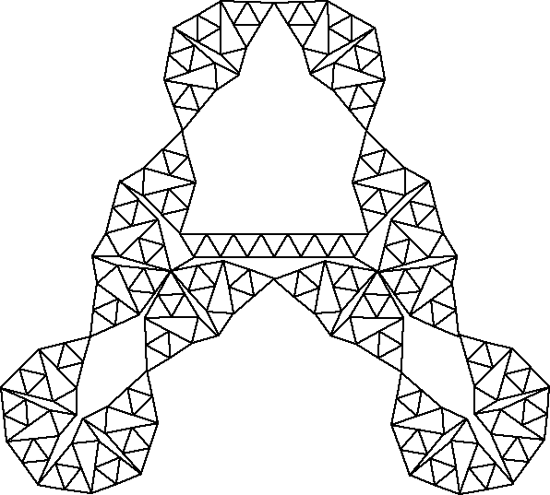
Non-Minimal {4,9} Graphs
241 vertices

Slide 31
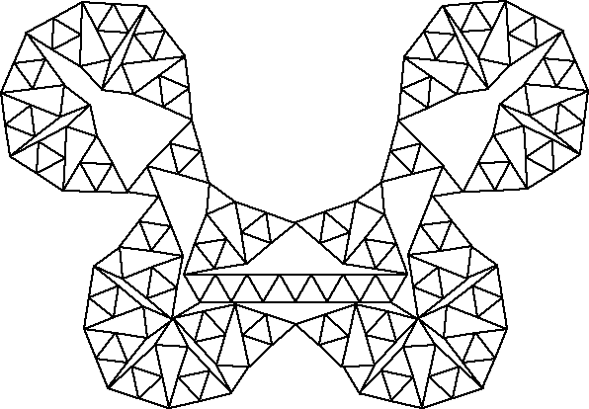
Smallest Known {4,9} Graph
The smallest known {4,9} graph has 211 vertices.

Slide 32
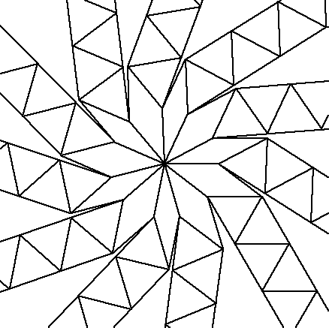
Smallest Known {4,11} Graph
Here is a close-up of a crowded region in the smallest known {4,11} graph.

Slide 33
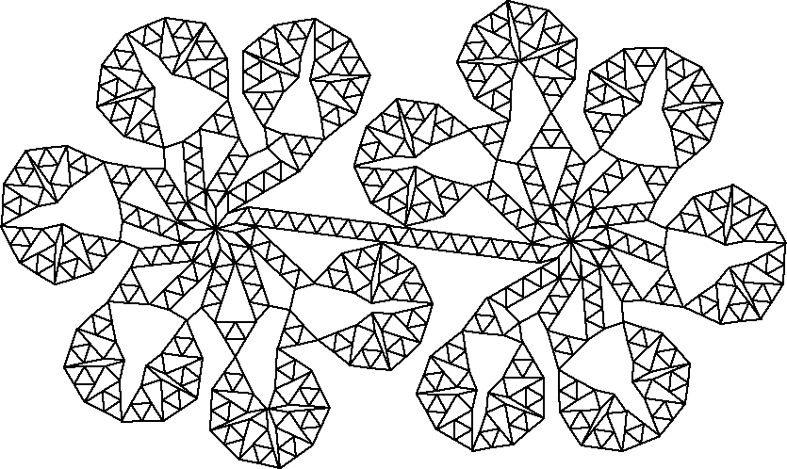
Smallest Known {4,11} Graph
This is the smallest known {4,11} graph.

Slide 34
Other {m,n} Graphs
We conjecture there is no {4,n} graph for n≥12.
It is known that there is no {m,n} graph for 5≤m<n.

Slide 35
Equal {m,n} Graphs
With Joe DeVincentis, I considered the variation of finding the smallest equal {m,n} graphs, the smallest matchstick graphs where half of the vertices have degree m and half have degree n.

Slide 36
Equal {1,n} Graphs
The smallest known equal {1,2}, {1,3}, {1,4}, {1,5}, and {1,6} matchstick graphs ({1,4} and {1,5} were found by Fred Helenius):

Slide 37
Equal {2,n} Graphs
The smallest known equal {2,3}, {2,4}, {2,5}, and {2,6} matchstick graphs ({2,5} was found by Gavin Theobald):

Slide 38
Equal {3,n} Graphs
The smallest known equal {3,4}, {3,5}, and {3,6} matchstick graphs:

Slide 39
Equal {4,n} Graphs
The smallest known equal {4,5} and {4,6} graphs:

Slide 40
{m,n} Graphs in 3 Dimensions
Again with Joe DeVincentis, I considered the variation of finding the smallest 3-dimensional {m,n} graphs.
The smallest 3-dimensional {2,n} graphs are n-1 triangles that share an edge:

Slide 41
{m,n} Graphs in 3 Dimensions
The smallest 3-dimensional {3}, {3,4} and {3,5} graphs are pyramids:

Slide 42
{m,n} Graphs in 3 Dimensions
The smallest 3-dimensional {4} and {4,5} graphs are bi-pyramids:
The smallest known 3-dimensional {4,6} graph has a hexagonal base and a triangular top:

Slide 43
Open Questions
Are the {3,n} and {4,n} matchstick graphs presented here the smallest such graphs?
Does a {4,12} graph exist?
Smallest graphs for larger degree sets?
What are the smallest equal {m,n} graphs?
Does an equal {1,7} graph exist?
Smallest {n} and {m,n} in 3 dimensions?

Slide 44
Want To Know More?
http://www.stetson.edu/~efriedma/mathmagic/1205.html
http://mathworld.wolfram.com/ MatchstickGraph.html
Questions?

