Slide 1
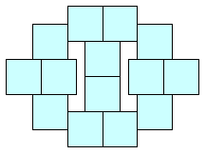
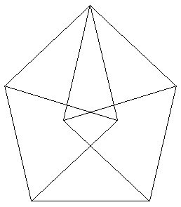
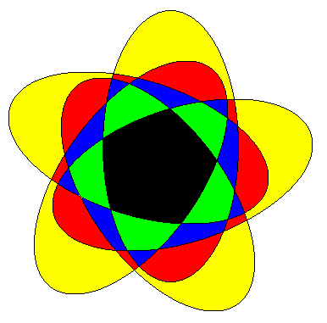
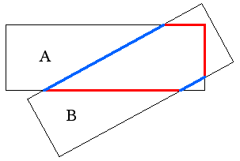
Two Dozen
Unsolved Problems in Plane Geometry
Erich Friedman
Stetson University
3/27/04
efriedma@stetson.edu

Slide 2
Polygons

Slide 3
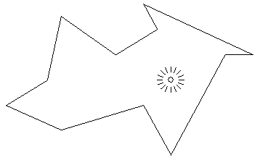
1. Polygonal Illumination Problem
Given a polygon S constructed with mirrors as sides, and given a point P in the interior of S,
is the inside of S
completely
illuminated by a
light source at P?

Slide 4
1. Polygonal Illumination Problem
It is conjectured that for every S and P, the answer is yes.
No proof or counterexample is known.
Even this easier problem is open: Does every polygon S have some point P where a light source would illuminate the interior?

Slide 5
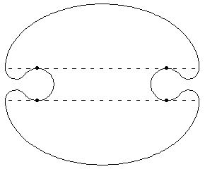
1. Polygonal Illumination Problem
For non-polygonal regions, the conjecture is false, as shown by the example below.
The top and bottom are elliptical arcs with foci shown, connected with some circular arcs.

Slide 6
2. Overlapping Polygons
Let A and B be congruent overlapping rectangles with perimeters A_{P} and B_{P} .
What is the best possible upper bound for
length(A∩B_{P} )
R = ------------------ ?
length(A_{P} ∩B)
It is known that R ≤ 4.
Is it true that R ≤ 3?

Slide 7
2. Overlapping Polygons
Let A and B are congruent overlapping triangles with smallest angle θ with perimeters A_{P} and B_{P} .
Conjecture: The best bound is
length(A∩B_{P} )
R_{Δ} = ------------------ ≤ csc(θ/2).
length(A_{P} ∩B)

Slide 8
3. Kabon Triangle Problem
How many disjoint triangles can be created with n lines?
The sequence K(n) starts 0, 0, 1, 2, 5, 7, .…

Slide 9
3. Kabon Triangle Problem
The sequence continues …11, 15, 20, …
What is K(10)?

Slide 10
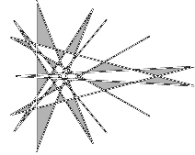
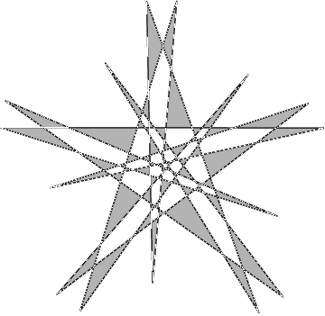
News Flash!
25 ≤ K(10) ≤ 26
32 ≤ K(11) ≤ 33
38 ≤ K(12) ≤ 40
V. Kabanovitch showed K(13)=47.
53 ≤ K(14) ≤ 55
T. Suzuki showed K(15)=65.

Slide 11
3. Kabon Triangle Problem
How fast does K(n) grow?
Easy to show (n-2) ≤ K(n) ≤ n(n-1)(n-2)/6.
Tamura proved that K(n) ≤ n(n-2)/3.
It is not even known if K(n)=o(n²).

Slide 12
4. n-Convex Sets
A set S is called convex if the line between any two points of S is also in S.
A set S is called n-convex if given any n points in S, there exists a line between 2 of them that lies inside S.
Thus 2-convex is the same as convex.
A 5-pointed star is not convex but is 3-convex.

Slide 13
4. n-Convex Sets
Valentine and Eggleston showed that every 3-convex shape is the union of at most three convex shapes.
What is the smallest number k so that every 4-convex shape is the union of k convex sets?
The answer is either 5 or 6.

Slide 14
4. n-Convex Sets
Here is an example of a 4-convex shape that is the union of no fewer than five convex sets.

Slide 15

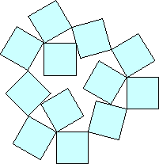
5. Squares Touching Squares
Easy to find the smallest collection of squares each touching 3 other squares:
What is the smallest collection of squares each touching 3 other squares at exactly one point?
What is the smallest number where each touches 3 other squares along part of an edge?

Slide 16
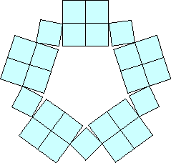
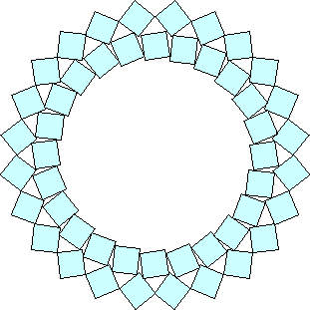
5. Squares Touching Squares
What is the smallest collection of squares so that each square touches 4 other squares?
What is the smallest collection so that each square touches 4 other squares at exactly one point?

Slide 17
Packing

Slide 18
6. Packing Unit Squares
Here are the smallest squares that we can pack 1 to 10 non-overlapping unit squares into.

Slide 19
6. Packing Unit Squares
What is the smallest square we can pack 11 unit squares in?
Is it this one, with side 3.877?

Slide 20
7. Smallest Packing Density
The packing density of a shape S is the proportion of the plane that can be covered by non-overlapping copies of S.
A circle has packing density π/√12 ≈ .906
What convex shape has the smallest packing density?

Slide 21
7. Smallest Packing Density
An octagon that has its corners smoothed by hyperbolas has packing density .902.
Is this the smallest possible?

Slide 22
8. Heesch Numbers
The Heesch number of a shape is the largest finite number of times it can be completely surrounded by copies of itself.
For example, the shape to the right has Heesch number 1.
What is the largest Heesch number?

Slide 23
8. Heesch Numbers
A hexagon with two external notches and 3 internal notches has Heesch number 4!

Slide 24
8. Heesch Numbers
The highest known Heesch number is 5.
Is this the largest?

Slide 25
Tiling

Slide 26

9. Cutting Rectangles into
Congruent Non-Rectangular Parts
For which values of n is it possible to cut a rectangle into n equal non-rectangular parts?
Using triangles, we can do this for all even n.

Slide 27
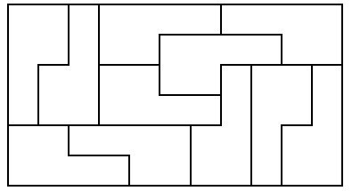
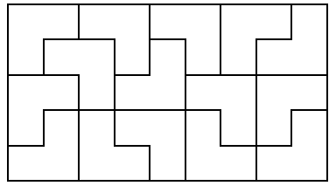
9. Cutting Rectangles into
Congruent Non-Rectangular Parts
Solutions are known for odd n≥11.
Here are solutions for n=11 and n=15.
Are there solutions for n=3, 5, 7, and 9?

Slide 28
10. Cutting Squares Into Squares
Can every square of side n≥22 be cut into smaller integer-sided squares so that no square is used more than twice?

Slide 29
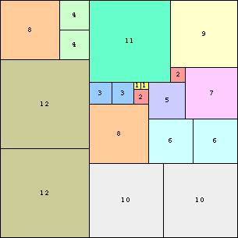
10. Cutting Squares Into Squares
Can every square of side n≥29 be cut into consecutive squares so that each size is used either once or twice?

Slide 30
10. Cutting Squares Into Squares
If we tile a square with distinct squares, are there always at least two squares with only four neighbors?

Slide 31
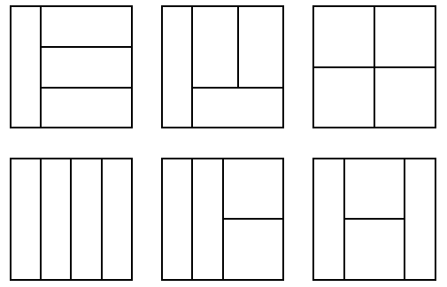
11. Cutting Squares into Rectangles of Equal Area
For each n, are there only finitely many ways to cut a square into n rectangles of equal area?

Slide 32
12. Aperiodic Tiles
A set of tiles is called aperiodic if they tile the plane, but not in a periodic way.
Penrose found this set of 2 colored aperiodic tiles, now called Penrose Tiles.
Dart
Kite

Slide 33
12. Aperiodic Tiles
This is part of a tiling using Penrose Tiles.
Is there a single tile which is aperiodic?

Slide 34
13. Reptiles of Order Two
A reptile is a shape that can be tiled with smaller copies of itself.
The order of a reptile is the smallest number of copies needed in such a tiling.
Triangles are order 2 reptiles.

Slide 35
13. Reptiles of Order Two
The only other known reptile of order 2 is shown.
Here r = √ψ
Are there any other reptiles of order 2?

Slide 36
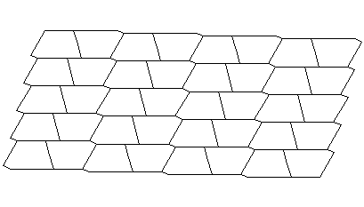
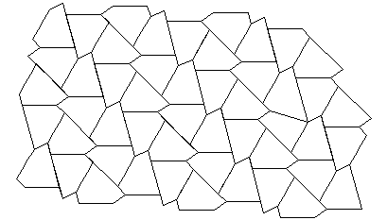
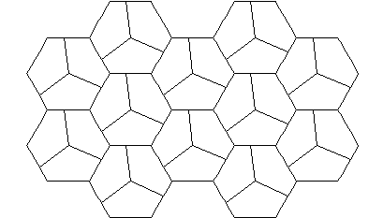
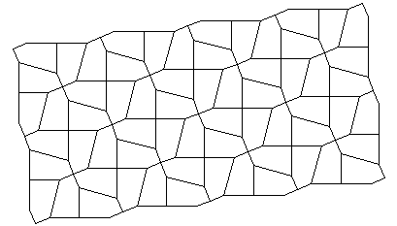
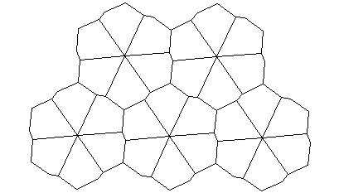
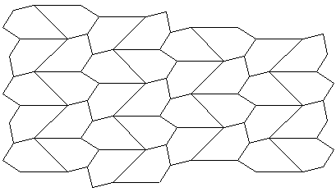
14. Tilings by Convex Pentagons
There are 14 known classes of convex pentagons that can be used to tile the plane.

Slide 37
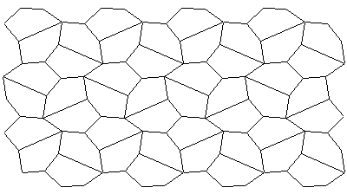
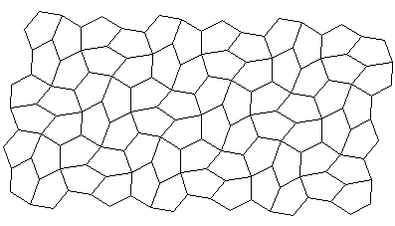
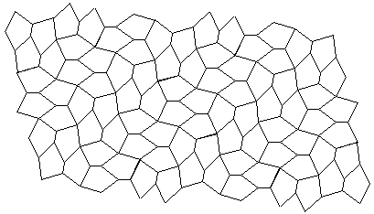
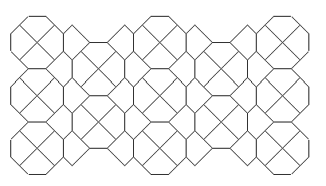
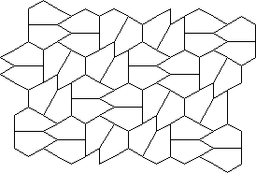
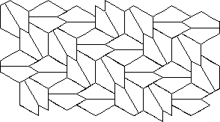
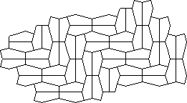
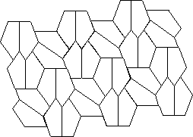
14. Tilings by Convex Pentagons
Are there any more?

Slide 38
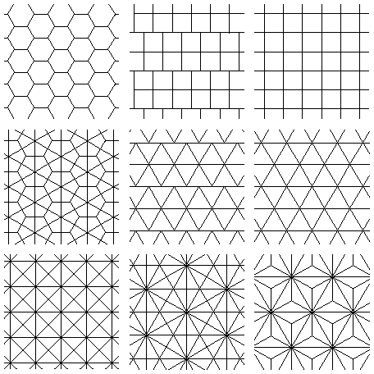
15. Tilings with a Constant Number of Neighbors
There are tilings of the plane using one tile so that each tile touches exactly n other tiles, for n=6, 7, 8, 9, 10, 12, 14, 16, and 21.

Slide 39
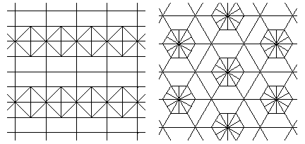
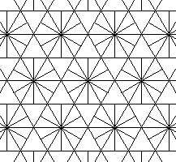
15. Tilings with a Constant Number of Neighbors
There are tilings of the plane using two tiles so that each tile touches exactly n other tiles, for n=11, 13, and 15.
Can be this be done for other values of n?

Slide 40
Finite Sets

Slide 41
16. Distances Between Points
A set of points S is in general position if no 3 points of S lie on a line and no 4 points of S lie on a circle.
Easy to see n points in the plane determine n(n-1)/2 = 1+2+3+…+(n-1) distances.
Can we find n points in general position so that one distance occurs once, one distance occurs twice,…and one distance occurs n-1 times?

Slide 42
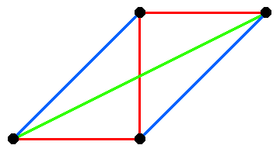
16. Distances Between Points
This is easy to
do for small n.
An example for
n=4 is shown.
Solutions are only known for n≤8.

Slide 43
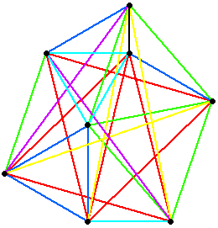
16. Distances Between Points
A solution by Pilásti for n=8 is shown to the right.
Are there any solutions for n≥9?
Erdös offered $500 for arbitrarily large examples.

Slide 44
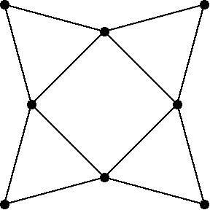
17. Perpendicular Bisectors
The 8 points below have the property that the perpendicular bisector of the line between any 2 points contains 2 other points of the set.
Are there any other sets of points with this property?

Slide 45
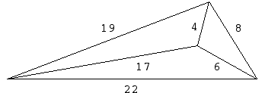
18. Integer Distances
How many points can be in general position so the distance between each pair of points is an integer?
A set with 4 points is shown.

Slide 46
18. Integer Distances
Leech found a set of 6 points with this property.
Are there larger sets?

Slide 47
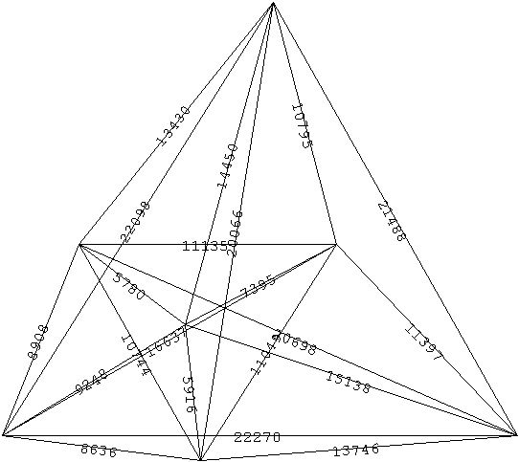
News Flash!
In March of 2007, Tobias Kreisel and Sascha Kurz found a 7 point set with integer distances!

Slide 48
19. Lattice Points
A lattice point is a point (x,y) in the plane, where x and y are integers.
Every shape that has area at least π/4 can be translated and rotated so that it covers at least 2 lattice points.
For n>2, what is the smallest area A so that every shape with area at least A can be moved to cover n lattice points?

Slide 49
19. Lattice Points
There is a convex shape with area 4/3 that covers a lattice point, no matter how it is placed.
Is there a smaller shape with this property?
What is the convex shape of the smallest possible area that must cover at least n lattice points?

Slide 50
Curves

Slide 51
20. Worm Problem
What is the smallest convex set that contains a copy of every continuous curve of length 1?
Is it this polygon found by Gerriets and Poole with area .286?

Slide 52
21. Symmetric Venn Diagrams
A Venn diagram is a collection of n curves that divides the plane into 2^{n} regions, no two of which are inside exactly the same curves.
A symmetric Venn diagram (SVD) is a collection of n congruent curves rotated about some point that forms a Venn diagram.

Slide 53
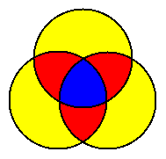
21. Symmetric Venn Diagrams
SVDs can only exist for n prime.
Here are SVDs for n=3 and n=5.

Slide 54
21. Symmetric Venn Diagrams
Here is a SVD for n=7.
Examples are known for n=2, 3, 5, 7, and 11.
Does an example exist for n=13?

Slide 55
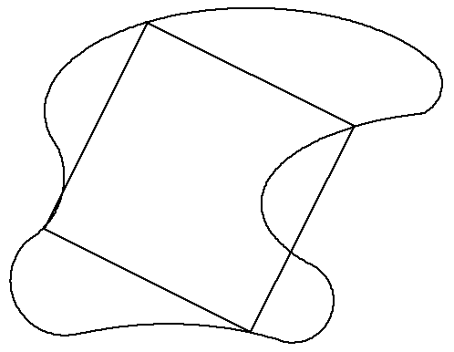
22. Squares on Closed Curves
Does every closed curve contain the vertices of a square?
This is known for boundaries of convex shapes, and piecewise differentiable curves without cusps.

Slide 56
23. Equichordal Points
A point P is an equichordal point of a shape S if every chord of S that passes through P has the same length.
The center of a circle is an equichordal point.
Can a convex shape have more than one equichordal point?

Slide 57
24. Chromatic Number of the Plane
What is the smallest number of colors χ with which we can color the plane so that no two points of the same color are distance 1 apart?
The vertices of a unit equilateral triangle require 3 different colors, so χ≥3.

Slide 58
24. Chromatic Number of the Plane
The vertices of the Moser Spindle require 4 colors, so χ≥4.

Slide 59
24. Chromatic Number of the Plane
The plane can be colored with 7 colors to avoid unit pairs having the same color, so χ≤7.

Slide 60
25. Conic Sections Through
Any Five Points of a Curve
It is well known that given any 5 points in the plane, there is a unique (possibly degenerate) conic section passing through those points.
Is there a closed curve (that is not an ellipse) with the property that any 5 points chosen from it determine an ellipse?
How about |x|^{2.001} + |y|^{2.001} = 1 ?

Slide 61
References
V. Klee, Some Unsolved Problems in Plane Geometry, Math Mag. 52 (1979) 131-145.
H. Croft, K. Falconer, and R. Guy, Unsolved Problems in Geometry, Springer Verlag, New York, 1991.
Eric Weisstein’s World of Mathematics, http://mathworld.wolfram.com
The Geometry Junkyard, http://www.ics.uci.edu/~eppstein/junkyard

