Slide 1
COMMON THREAD

Slide 2
Question 1:
WHAT DRUG DID BAYER TRADEMARK IN 1895 AS A COUGH SUPPRESSANT, NAMING IT FOR THE EUPHORIC, POWERFUL FEELING IT PRODUCED?

Slide 3
Question 2:
WHAT SPORT'S HALL OF FAMERS INCLUDE DAVE BING, BERNARD KING, AND YAO MING?

Slide 4
Question 3:
WHAT GETS 3.78 CM FARTHER FROM THE EARTH EVERY YEAR?

Slide 5
Question 4:
WHAT WAS BEETHOVEN'S PROFESSION BEFORE HE BECAME FAMOUS FOR COMPOSING?

Slide 6
Question 5:
WHAT $30,000 ADDITION DO MORE HOUSES IN ARIZONA, FLORIDA, AND NEVADA HAVE THAN ANY OTHER STATES?

Slide 7
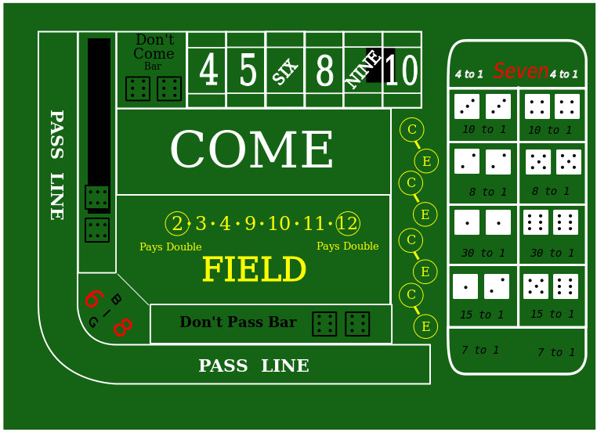
Question 6:
WHAT CASINO TABLE LOOKS LIKE THIS?

Slide 8
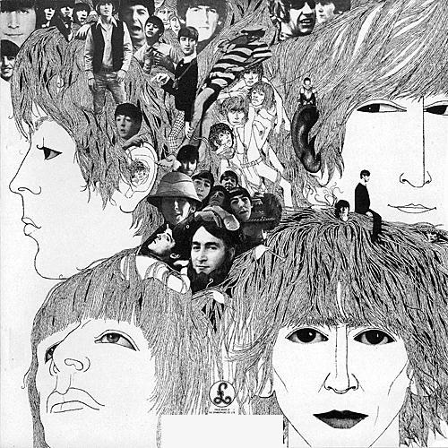
Question 7:
WHAT BEATLES ALBUM HAD THIS COVER?

Slide 9
Question 8:
WHAT 2009 MOVIE STARRED WOODY HARRELSON AS AN ARMY CAPTAIN ASSIGNED TO NOTIFY FAMILIES OF FALLEN SOLDIERS?

Slide 10
Question 9:
WHAT DOES YOUTUBE HAVE MORE OF THAN PEOPLE ON THE EARTH?

Slide 11
Question 10:
WHAT DO ALL THESE ANSWERS HAVE IN COMMON?

Slide 12
ANSWERS WILL BE PROVIDED SHORTLY

Slide 13
Question 1:
WHAT DRUG DID BAYER TRADEMARK IN 1895 AS A COUGH SUPPRESSANT, NAMING IT FOR THE EUPHORIC, POWERFUL FEELING IT PRODUCED?
HEROIN

Slide 14
Question 2:
WHAT SPORT'S HALL OF FAMERS INCLUDE DAVE BING, BERNARD KING, AND YAO MING?
BASKETBALL

Slide 15
Question 3:
WHAT GETS 3.78 CM FARTHER FROM THE EARTH EVERY YEAR?
THE MOON

Slide 16
Question 4:
WHAT WAS BEETHOVEN'S PROFESSION BEFORE HE BECAME FAMOUS FOR COMPOSING?
PIANO PLAYER

Slide 17
Question 5:
WHAT $30,000 ADDITION DO MORE HOUSES IN ARIZONA, FLORIDA, AND NEVADA HAVE THAN ANY OTHER STATES?
POOL

Slide 18
Question 6:
WHAT CASINO TABLE LOOKS LIKE THIS?
CRAPS

Slide 19
Question 7:
WHAT BEATLES ALBUM HAD THIS COVER?
REVOLVER

Slide 20
Question 8:
WHAT 2009 MOVIE STARRED WOODY HARRELSON AS AN ARMY CAPTAIN ASSIGNED TO NOTIFY FAMILIES OF FALLEN SOLDIERS?
THE MESSENGER

Slide 21
Question 9:
WHAT DOES YOUTUBE HAVE MORE OF THAN PEOPLE ON THE EARTH?
VIDEOS

Slide 22
Question 10:
WHAT DO ALL THESE ANSWERS HAVE IN COMMON?
THINGS YOU CAN SHOOT

