Slide 1
COMMON THREAD

Slide 2
Question 1:
WHAT COLOR TRIANGLE APPEARS ON THE FLAG OF THE BAHAMAS?

Slide 3
Question 2:
WHAT BRITISH TV SERIES STARRED ROBBIE COLTRANE AS THE CRIMINAL PSYCHOLOGIST DR. EDWARD FITZGERALD?

Slide 4
Question 3:
WHAT PACIFIC COAST CITY, TODAY THE HOME OF A POPULAR JAZZ FESTIVAL, WAS THE PROVINCIAL CAPITAL OF MEXICAN CALIFORNIA?

Slide 5
Question 4:
WHICH CLASSIC UNIVERSAL STUDIOS MONSTER, AKA LAWRENCE TALBOT, DID BENICIO DEL TORO PLAY IN A 2010 MOVIE?

Slide 6
Question 5:
WHAT DOES THE SYMBOL "U" MEAN IN MATHEMATICS?

Slide 7
Question 6:
WHAT FRUIT ACCOUNTS FOR HALF OF THE INTERNATIONAL DECIDUOUS FRUIT TREE PRODUCTION?

Slide 8
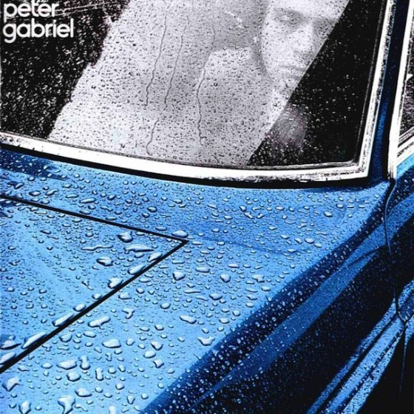
Question 7:
PETER GABRIEL'S FIRST 4 ALBUMS WERE EPONYMOUS, SO HIS 1ST ALBUM IS KNOWN AS WHAT?

Slide 9
Question 8:
IN A MARK TWAIN STORY, A CALAVERAS COUNTY FROG NAMED DAN'L WEBSTER IS A CHAMPION AT WHAT ACTIVITY?

Slide 10
Question 9:
WHAT WORD FOLLOWS "84" IN THE NAME OF THE NATION’S LARGEST PRIVATELY HELD SUPPLIER OF BUILDING MATERIALS?

Slide 11
Question 10:
WHAT DO ALL THESE ANSWERS HAVE IN COMMON?

Slide 12
ANSWERS WILL BE PROVIDED SHORTLY

Slide 13
Question 1:
WHAT COLOR TRIANGLE APPEARS ON THE FLAG OF THE BAHAMAS?
BLACK

Slide 14
Question 2:
WHAT BRITISH TV SERIES STARRED ROBBIE COLTRANE AS THE CRIMINAL PSYCHOLOGIST DR. EDWARD FITZGERALD?
CRACKER

Slide 15
Question 3:
WHAT PACIFIC COAST CITY, TODAY THE HOME OF A POPULAR JAZZ FESTIVAL, WAS THE PROVINCIAL CAPITAL OF MEXICAN CALIFORNIA?
MONTEREY

Slide 16
Question 4:
WHICH CLASSIC UNIVERSAL STUDIOS MONSTER, AKA LAWRENCE TALBOT, DID BENICIO DEL TORO PLAY IN A 2010 MOVIE?
WOLFMAN

Slide 17
Question 5:
WHAT DOES THE SYMBOL "U" MEAN IN MATHEMATICS?
UNION

Slide 18
Question 6:
WHAT FRUIT ACCOUNTS FOR HALF OF THE INTERNATIONAL DECIDUOUS FRUIT TREE PRODUCTION?
APPLE

Slide 19
Question 7:
PETER GABRIEL'S FIRST 4 ALBUMS WERE EPONYMOUS, SO HIS 1ST ALBUM IS KNOWN AS WHAT?
CAR

Slide 20
Question 8:
IN A MARK TWAIN STORY, A CALAVERAS COUNTY FROG NAMED DAN'L WEBSTER IS A CHAMPION AT WHAT ACTIVITY?
JUMPING

Slide 21
Question 9:
WHAT WORD FOLLOWS "84" IN THE NAME OF THE NATION’S LARGEST PRIVATELY HELD SUPPLIER OF BUILDING MATERIALS?
LUMBER

Slide 22
Question 10:
WHAT DO ALL THESE ANSWERS HAVE IN COMMON?
WORDS THAT CAN BE FOLLOWED BY "JACK"

