Slide 1
COMMON THREAD: IDENTIFY THESE CELEBRITIES

Slide 2
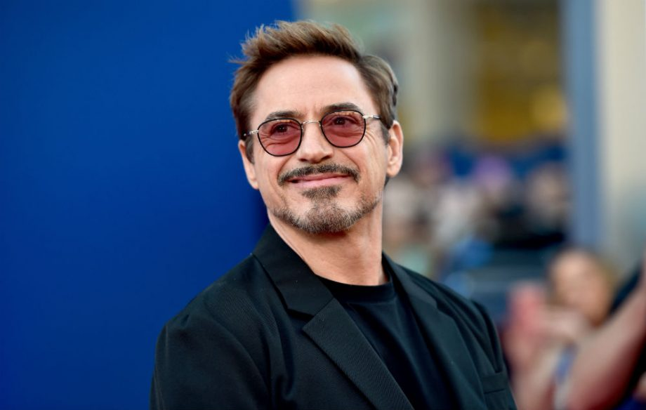
Question 1:

Slide 3
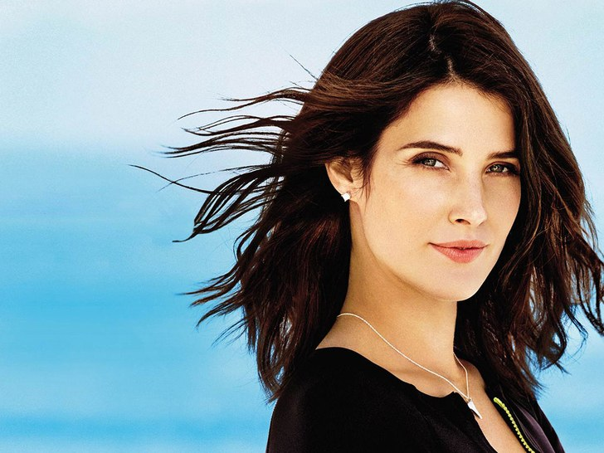
Question 2:

Slide 4
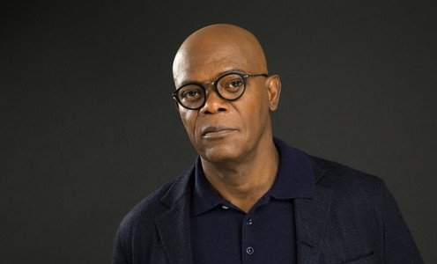
Question 3:

Slide 5
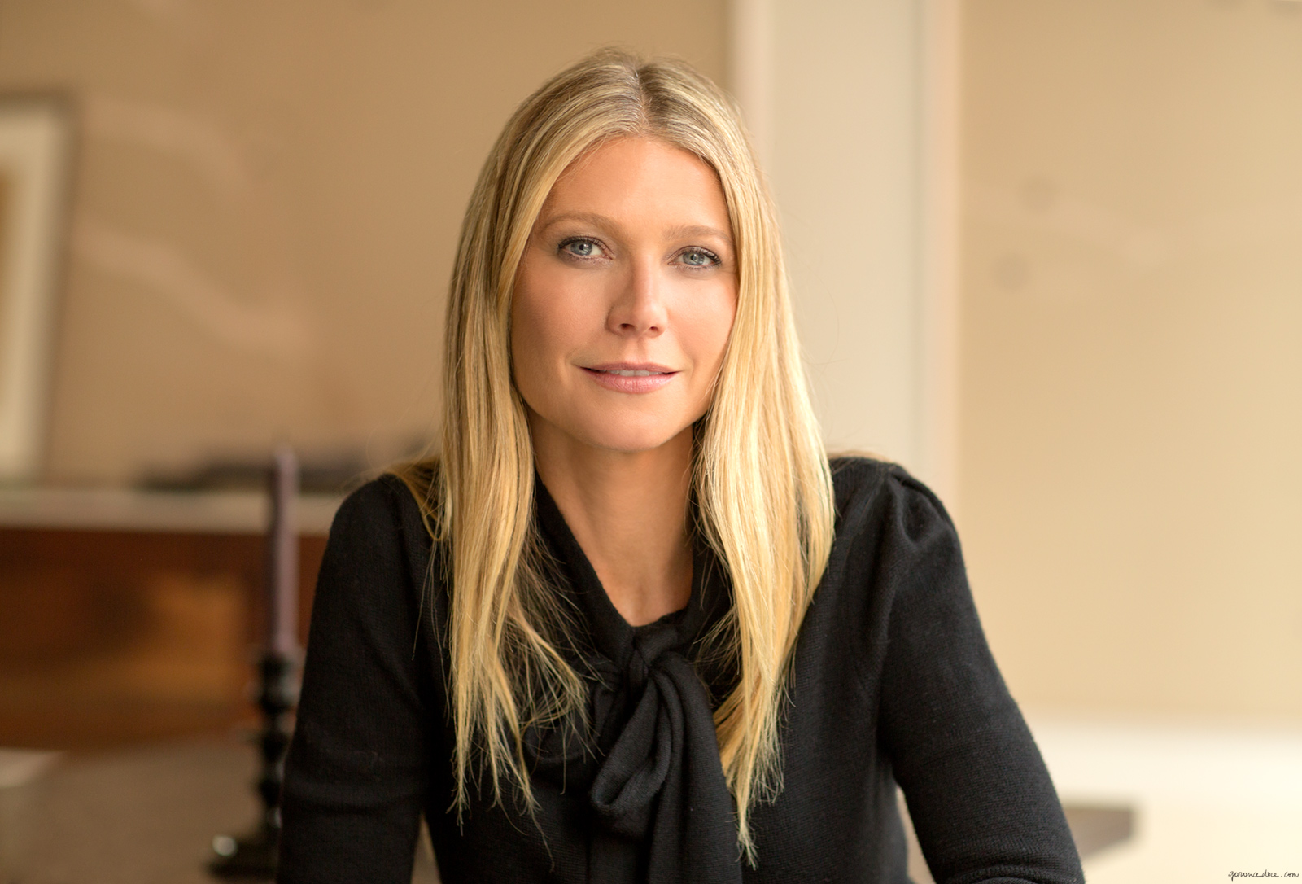
Question 4:

Slide 6
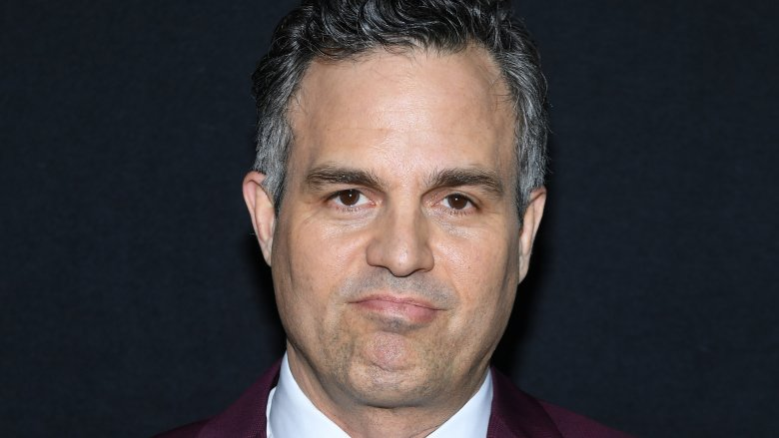
Question 5:

Slide 7
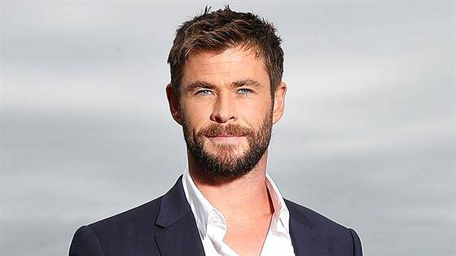
Question 6:

Slide 8
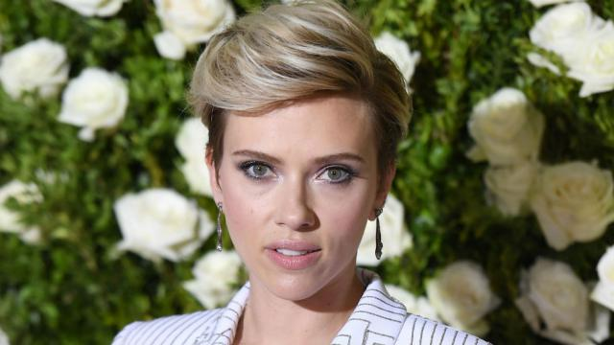
Question 7:

Slide 9
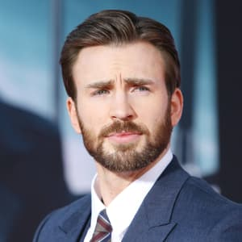
Question 8:

Slide 10
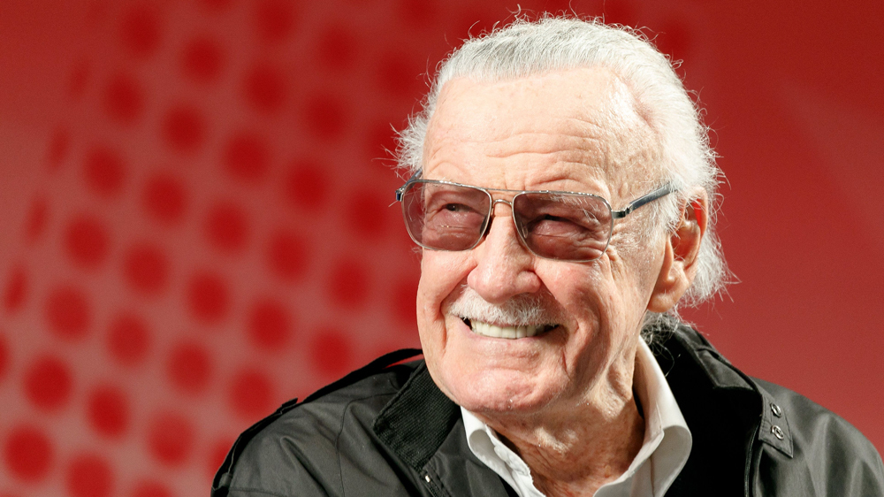
Question 9:

Slide 11
Question 10:
WHAT DO THESE PEOPLE HAVE IN COMMON?

Slide 12
ANSWERS WILL BE PROVIDED SHORTLY

Slide 13
Question 1:
ROBERT DOWNEY JR.

Slide 14
Question 2:
COBIE SMULDERS

Slide 15
Question 3:
SAMUEL L. JACKSON

Slide 16
Question 4:
GWYNETH PALTROW

Slide 17
Question 5:
MARK RUFFALO

Slide 18
Question 6:
CHRIS HEMSWORTH

Slide 19
Question 7:
SCARLETT JOHANSSON

Slide 20
Question 8:
CHRIS EVANS

Slide 21
Question 9:
STAN LEE

Slide 22
Question 10:
WHAT DO THESE PEOPLE HAVE IN COMMON?
THEY WERE IN "THE AVENGERS"

