Slide 1
COMMON THREAD (THANKS MARGIE)

Slide 2
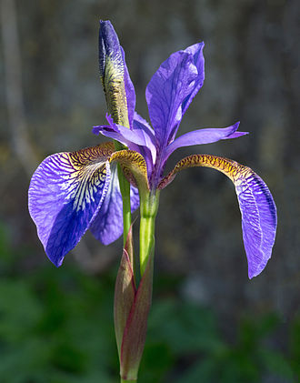
Question 1:
WHAT FLOWER IS THIS?

Slide 3
Question 2:
WHAT IS THE ONLY COMPACT CAR THAT FORD MANUFACTURES?

Slide 4
Question 3:
WHAT SORT OF NUMBER APPEARED FOR THE FIRST TIME IN 3RD CENTURY CHINA?

Slide 5
Question 4:
WHAT IS A 2ND OR 3RD GRADE GIRL SCOUT CALLED?

Slide 6
Question 5:
WHAT IS THE TERM FOR THE STRUCTURAL SKELETON OF A VEHICLE?

Slide 7
Question 6:
WHAT IS THE NICKNAME OF A FLIGHT LEAVING LATE AT NIGHT AND ARRIVING THE NEXT MORNING?

Slide 8
Question 7:
WHAT MOUNTAIN WAS HOME TO THE 12 GODS OF GREEK MYTHOLOGY?

Slide 9
Question 8:
WHAT SUPERHERO DRESSES IN RED EXCEPT FOR THE LIGHTNING BOLT LOGO ON HIS CHEST?

Slide 10
Question 9:
WHAT IS THE LAST WORD OF THE TITLE OF THE QUIRKY 1990-1995 TV SHOW ABOUT LIFE IN ALASKA?

Slide 11
Question 10:
WHAT DO ALL THESE ANSWERS HAVE IN COMMON?

Slide 12
ANSWERS WILL BE PROVIDED SHORTLY

Slide 13
Question 1:
WHAT FLOWER IS THIS?
IRIS

Slide 14
Question 2:
WHAT IS THE ONLY COMPACT CAR THAT FORD MANUFACTURES?
FOCUS

Slide 15
Question 3:
WHAT SORT OF NUMBER APPEARED FOR THE FIRST TIME IN 3RD CENTURY CHINA?
NEGATIVE

Slide 16
Question 4:
WHAT IS A 2ND OR 3RD GRADE GIRL SCOUT CALLED?
BROWNIE

Slide 17
Question 5:
WHAT IS THE TERM FOR THE STRUCTURAL SKELETON OF A VEHICLE?
FRAME

Slide 18
Question 6:
WHAT IS THE NICKNAME OF A FLIGHT LEAVING LATE AT NIGHT AND ARRIVING THE NEXT MORNING?
RED–EYE

Slide 19
Question 7:
WHAT MOUNTAIN WAS HOME TO THE 12 GODS OF GREEK MYTHOLOGY?
OLYMPUS

Slide 20
Question 8:
WHAT SUPERHERO DRESSES IN RED EXCEPT FOR THE LIGHTNING BOLT LOGO ON HIS CHEST?
FLASH

Slide 21
Question 9:
WHAT IS THE LAST WORD OF THE TITLE OF THE QUIRKY 1990-1995 TV SHOW ABOUT LIFE IN ALASKA?
(NORTHERN) EXPOSURE

Slide 22
Question 10:
WHAT DO ALL THESE ANSWERS HAVE IN COMMON?
PHOTOGRAPHY TERMS

