Slide 1
COMMON THREAD

Slide 2
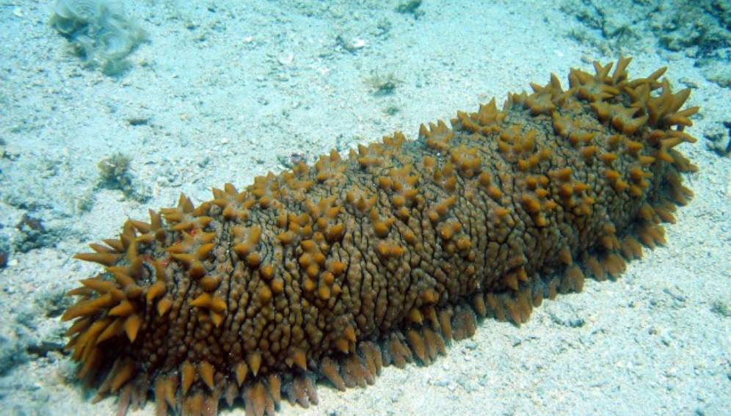
Question 1:
WHAT MARINE ANIMAL IS THIS?

Slide 3
Question 2:
IN WHAT HANS CHRISTIAN ANDERSEN FAIRY TALE IS A WOMAN'S ROYAL IDENTITY ESTABLISHED BY A TEST OF HER PHYSICAL SENSITIVITY?

Slide 4
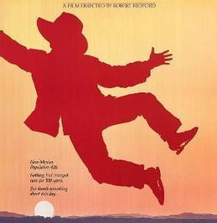
Question 3:
WHAT 1988 FILM DIRECTED BY ROBERT REDFORD HAD THIS MOVIE POSTER?

Slide 5
Question 4:
WHAT WAS THE FIRST ROCK ALBUM TO WIN THE GRAMMY FOR ALBUM OF THE YEAR?

Slide 6
Question 5:
WHAT 1991 CHICK-FLICK STARRED KATHY BATES, JESSICA TANDY, MARY STUART MASTERSON, AND MARY-LOUISE PARKER?

Slide 7
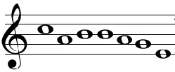
Question 6:
WHAT NOTES ARE THESE?

Slide 8
Question 7:
WHAT WAS THE FULL NAME OF THE ACTRESS STRANDED ON "GILLIGAN'S ISLAND"?

Slide 9
Question 8:
WHAT WORD DID VICE PRESIDENT DAN QUAYLE FAMOUSLY MISSPELL?

Slide 10
Question 9:
WHAT COMIC IS KNOWN FOR HIS PROP COMEDY AND RED HAIR?

Slide 11
Question 10:
WHAT DO ALL THESE ANSWERS HAVE IN COMMON?

Slide 12
ANSWERS WILL BE PROVIDED SHORTLY

Slide 13
Question 1:
WHAT MARINE ANIMAL IS THIS?
SEA CUCUMBER

Slide 14
Question 2:
IN WHAT HANS CHRISTIAN ANDERSEN FAIRY TALE IS A WOMAN'S ROYAL IDENTITY ESTABLISHED BY A TEST OF HER PHYSICAL SENSITIVITY?
THE PRINCESS AND THE PEA

Slide 15
Question 3:
WHAT 1988 FILM DIRECTED BY ROBERT REDFORD HAD THIS MOVIE POSTER?
THE MILAGRO BEANFIELD WAR

Slide 16
Question 4:
WHAT WAS THE FIRST ROCK ALBUM TO WIN THE GRAMMY FOR ALBUM OF THE YEAR?
SGT. PEPPER'S LONELY HEARTS CLUB BAND

Slide 17
Question 5:
WHAT 1991 CHICK-FLICK STARRED KATHY BATES, JESSICA TANDY, MARY STUART MASTERSON, AND MARY-LOUISE PARKER?
FRIED GREEN TOMATOES

Slide 18
Question 6:
WHAT NOTES ARE THESE?
CABBAGE

Slide 19
Question 7:
WHAT WAS THE FULL NAME OF THE ACTRESS STRANDED ON "GILLIGAN'S ISLAND"?
GINGER GRANT

Slide 20
Question 8:
WHAT WORD DID VICE PRESIDENT DAN QUAYLE FAMOUSLY MISSPELL?
POTATO

Slide 21
Question 9:
WHAT COMIC IS KNOWN FOR HIS PROP COMEDY AND RED HAIR?
CARROT TOP

Slide 22
Question 10:
WHAT DO ALL THESE ANSWERS HAVE IN COMMON?
CONTAIN VEGETABLES

