Slide 1
COMMON THREAD

Slide 2
Question 1:
WHAT CARTOON HAD A GROUP OF CRIME SOLVERS RIDING IN A VAN PAINTED WITH FLOWER POWER IMAGERY NAMED "THE MYSTERY MACHINE"?

Slide 3
Question 2:
WHAT PATRIOTIC SONG'S LYRICS WERE WRITTEN BY KATHARINE LEE BATES AND MUSIC WAS WRITTEN BY SAMUEL WARD?

Slide 4
Question 3:
WHO WAS AMERICA'S 1ST WOMAN IN SPACE?

Slide 5
Question 4:
WHAT CHILDREN'S TV ICON HAD MIDDLE NAME MCFEELY?

Slide 6
Question 5:
IN WHAT STATE IS ABRAHAM LINCOLN BURIED?

Slide 7
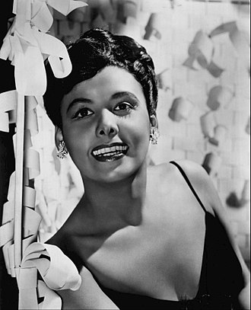
Question 6:
WHAT SINGER, DANCER, ACTRESS, AND CIVIL RIGHTS ACTIVIST IS THIS?

Slide 8
Question 7:
WHAT CHRISTMAS PLANT IS NAMED AFTER THE FIRST U.S. MINISTER TO MEXICO, WHO INTRODUCED IT TO THE U.S. IN 1825?

Slide 9
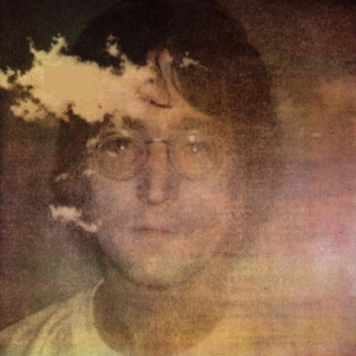
Question 8:
WHO PUT OUT THIS 1971 ALBUM?

Slide 10
Question 9:
WHAT DEC 26 - JAN 1 CELEBRATION'S NAME COMES FROM A SWAHILI PHRASE MEANING "FIRST FRUITS"?

Slide 11
Question 10:
WHAT DO ALL THESE ANSWERS HAVE IN COMMON?

Slide 12
ANSWERS WILL BE PROVIDED SHORTLY

Slide 13
Question 1:
WHAT CARTOON HAD A GROUP OF CRIME SOLVERS RIDING IN A VAN PAINTED WITH FLOWER POWER IMAGERY NAMED "THE MYSTERY MACHINE"?
SCOOBY–DOO

Slide 14
Question 2:
WHAT PATRIOTIC SONG'S LYRICS WERE WRITTEN BY KATHARINE LEE BATES AND MUSIC WAS WRITTEN BY SAMUEL WARD?
AMERICA THE BEAUTIFUL

Slide 15
Question 3:
WHO WAS AMERICA'S 1ST WOMAN IN SPACE?
SALLY RIDE

Slide 16
Question 4:
WHAT CHILDREN'S TV ICON HAD MIDDLE NAME MCFEELY?
MISTER ROGERS

Slide 17
Question 5:
IN WHAT STATE IS ABRAHAM LINCOLN BURIED?
ILLINOIS

Slide 18
Question 6:
WHAT SINGER, DANCER, ACTRESS, AND CIVIL RIGHTS ACTIVIST IS THIS?
LENA HORNE

Slide 19
Question 7:
WHAT CHRISTMAS PLANT IS NAMED AFTER THE FIRST U.S. MINISTER TO MEXICO, WHO INTRODUCED IT TO THE U.S. IN 1825?
POINSETTIA

Slide 20
Question 8:
WHO PUT OUT THIS 1971 ALBUM?
JOHN LENNON

Slide 21
Question 9:
WHAT DEC 26 - JAN 1 CELEBRATION'S NAME COMES FROM A SWAHILI PHRASE MEANING "FIRST FRUITS"?
KWANZAA

Slide 22
Question 10:
WHAT DO ALL THESE ANSWERS HAVE IN COMMON?
COMMEMORATED WITH 2018 U.S. STAMPS

