Slide 1
COMMON THREAD

Slide 2
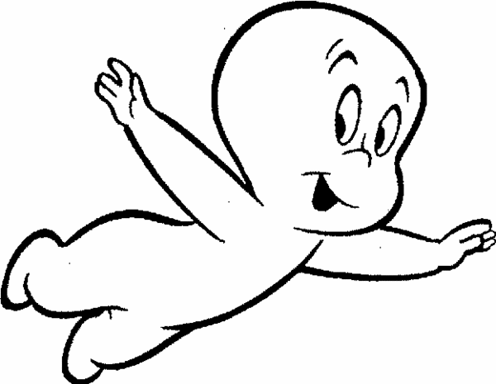
Question 1:
WHO IS THIS?

Slide 3
Question 2:
WHO WAS THE RICHEST U.S. VICE PRESIDENT EVER?

Slide 4
Question 3:
WHO VOICED DARTH VADER IN "STAR WARS" AND MUFASA IN "THE LION KING"?

Slide 5
Question 4:
WHO CREATED THE COVER ILLUSTRATIONS FOR "THE SATURDAY EVENING POST" FOR ALMOST 50 YEARS?

Slide 6
Question 5:
WHAT MUSICAL GROUP'S ONLY BIG HIT WAS "BABY COME BACK"?

Slide 7
Question 6:
WHAT ROLE DOES LUCY LIU PLAY ON TV'S "ELEMENTARY"?

Slide 8
Question 7:
WHAT TV SHOW STARRED BOB CRANE AND RICHARD DAWSON AS P.O.W.'S?

Slide 9
Question 8:
WHAT SORTS OF GOLF CLUBS, NAMED FOR THE MATERIAL THEY USED TO BE MADE OF, ARE USED FOR LONG DISTANCE DRIVES?

Slide 10
Question 9:
WHO WON THE HEISMAN TROPHY IN 2002, AND WAS QB FOR THE BENGALS, RAIDERS, AND CARDINALS BEFORE RETIRING IN 2017?

Slide 11
Question 10:
WHAT DO ALL THESE ANSWERS HAVE IN COMMON?

Slide 12
ANSWERS WILL BE PROVIDED SHORTLY

Slide 13
Question 1:
WHO IS THIS?
CASPER THE FRIENDLY GHOST

Slide 14
Question 2:
WHO WAS THE RICHEST U.S. VICE PRESIDENT EVER?
NELSON ROCKEFELLER

Slide 15
Question 3:
WHO VOICED DARTH VADER IN "STAR WARS" AND MUFASA IN "THE LION KING"?
JAMES EARL JONES

Slide 16
Question 4:
WHO CREATED THE COVER ILLUSTRATIONS FOR "THE SATURDAY EVENING POST" FOR ALMOST 50 YEARS?
NORMAN ROCKWELL

Slide 17
Question 5:
WHAT MUSICAL GROUP'S ONLY BIG HIT WAS "BABY COME BACK"?
PLAYER

Slide 18
Question 6:
WHAT ROLE DOES LUCY LIU PLAY ON TV'S "ELEMENTARY"?
DR. JOAN WATSON

Slide 19
Question 7:
WHAT TV SHOW STARRED BOB CRANE AND RICHARD DAWSON AS P.O.W.'S?
HOGAN'S HEROES

Slide 20
Question 8:
WHAT SORTS OF GOLF CLUBS, NAMED FOR THE MATERIAL THEY USED TO BE MADE OF, ARE USED FOR LONG DISTANCE DRIVES?
WOODS

Slide 21
Question 9:
WHO WON THE HEISMAN TROPHY IN 2002, AND WAS QB FOR THE BENGALS, RAIDERS, AND CARDINALS BEFORE RETIRING IN 2017?
CARSON PALMER

Slide 22
Question 10:
WHAT DO ALL THESE ANSWERS HAVE IN COMMON?
CONTAIN LAST NAMES OF GOLFING GREATS

