Slide 1
IDENTIFY THESE FAMOUS PEOPLE COMMON THREAD

Slide 2
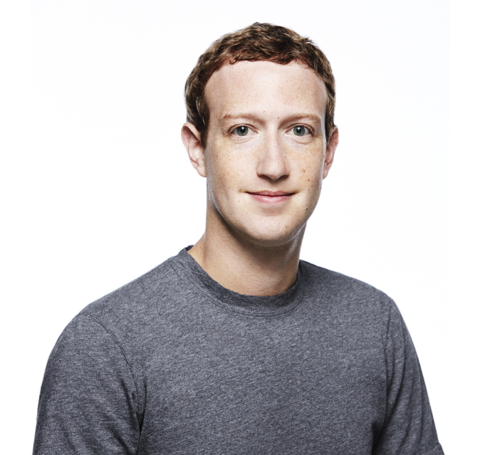
Question 1:

Slide 3
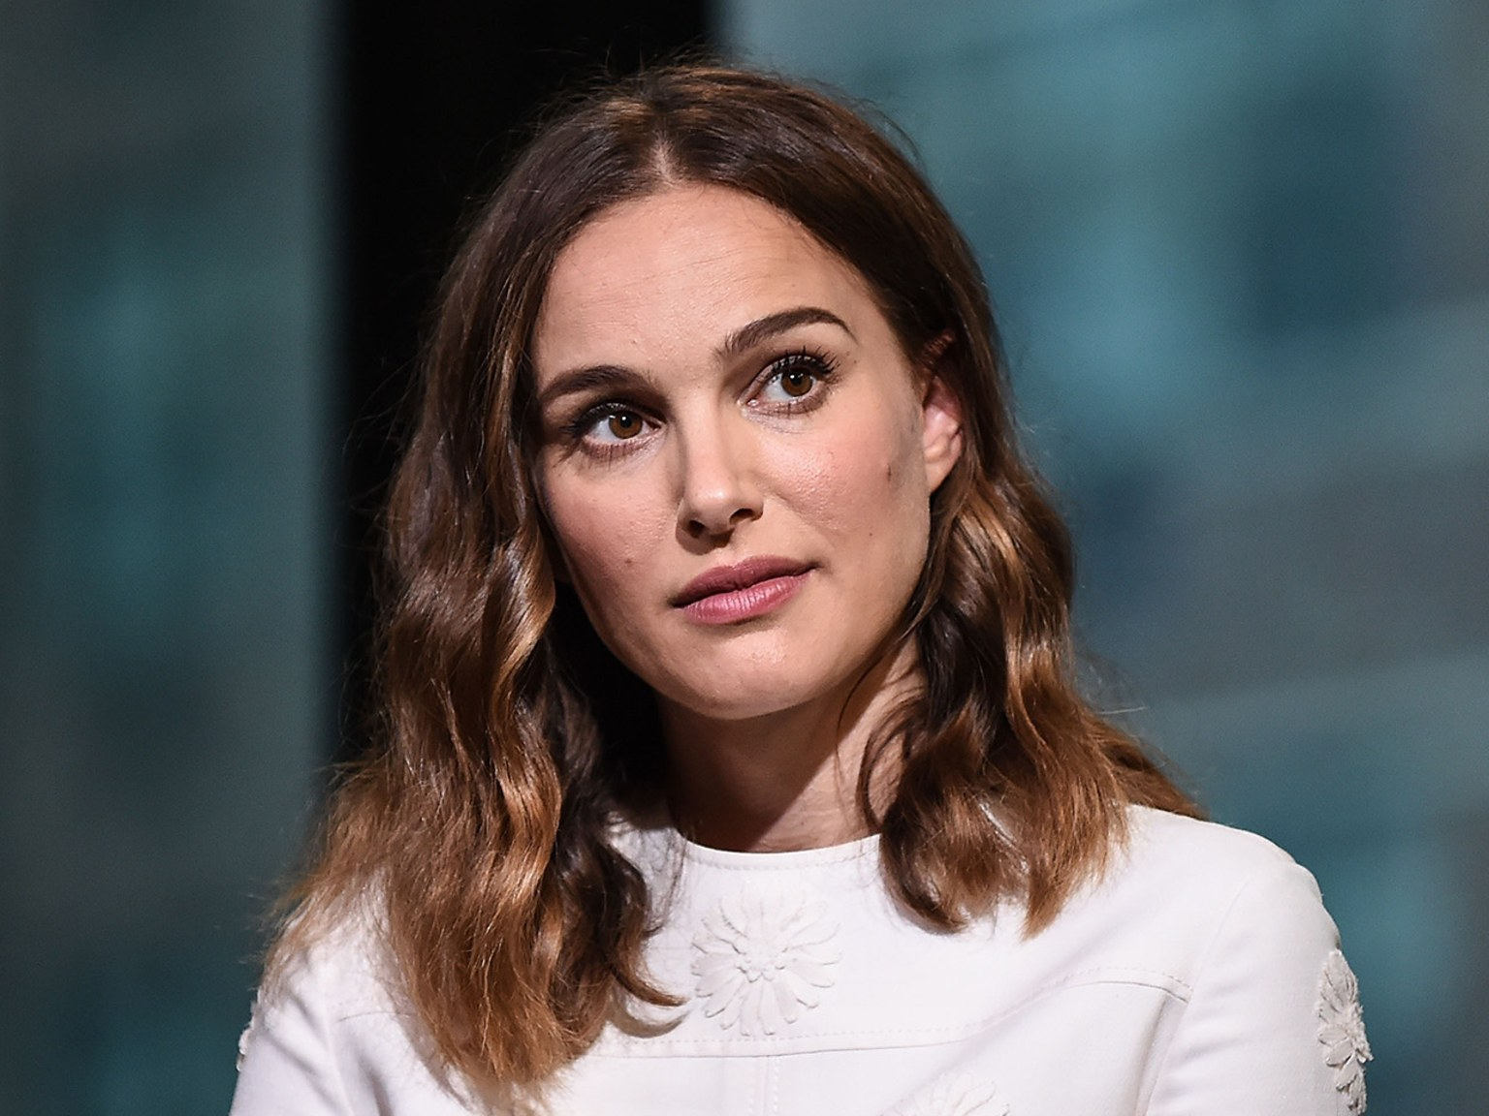
Question 2:

Slide 4
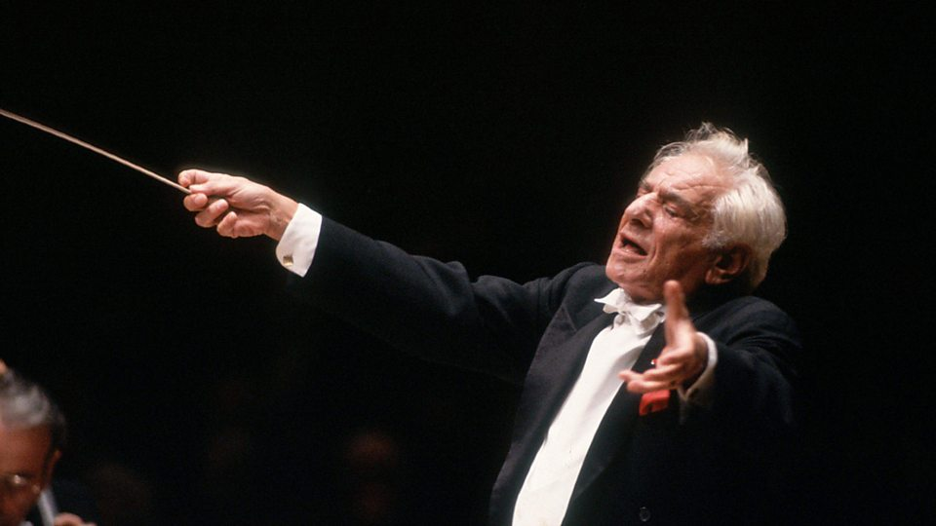
Question 3:

Slide 5
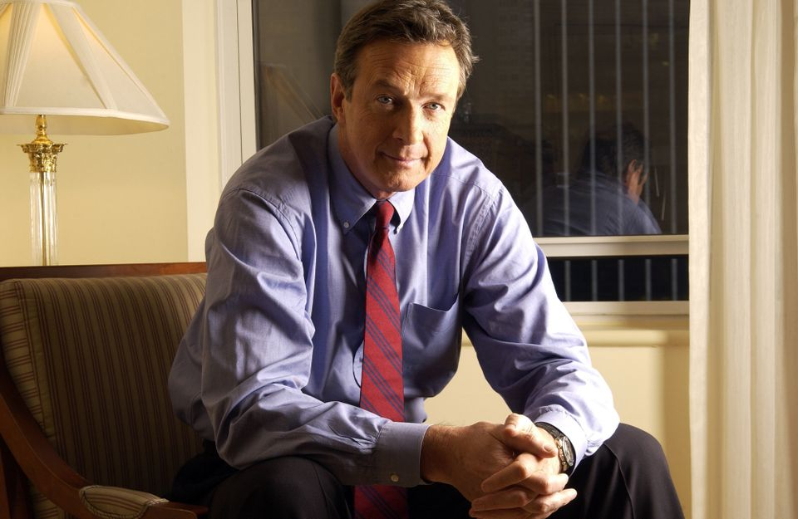
Question 4:

Slide 6
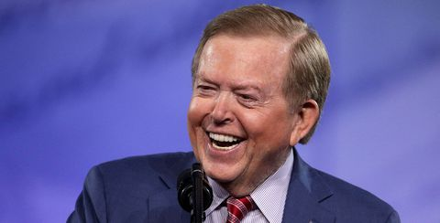
Question 5:

Slide 7
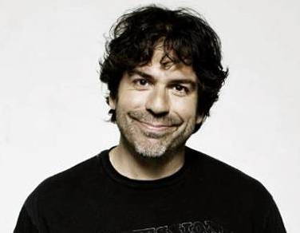
Question 6:

Slide 8
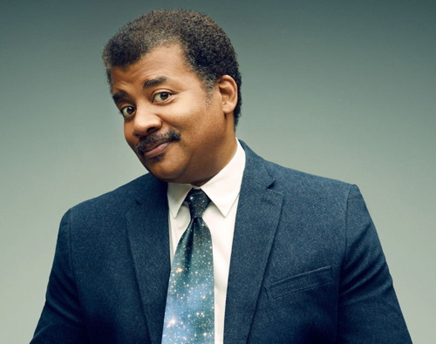
Question 7:

Slide 9
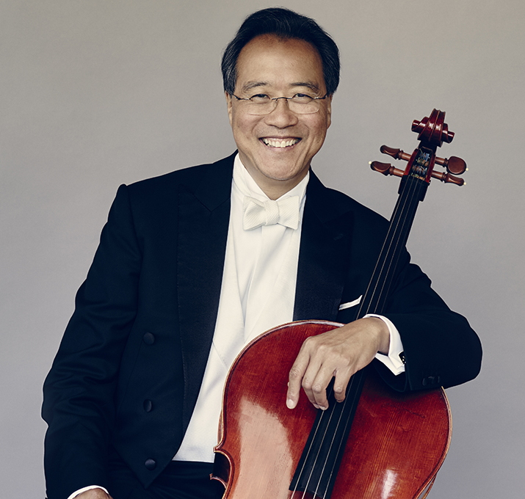
Question 8:

Slide 10
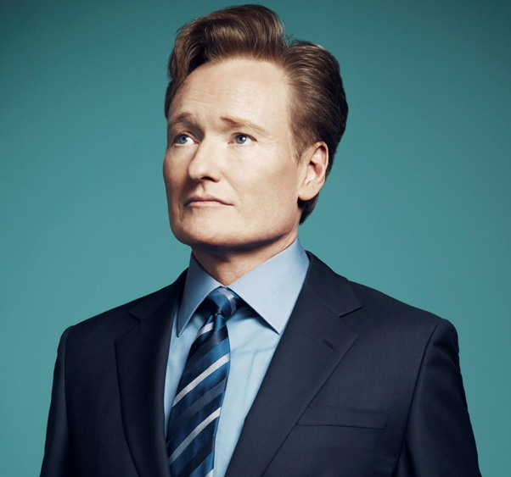
Question 9:

Slide 11
Question 10:
WHAT DO ALL THESE PEOPLE HAVE IN COMMON?

Slide 12
ANSWERS WILL BE PROVIDED SHORTLY

Slide 13
Question 1:
MARK ZUCKERBERG

Slide 14
Question 2:
NATALIE PORTMAN

Slide 15
Question 3:
LEONARD BERNSTEIN

Slide 16
Question 4:
MICHAEL CRICHTON

Slide 17
Question 5:
LOU DOBBS

Slide 18
Question 6:
GREG GIRALDO

Slide 19
Question 7:
NEIL DEGRASSE TYSON

Slide 20
Question 8:
YO-YO MA

Slide 21
Question 9:
CONAN O'BRIEN

Slide 22
Question 10:
WHAT DO ALL THESE PEOPLE HAVE IN COMMON?
THEY ARE GRADUATES OF HARVARD UNIVERSITY

