Slide 1
COMMON THREAD

Slide 2
Question 1:
WHAT ITALIAN ACTRESS WAS THE FIRST TO WIN AN OSCAR FOR ACTING IN A FOREIGN FILM ("TWO WOMEN")?

Slide 3
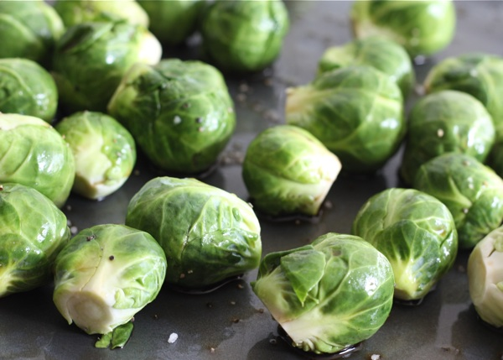
Question 2:
WHAT VEGETABLE IS THIS?

Slide 4
Question 3:
WHAT COMPOSER WROTE "GOD BLESS AMERICA" AND "THERE'S NO BUSINESS LIKE SHOW BUSINESS"?

Slide 5
Question 4:
WHAT 1984 FILM STARRED ROBIN WILLIAMS AS AN EASTERN BLOC MUSICIAN WHO DEFECTS TO THE U.S.?

Slide 6
Question 5:
WHAT ARE FEELINGS OF AFFECTION OR SYMPATHY FOR A CAPTOR CALLED?

Slide 7
Question 6:
WHAT CHARACTER IN "ROMEO AND JULIET" WAS JULIET EXPECTED TO MARRY?

Slide 8
Question 7:
WHAT WAS BUILT IN 1830, DISMANTLED IN 1967, AND RELOCATED AND REBUILT IN LAKE HAVASU, ARIZONA IN 1971?

Slide 9
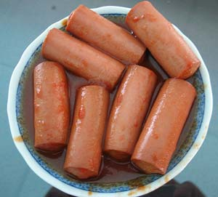
Question 8:
WHAT KIND OF MEAT IS THIS?

Slide 10
Question 9:
WHAT COMMON PHRASE ORIGINATED WITH ST. AMBROSE, WHO FASTED IN A CITY HE WAS VISITING BECAUSE EVERYONE ELSE THERE WAS DOING SO?

Slide 11
Question 10:
WHAT DO ALL THESE ANSWERS HAVE IN COMMON?

Slide 12
ANSWERS WILL BE PROVIDED SHORTLY

Slide 13
Question 1:
WHAT ITALIAN ACTRESS WAS THE FIRST TO WIN AN OSCAR FOR ACTING IN A FOREIGN FILM ("TWO WOMEN")?
SOPHIA LOREN

Slide 14
Question 2:
WHAT VEGETABLE IS THIS?
BRUSSELS SPROUTS

Slide 15
Question 3:
WHAT COMPOSER WROTE "GOD BLESS AMERICA" AND "THERE'S NO BUSINESS LIKE SHOW BUSINESS"?
IRVING BERLIN

Slide 16
Question 4:
WHAT 1984 FILM STARRED ROBIN WILLIAMS AS AN EASTERN BLOC MUSICIAN WHO DEFECTS TO THE U.S.?
MOSCOW ON THE HUDSON

Slide 17
Question 5:
WHAT ARE FEELINGS OF AFFECTION OR SYMPATHY FOR A CAPTOR CALLED?
STOCKHOLM SYNDROME

Slide 18
Question 6:
WHAT CHARACTER IN "ROMEO AND JULIET" WAS JULIET EXPECTED TO MARRY?
PARIS

Slide 19
Question 7:
WHAT WAS BUILT IN 1830, DISMANTLED IN 1967, AND RELOCATED AND REBUILT IN LAKE HAVASU, ARIZONA IN 1971?
LONDON BRIDGE

Slide 20
Question 8:
WHAT KIND OF MEAT IS THIS?
VIENNA SAUSAGES

Slide 21
Question 9:
WHAT COMMON PHRASE ORIGINATED WITH ST. AMBROSE, WHO FASTED IN A CITY HE WAS VISITING BECAUSE EVERYONE ELSE THERE WAS DOING SO?
WHEN IN ROME, DO AS THE ROMANS DO

Slide 22
Question 10:
WHAT DO ALL THESE ANSWERS HAVE IN COMMON?
CONTAIN EUROPEAN CAPITALS

