Slide 1
COMMON THREAD: IDENTIFY THESE CELEBRITIES

Slide 2
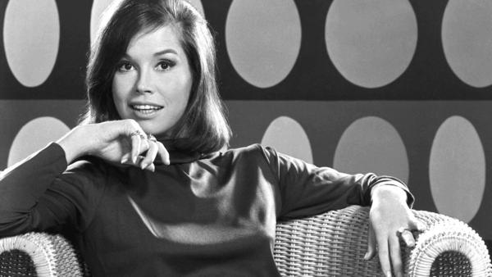
Question 1:

Slide 3
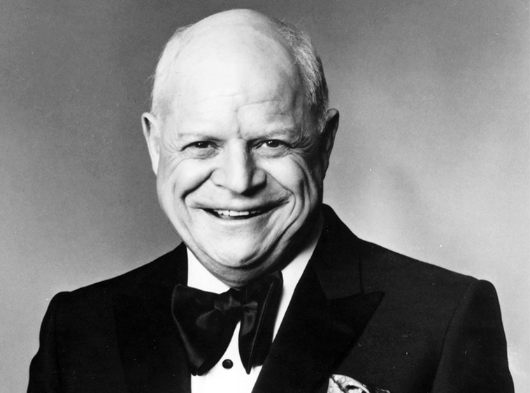
Question 2:

Slide 4
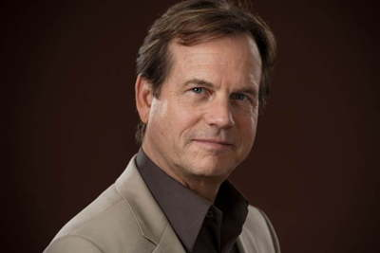
Question 3:

Slide 5
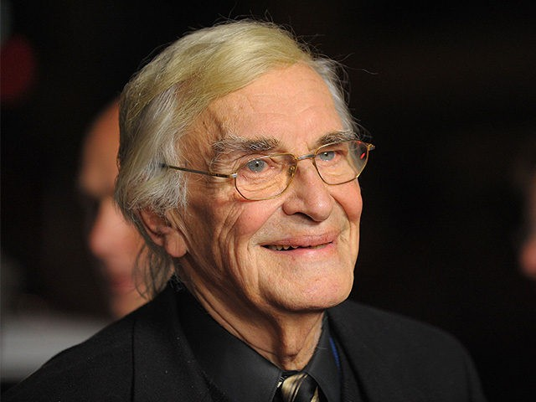
Question 4:

Slide 6
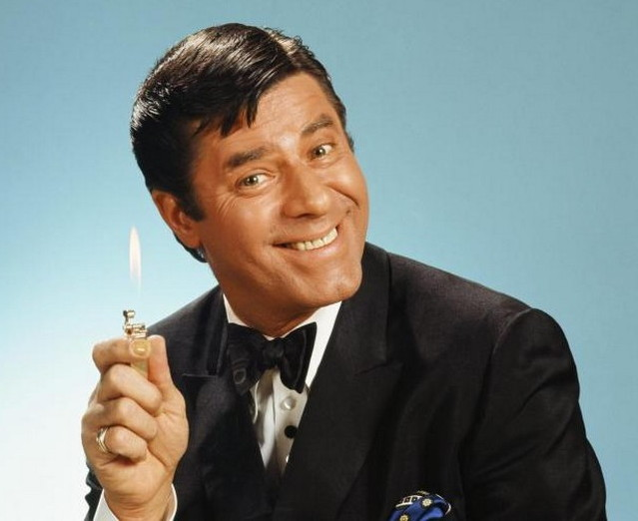
Question 5:

Slide 7
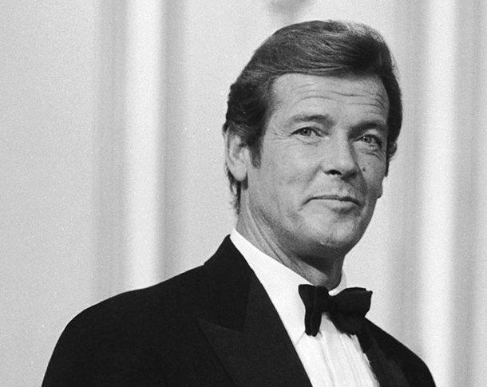
Question 6:

Slide 8
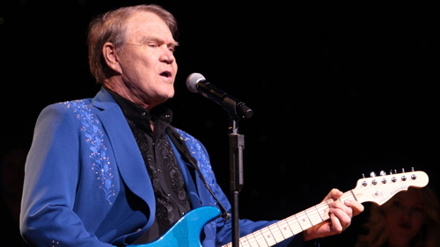
Question 7:

Slide 9
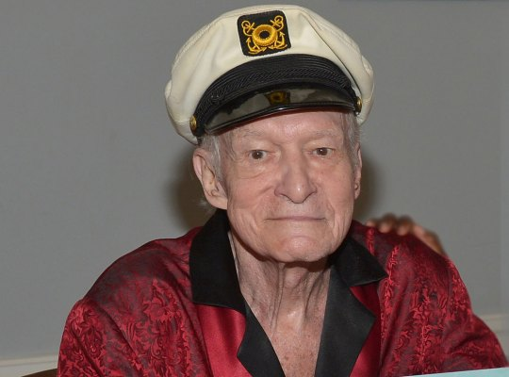
Question 8:

Slide 10
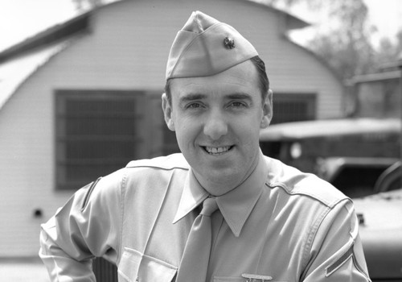
Question 9:

Slide 11
Question 10:
WHAT DO ALL THESE ANSWERS HAVE IN COMMON?

Slide 12
ANSWERS WILL BE PROVIDED SHORTLY

Slide 13
Question 1:
MARY TYLER MOORE

Slide 14
Question 2:
DON RICKLES

Slide 15
Question 3:
BILL PAXTON

Slide 16
Question 4:
MARTIN LANDAU

Slide 17
Question 5:
JERRY LEWIS

Slide 18
Question 6:
ROGER MOORE

Slide 19
Question 7:
GLEN CAMPBELL

Slide 20
Question 8:
HUGH HEFNER

Slide 21
Question 9:
JIM NABORS

Slide 22
Question 10:
WHAT DO ALL THESE ANSWERS HAVE IN COMMON?
THEY ALL DIED IN 2017

