Slide 1
WHO HAS THESE HAIRDOS? (THANKS MARGIE)

Slide 2
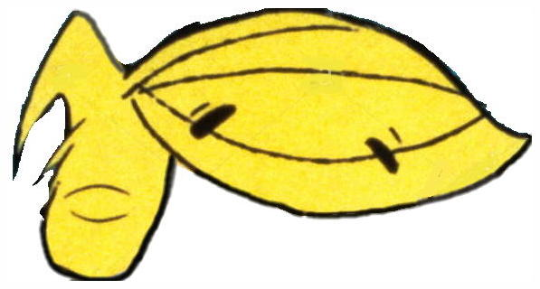
Question 1:

Slide 3
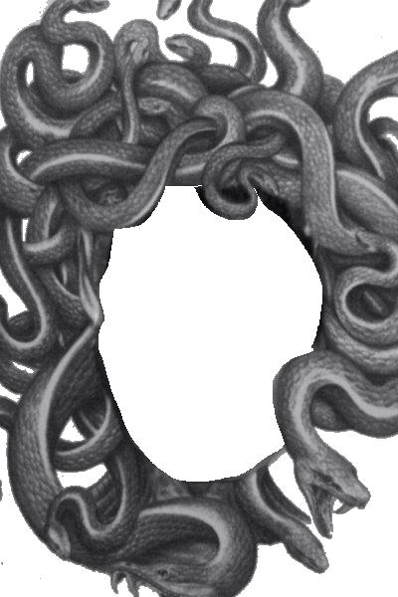
Question 2:

Slide 4
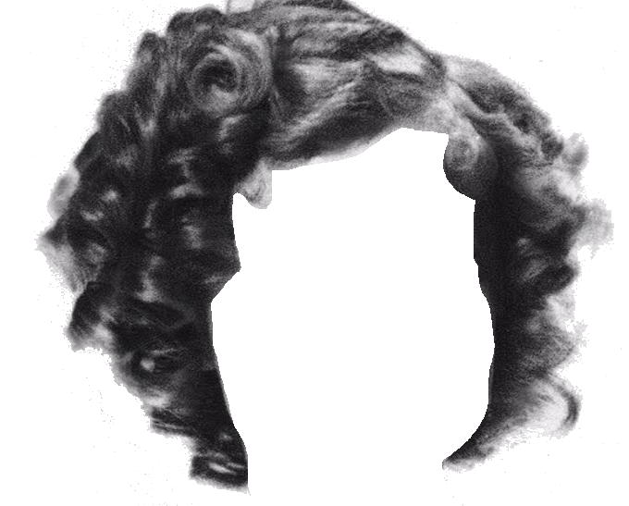
Question 3:

Slide 5
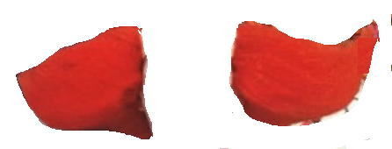
Question 4:

Slide 6
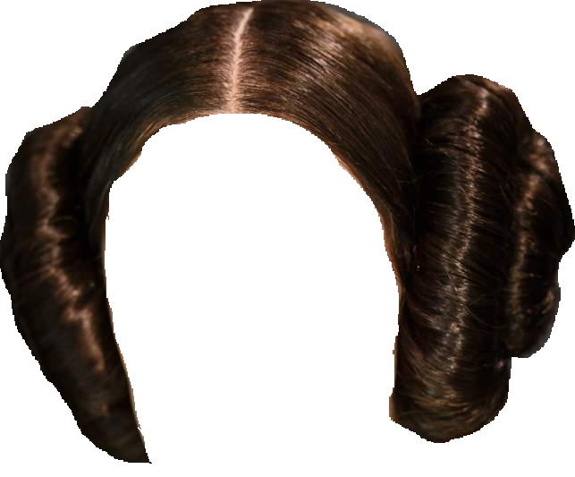
Question 5:

Slide 7

Question 6:

Slide 8
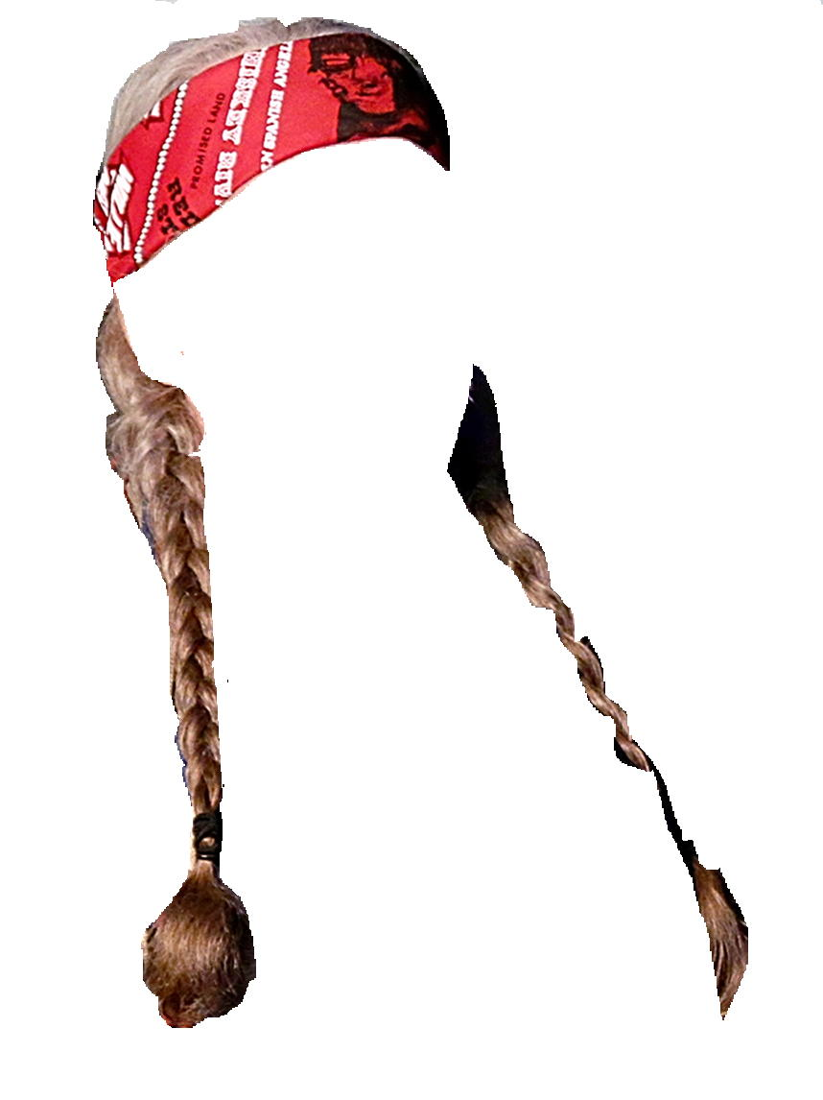
Question 7:

Slide 9
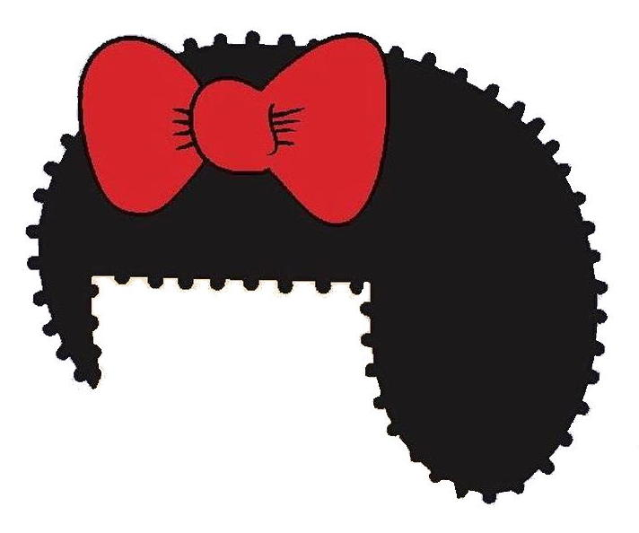
Question 8:

Slide 10
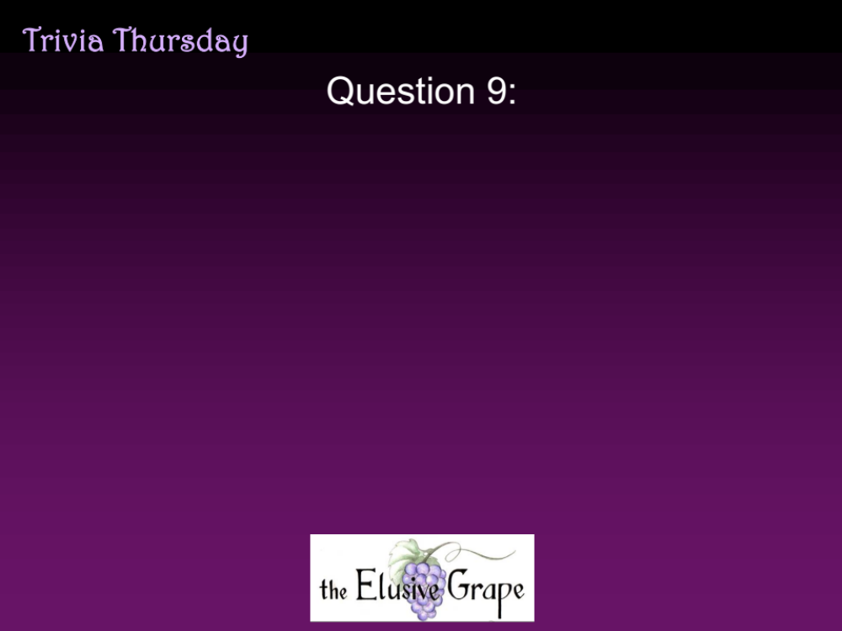
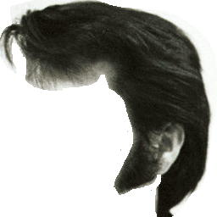
Question 9:

Slide 11

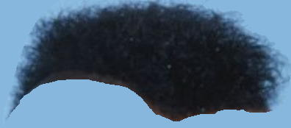
Question 10:

Slide 12
ANSWERS WILL BE PROVIDED SHORTLY

Slide 13
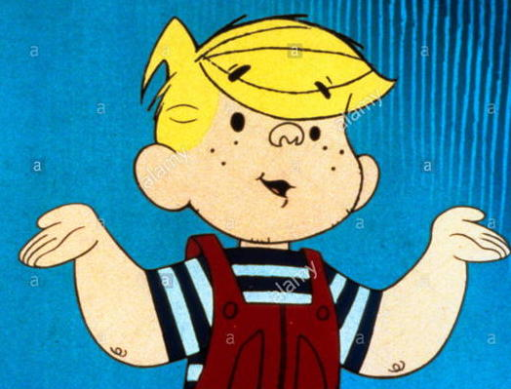
Question 1:
DENNIS THE MENACE

Slide 14
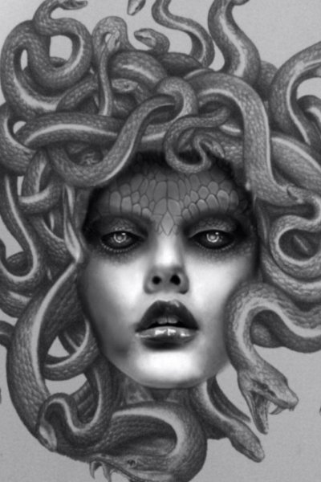
Question 2:
MEDUSA

Slide 15
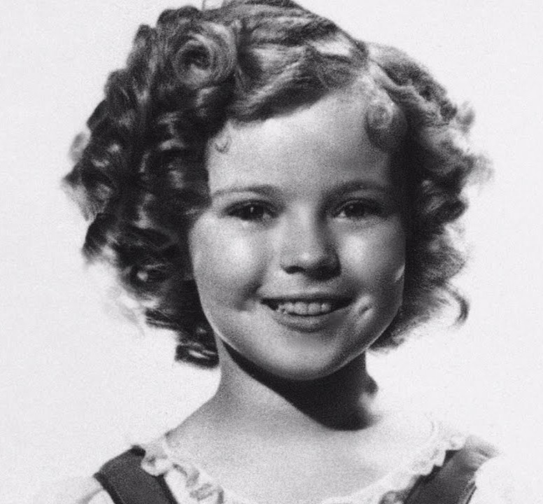
Question 3:
SHIRLEY TEMPLE

Slide 16
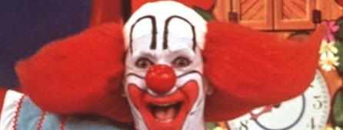
Question 4:
BOZO THE CLOWN

Slide 17
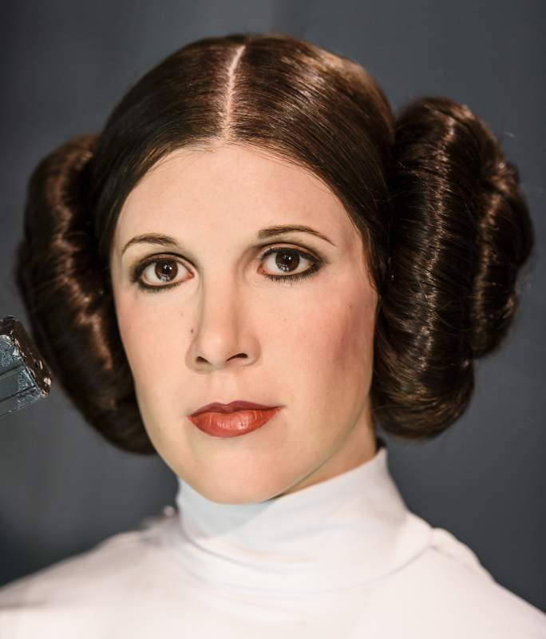
Question 5:
PRINCESS LEIA

Slide 18
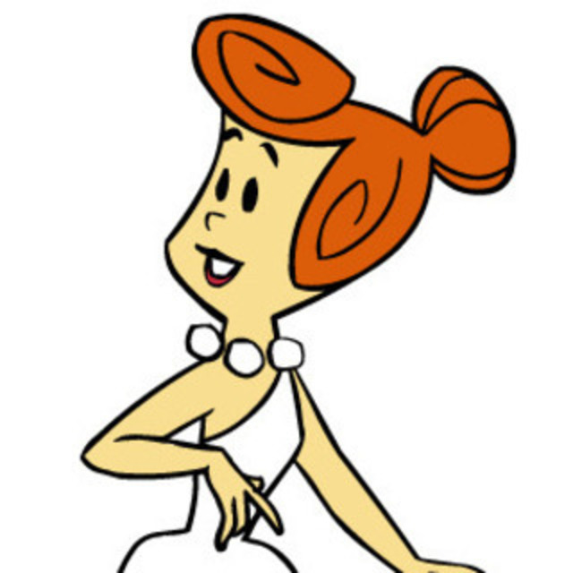
Question 6:
WILMA FLINTSTONE

Slide 19
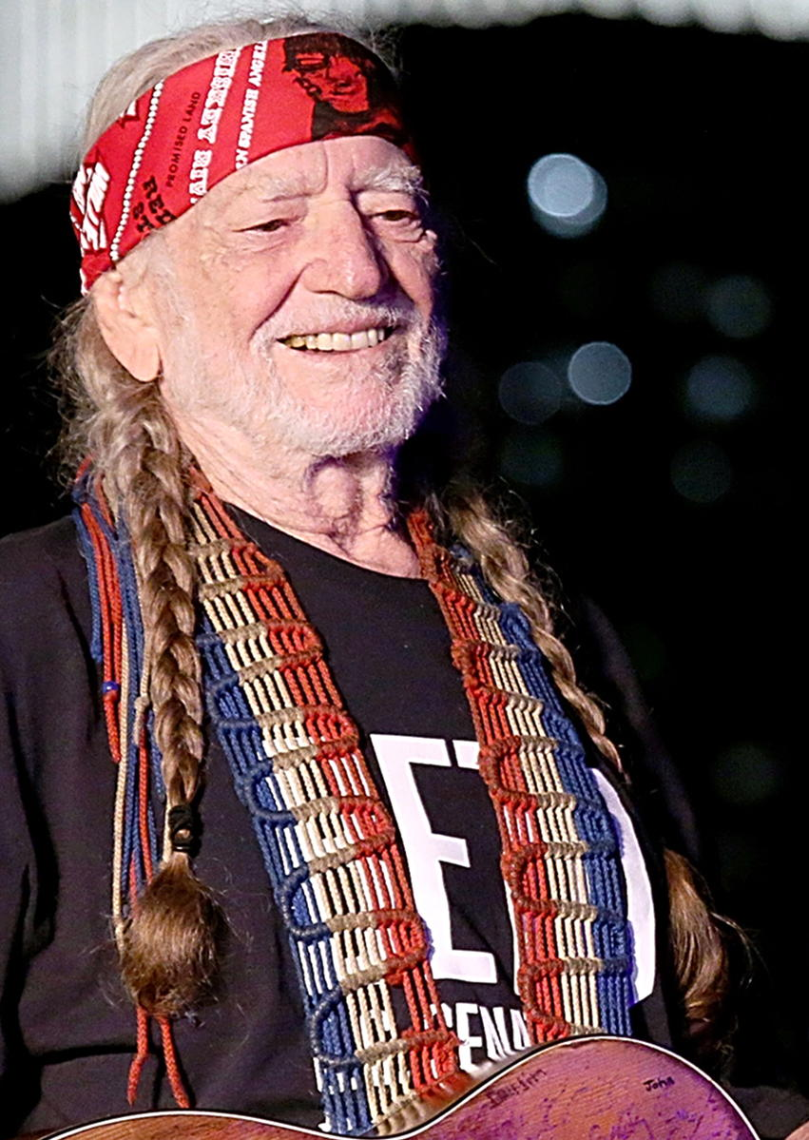
Question 7:
WILLIE NELSON

Slide 20
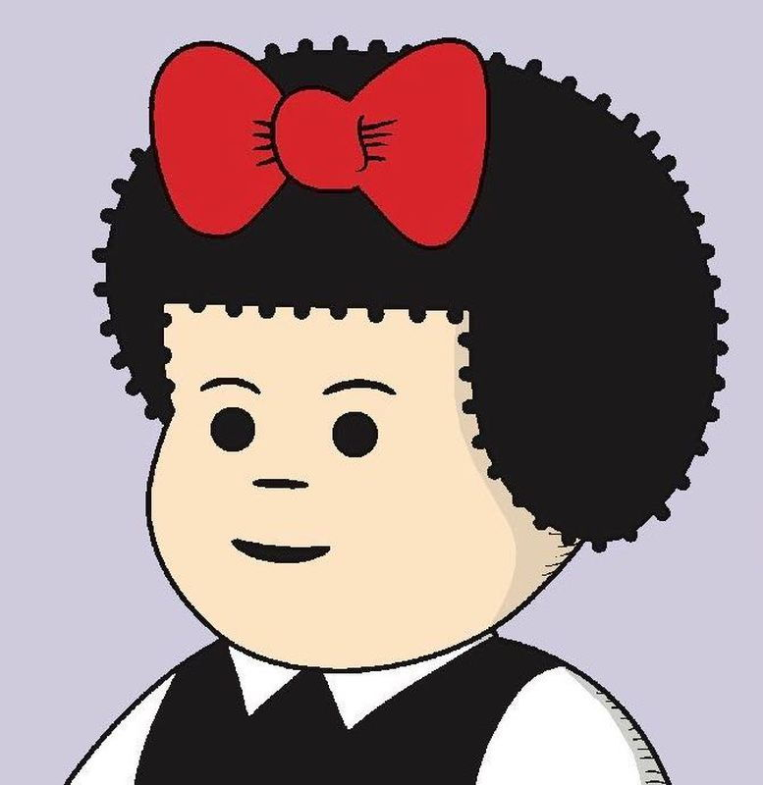
Question 8:
NANCY

Slide 21
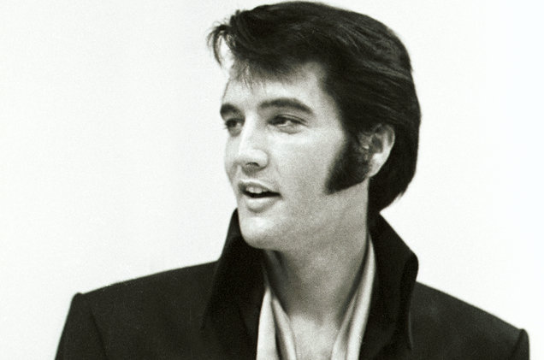
Question 9:
ELVIS PRESLEY

Slide 22
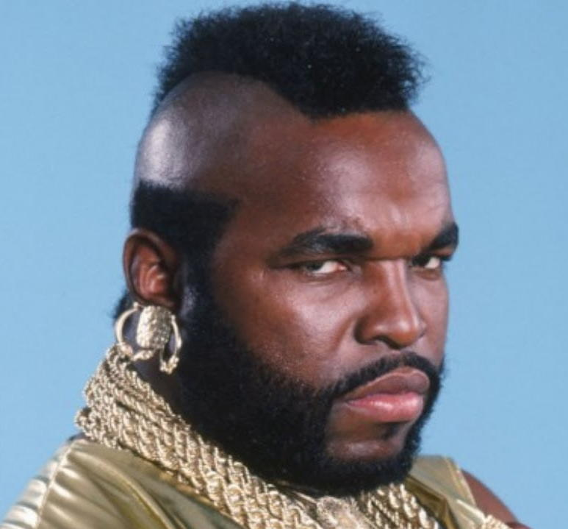
Question 10:
MR. T

