Slide 1
The Game of Cubic is NP-complete
Erich Friedman
Stetson University

Slide 2
The Game of Cubic
variously colored unit blocks in some configuration
player can drag blocks horizontally to adjacent positions
gravity pulls unsupported blocks down
when blocks of the same color meet, they disappear
the goal is to remove all the colored blocks
can be played at: http://www.agon.com/doodle/four.html

Slide 3
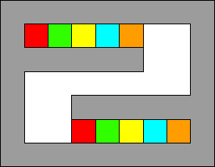
Example

Slide 4
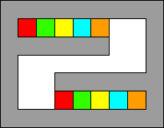
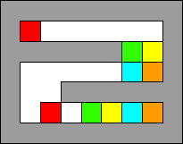
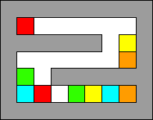
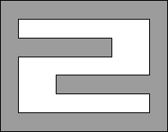
Solution

Slide 5
P and NP
P is the set of all yes/no problems which are decidable in polynomial time.
NP is the set of all yes/no problems in which a “proof” for a yes answer can be checked in polynomial time.
Determining whether a number is prime is P and NP.
Finding whether a graph has a Hamiltonian path is NP.
The question whether P=NP is one of the most important open questions in computer science.

Slide 6
NP-completeness
A problem is NP-complete if:
  it is in NP, and
  the existence of a polynomial time algorithm to solve it implies the existence of a polynomial time algorithm for all problems in NP.
Examples of NP-complete problems are:
  Traveling Salesman Problem
  Map and Graph Coloring Problems
  Finding Hamiltonian Paths or Circuits
  Satisfiability: Are there inputs to a Boolean circuit with AND/OR/NOT gates that make the outputs TRUE?

Slide 7
Cubic is NP-complete
The Main Result of this talk is:
    The question of whether or not a given
    Cubic position is solvable is NP-complete.
To prove this, we will build Boolean circuits using blocks and passageways in the Cubic universe.
    "wires" carry truth values
    "junctions" in these wires simulate logical gates
Since Satisfiability is NP-complete, so then is Cubic.

Slide 8
The Construction
We need:
    wires
    variables that can have either truth value
    way to end a wire that forces it to be TRUE
    AND gate
    OR gate
    NOT gate
    way to split the signal in a wire
    way to allow wires to cross

Slide 9
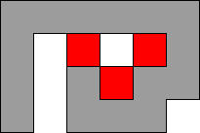

Wires, Variables, and Ends
wires are passageways for blocks to move in
a wire carries the value TRUE is there is a (red) block moving through it, and the value FALSE otherwise
a variable is shown on the left
a way to end a wire that must be TRUE is shown on the right

Slide 10
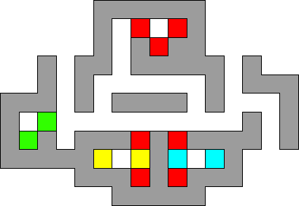
The AND Gate

Slide 11
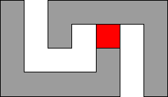
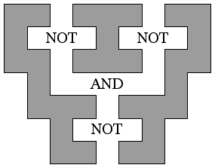
The NOT Gate
The OR Gate

Slide 12
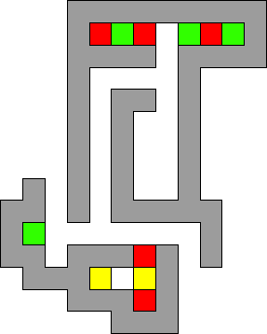
A Way to Switch Colors
SWITCH =

Slide 13
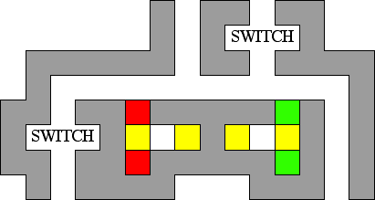
A Way to Let Wires Cross

Slide 14
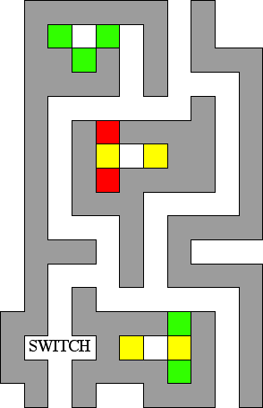
A Way to
Split a Wire

Slide 15
Summary
We have shown that for any given circuit, we can find a Cubic position that can be solved if and only if there is a set of inputs to the circuit that make the output TRUE.
This Satisfiability problem for circuits is known to be NP-complete.
The mapping from circuits to Cubic is bounded.
Therefore whether a given Cubic position can be solved is also NP-complete.

Slide 16
References
D. Beauquier, M. Nivat, E. Rémila, and J.M. Robson, Computational Geometry 5 (1995) 1-25.
J. Culberson, "Sokoban is PSPACE-complete." preprint.
M.R. Garey and D.S. Johnson, Computers and Intractibility: A Guide to the Theory of NP-Completeness. W.H. Freeman, 1979.
E. Goles and I. Rapaport, "Complexity of tile rotation problems." Theoretical Computer Science 188 (1997) 129-159.
E. Goles and I. Rapaport, "Tiling allowing rotations only." Theoretical Computer Science 218 (1999) 285-295.
R. Kaye, "Minesweeper is NP-complete." Mathematical Intelligencer, to appear.
K. Lindgren, C. Moore and M.G. Nordahl, "Complexity of two-dimensional patterns." Journal of Statistical Physics 91 (1998) 909-951.
C. Moore and J.M. Robson, "Hard Tiling Problems with Simple Tiles." preprint.
E. Rémila, "Tilings with bars and satisfaction of Boolean formulas." Europ. J. Combinatorics 17 (1996) 485-491.

