Slide 1
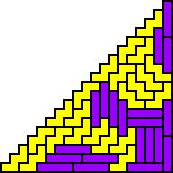
Tiling Triangular
Polyominoes
With Two Tiles
Erich Friedman
Stetson University
September 13, 2006

Slide 2

Definitions
A polyomino is a collection of unit squares arranged with coincident sides.
A triangular polyomino is a polyomino in the shape of an isosceles right triangle.
To tile a shape S with a polyomino P means to cover S with copies p₁, p₂, …p_{n} of P so that the p_{i} have non-intersecting interior.

Slide 3
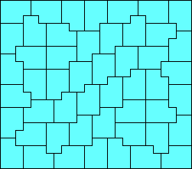
Background
The problem of which polyominoes can tile which rectangles has been well-studied (Golumb, Klarner, Reid, Gardner, Marshall).

Slide 4
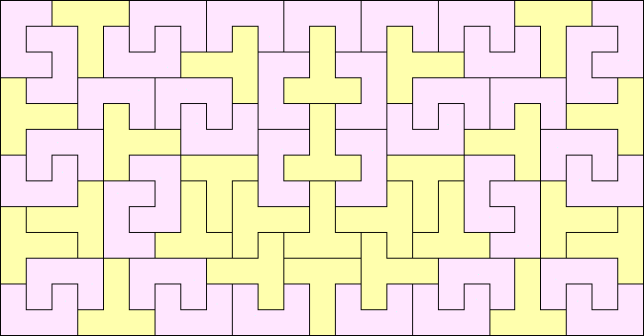
Background
Many polyominoes can not tile any rectangle, but can tile rectangles in pairs. This has also been well-studied (Kramer, Reid).

Slide 5
Our Problems
Which pairs of polyominoes can tile triangular polyominoes?
What are the smallest such tilings?
The pictures in gray are mine.
Those in blue / orange are from Patrick Hamlyn.
Those in yellow / purple are from Mike Reid.
Those in green / pink are from Bernd Rennhak.

Slide 6
Areas 1+2, 1+3, 2+3
There is one polyomino of area 1, and it is a triangular polyomino.
There are two polyominoes of area 3, one of which is triangular.
The only other small case is shown to the right, and is impossible.
+
Why?

Slide 7
The Diagonal Theorem
A polyomino has the diagonal property if it can cover more main diagonal squares (red) than subdiagonal squares (green).
Theorem: If two polyominoes tile a triangular polyomino, then one of them must have the diagonal property.
Proof: more red squares than green ones.

Slide 8
Areas 1+4, 2+4, 3+4
There are five polyominoes of area 4, but only one with the diagonal property.
Here is the only minimal 2+4 tiling:
The only remaining candidate for a 3+4 tiling is shown below, but is impossible.
Why?
+

Slide 9
More Definitions
The bounding box of a polyomino P is the smallest rectangle containing P.
If the bounding box for P is not a square, we say P is non-squarish.
If P is non-squarish, then it can be oriented horizontally (the bounding box is wider than it is high), or vertically (the bounding box is higher than it is wide).

Slide 10
The Orientation Theorem
Theorem: Assume a triangular polyomino is tiled with non-squarish polyominoes. Moving from the bottom left to the top right, consider the orientation of the polyominoes covering the main diagonal squares. At some point, these must switch from horizontal to vertical.
Proof: They start horizontal and end vertical.

Slide 11
Areas 4+4
The pairs below are impossible because of the Orientation Theorem.
+
+
The other two pairs admit triangle tilings. These tilings are the smallest possible.
Why?

Slide 12
The Divisibility Theorem
Theorem: If polyominoes with areas A₁ and A₂ tile a triangular polyomino with side n, then gcd(A_{1,} A₂) divides n(n+1)/2.
Proof: There are n(n+1)/2 squares in the triangular polyomino, and every polyomino contains some multiple of gcd(A_{1,} A₂) squares.

Slide 13
Areas 4+4
In particular, when A₁=4 and A₂=4, gcd(A₁, A₃)=4.
Note 4 divides n(n+1)/2 when n=0 or 7 (mod 8).

Slide 14
Areas 2+5
There are 12 polyominoes with area 5, but only 4 of them have the diagonal property.
Below are the smallest tilings.
Why?

Slide 15
The Checkerboard Theorem
If a polyomino is placed on a checkerboard, and covers w white squares and b black ones, we say the excess of the polyomino is |w-b|.
Theorem: If polyominoes with excess 0 and x tile a triangular polyomino with side 2n-1 or 2n, then x divides n, and there are at least n/x polyominoes with excess x in the tiling.
Proof: These triangles have excess n.

Slide 16
Areas 2+5
The cross has excess 3, so the smallest it can tile is n=2(3)-1=5.
The others have excess 1, so we need to pack n of them into a triangular polyomino with side 2n-1 or 2n.

Slide 17
Areas 3+5
There is only one minimal 3+5 tiling:
The other polyominoes of area 5 fail to satisfy the diagonal property, or a generalization of the Orientation Theorem.

Slide 18
Areas 4+5
Eliminating the cases that fail the Diagonal Theorem or the Orientation Theorem, we are left with a dozen possible pairings.
But in the 6 cases below, there is no triangular tiling.
Why?
+

Slide 19
The Bottom Theorem
A polyomino has the bottom property if it can cover more bottom squares (red) than subbottom squares (green).
Theorem: If two polyominoes tile a triangular polyomino, then one of them must have the bottom property.
Proof: more red squares than green ones.

Slide 20
Areas 4+5
Here are the minimal 4+5 tilings:

Slide 21
Review
At least one needs the diagonal property.
At least one needs the bottom property.
They must satisfy the Orientation Theorem.
The size of the smallest tilings are restricted by the Divisibility Theorem and the Checkerboard Theorem.

Slide 22
Your Turn! Areas 5+5
Which of the following pairs of polyominoes with area 5 might tile a triangular polyomino?
+
+
+
+

Slide 23
Areas 5+5
There are nine minimal 5+5 tilings:

Slide 24
Areas 5+5

Slide 25
Areas 6+6
There are only six minimal 6+6 tilings.
The analysis was finished in July 2006.

Slide 26
Areas 6+6

Slide 27
Areas 7+7
There are sixteen known minimal 7+7 tilings.
The analysis of all 5778 cases is not yet finished.

Slide 28
Areas 7+7

Slide 29
Areas 7+7

Slide 30
Areas 8+8, 9+9
There are no known 8+8 tilings.
There are eight known minimal 9+9 tilings.

Slide 31
Areas 9+9, 10+10
No one has tried the 10+10 cases yet.

Slide 32
Other Triangles - Areas 8+8

Slide 33
Other Triangles - Areas 8+8

Slide 34
Other Triangles - Areas 9+9

Slide 35
Other Triangles - Areas 9+9

Slide 36
Diamonds - Areas 5+5

Slide 37
Diamonds - Areas 5
Surprisingly, there are two pentominoes that tile a diamond all by themselves.
(George Sicherman)

Slide 38
Tiling Triangles with Polyhexes

Slide 39
Tiling Triangles with Polyhexes
(Brendan Owen)
(Brendan Owen)

Slide 40
Tiling Triangles with Polyiamonds
(Brendan Owen)
(Karl Scherer)

Slide 41
Unsolved Problems
Have we found all the 7+7 triangular polyomino tilings?
What polyomino tilings are there of right triangles of other slopes?
What triangular tilings are there using polyhexes and polyiamonds?
What tilings are there of pyramids in 3 dimensions?

Slide 42
Web References
Tiling Triangular Polyominoes http://www.stetson.edu/~efriedma/mathmagic/0506.html
Rectifiable Polyominoes http://www.math.ucf.edu/~reid/Polyomino/rectifiable_data.html
Polyhex and Polyiamond Tilings http://www.recmath.com/PolyPages/
Polycube Tilings http://www.mathematik.uni-bielefeld.de/~sillke/results.html

