Slide 1
COMMON THREAD

Slide 2
Question 1:
WHAT 2000 FILM MADE $128 MILLION IN THE U.S., A RECORD FOR A CHINESE FILM?

Slide 3
Question 2:
WHAT IS THE ONLY MUSICAL GROUP TO HAVE 2 ALBUMS THAT SOLD MORE THAN 16 MILLION COPIES EACH?

Slide 4
Question 3:
WHAT ALCOHOLIC DRINK IS MADE FROM RUM, PASSION FRUIT SYRUP, AND LEMON JUICE?

Slide 5
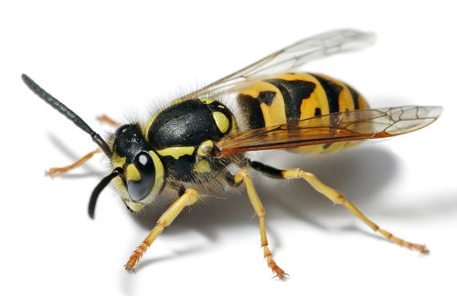
Question 4:
WHAT TYPE OF WASP IS THIS?

Slide 6
Question 5:
WHAT NAME IS GIVEN TO THE SERIES OF PROTESTS IN THE UKRAINE IN LATE 2004 AND EARLY 2005?

Slide 7
Question 6:
WHAT IS THE MOST COMMON U.S. BIRD THAT IS ALMOST ENTIRELY RED?

Slide 8
Question 7:
WHAT 1995 FILM SET IN 1948 STARRED DENZEL WASHINGTON AS A PRIVATE INVESTIGATOR?

Slide 9
Question 8:
WHAT IS THE HIGHEST GROSSING FILM OF 2018?

Slide 10
Question 9:
WHAT TEAM MADE THE NBA FINALS 2015-2018?

Slide 11
Question 10:
WHAT DO ALL THESE NUMBERS HAVE IN COMMON?

Slide 12
ANSWERS WILL BE PROVIDED SHORTLY

Slide 13
Question 1:
WHAT 2000 FILM MADE $128 MILLION IN THE U.S., A RECORD FOR A CHINESE FILM?
CROUCHING TIGER, HIDDEN DRAGON

Slide 14
Question 2:
WHAT IS THE ONLY MUSICAL GROUP TO HAVE 2 ALBUMS THAT SOLD MORE THAN 16 MILLION COPIES EACH?
THE EAGLES

Slide 15
Question 3:
WHAT ALCOHOLIC DRINK IS MADE FROM RUM, PASSION FRUIT SYRUP, AND LEMON JUICE?
HURRICANE

Slide 16
Question 4:
WHAT TYPE OF WASP IS THIS?
YELLOW JACKET

Slide 17
Question 5:
WHAT NAME IS GIVEN TO THE SERIES OF PROTESTS IN THE UKRAINE IN LATE 2004 AND EARLY 2005?
THE ORANGE REVOLUTION

Slide 18
Question 6:
WHAT IS THE MOST COMMON U.S. BIRD THAT IS ALMOST ENTIRELY RED?
CARDINAL

Slide 19
Question 7:
WHAT 1995 FILM SET IN 1948 STARRED DENZEL WASHINGTON AS A PRIVATE INVESTIGATOR?
DEVIL IN A BLUE DRESS

Slide 20
Question 8:
WHAT IS THE HIGHEST GROSSING FILM OF 2018?
BLACK PANTHER

Slide 21
Question 9:
WHAT TEAM MADE THE NBA FINALS 2015-2018?
CLEVELAND CAVALIERS

Slide 22
Question 10:
WHAT DO ALL THESE NUMBERS HAVE IN COMMON?
CONTAIN NICKNAMES OF ACC SPORTS TEAMS

