Slide 1
COMMON THREAD

Slide 2
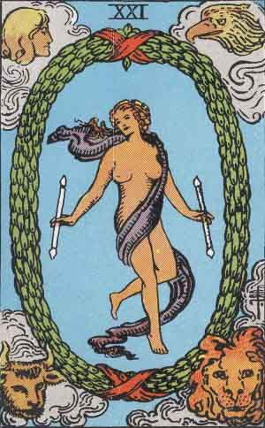
Question 1:
WHAT IS THE NAME OF THIS TAROT CARD, THE LAST IN THE TRUMP SUIT?

Slide 3
Question 2:
THE RHINOVIRUS CAUSES WHAT HUMAN DISEASE?

Slide 4
Question 3:
WHAT IS THE LAST NAME OF THE 50'S ACTOR WHO PLAYED A HOMICIDAL SCULPTOR IN "HOUSE OF WAX" AND A MAD SCIENTIST IN "THE FLY"?

Slide 5
Question 4:
WHAT HOLIDAY'S SERVICE, FROM THE "KOL NIDRE" TO THE "NEILAH", IS THE LONGEST IN THE JEWISH LITURGY?

Slide 6
Question 5:
WHAT'S THE MOST COMMON TERM OF FIXED-RATE MORTGAGE IN THE U.S.?

Slide 7
Question 6:
WHAT MASCOT RIDES THE WHITE HORSE NAMED TRAVELER AT USC HOME FOOTBALL GAMES?

Slide 8
Question 7:
THE VERSES OF "GANGNAM STYLE," THE MOST-WATCHED VIDEO IN YOUTUBE HISTORY, ARE SUNG IN WHAT LANGUAGE?

Slide 9
Question 8:
WHAT COUNTRY IS JUST EAST OF CAMBODIA?

Slide 10
Question 9:
WHAT OIL COMPANY MERGED WITH STANDARD OIL OF CALIFORNIA IN 1985 TO FORM CHEVRON?

Slide 11
Question 10:
WHAT DO ALL THESE ANSWERS HAVE IN COMMON?

Slide 12
ANSWERS WILL BE PROVIDED SHORTLY

Slide 13
Question 1:
WHAT IS THE NAME OF THIS TAROT CARD, THE LAST IN THE TRUMP SUIT?
THE WORLD

Slide 14
Question 2:
THE RHINOVIRUS CAUSES WHAT HUMAN DISEASE?
COLD

Slide 15
Question 3:
WHAT IS THE LAST NAME OF THE 50'S ACTOR WHO PLAYED A HOMICIDAL SCULPTOR IN "HOUSE OF WAX" AND A MAD SCIENTIST IN "THE FLY"?
(VINCENT) PRICE

Slide 16
Question 4:
WHAT HOLIDAY'S SERVICE, FROM THE "KOL NIDRE" TO THE "NEILAH", IS THE LONGEST IN THE JEWISH LITURGY?
YOM KIPPUR

Slide 17
Question 5:
WHAT'S THE MOST COMMON TERM OF FIXED-RATE MORTGAGE IN THE U.S.?
30 YEARS

Slide 18
Question 6:
WHAT MASCOT RIDES THE WHITE HORSE NAMED TRAVELER AT USC HOME FOOTBALL GAMES?
TROJAN

Slide 19
Question 7:
THE VERSES OF "GANGNAM STYLE," THE MOST-WATCHED VIDEO IN YOUTUBE HISTORY, ARE SUNG IN WHAT LANGUAGE?
KOREAN

Slide 20
Question 8:
WHAT COUNTRY IS JUST EAST OF CAMBODIA?
VIETNAM

Slide 21
Question 9:
WHAT OIL COMPANY MERGED WITH STANDARD OIL OF CALIFORNIA IN 1985 TO FORM CHEVRON?
GULF

Slide 22
Question 10:
WHAT DO ALL THESE ANSWERS HAVE IN COMMON?
CAN BE FOLLOWED BY "WAR"

