Slide 1
COMMON THREAD

Slide 2
Question 1:
WHAT ACTRESS STARRED IN "NATURAL BORN KILLERS", "WHAT'S EATING GILBERT GRAPE", AND "STRANGE DAYS"?

Slide 3
Question 2:
IN WHAT CITY WOULD YOU FIND THE BRIDGE OF SIGHS AND PIAZZA SAN MARCO?

Slide 4
Question 3:
WHO BECAME KING UPON THE DEATH OF HIS BROTHER, RICHARD THE LIONHEART?

Slide 5
Question 4:
WHAT WAS THE MOST EXPENSIVE SECULAR BUILDING PROJECT IN ENGLAND DURING THE MIDDLE AGES, AND IS THE FAVORITE WEEKEND HOME OF QUEEN ELIZABETH II?

Slide 6
Question 5:
WHAT IS THE NAME OF THE COMIC MEERKAT IN "THE LION KING"?

Slide 7
Question 6:
WHO WROTE "THE OWL AND THE PUSSYCAT"?

Slide 8
Question 7:
WHAT IS THE NAME FOR A VILLAGE THAT DOESN’T HAVE A CHURCH OF ITS OWN?

Slide 9
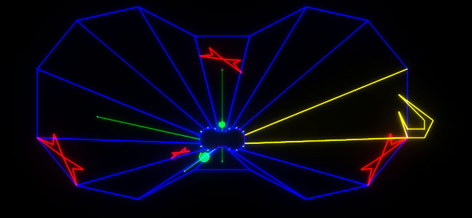
Question 8:
WHAT VIDEO GAME IS THIS?

Slide 10
Question 9:
WHAT GAME IS PLAYED ON AN 8x8 GRID USING DISKS THAT ARE BLACK ON ONE SIDE AND WHITE ON THE OTHER?

Slide 11
Question 10:
WHAT DO ALL THESE ANSWERS HAVE IN COMMON?

Slide 12
ANSWERS WILL BE PROVIDED SHORTLY

Slide 13
Question 1:
WHAT ACTRESS STARRED IN "NATURAL BORN KILLERS", "WHAT'S EATING GILBERT GRAPE", AND "STRANGE DAYS"?
JULIETTE LEWIS

Slide 14
Question 2:
IN WHAT CITY WOULD YOU FIND THE BRIDGE OF SIGHS AND PIAZZA SAN MARCO?
VENICE

Slide 15
Question 3:
WHO BECAME KING UPON THE DEATH OF HIS BROTHER, RICHARD THE LIONHEART?
KING JOHN

Slide 16
Question 4:
WHAT WAS THE MOST EXPENSIVE SECULAR BUILDING PROJECT IN ENGLAND DURING THE MIDDLE AGES, AND IS THE FAVORITE WEEKEND HOME OF QUEEN ELIZABETH II?
WINDSOR CASTLE

Slide 17
Question 5:
WHAT IS THE NAME OF THE COMIC MEERKAT IN "THE LION KING"?
TIMON

Slide 18
Question 6:
WHO WROTE "THE OWL AND THE PUSSYCAT"?
EDWARD LEAR

Slide 19
Question 7:
WHAT IS THE NAME FOR A VILLAGE THAT DOESN’T HAVE A CHURCH OF ITS OWN?
HAMLET

Slide 20
Question 8:
WHAT VIDEO GAME IS THIS?
TEMPEST

Slide 21
Question 9:
WHAT GAME IS PLAYED ON AN 8x8 GRID USING DISKS THAT ARE BLACK ON ONE SIDE AND WHITE ON THE OTHER?
OTHELLO

Slide 22
Question 10:
WHAT DO ALL THESE ANSWERS HAVE IN COMMON?
THEY CONTAIN PARTS OF THE NAMES OF SHAKESPEARE PLAYS

