Slide 1
WELCOME TO THURSDAY NIGHT TRIVIA AT THE ELUSIVE GRAPE

Slide 2
COMMON THREAD

Slide 3
Question 1:
"GOTO" AND "GOSUB" WERE COMMANDS IN WHAT COMPUTER LANGUAGE DEVELOPED IN 1964?

Slide 4
Question 2:
BEFORE HE CHANGED IT TO "ONO" IN 1969, WHAT WWII-ERA FAVORITE WAS JOHN LENNON'S MIDDLE NAME?

Slide 5
Question 3:
IN 1653, OLIVER CROMWELL LED THE ARMED FORCE THAT OFFICIALLY DISSOLVED THE "RUMP" OF WHAT BODY?

Slide 6
Question 4:
WHAT RHODE ISLAND CITY WAS THE LOCATION OF THE "SUMMER WHITE HOUSES" OF KENNEDY AND EISENHOWER?

Slide 7
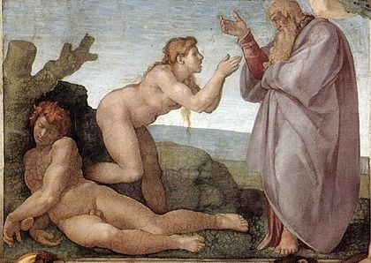
Question 5:
WHO IS THE MIDDLE FIGURE IN THIS SISTINE CHAPEL PAINTING?

Slide 8
Question 6:
WHAT IS THE CAPITAL OF OREGON?

Slide 9
Question 7:
WHAT 1994 FILM STARRED JAMES GARNER AS A LAWMAN, THOUGH HE PLAYED THE TITLE ROLE OF CARD SHARK IN THE 50'S TV SHOW OF THE SAME NAME?

Slide 10
Question 8:
WHAT CITY IS THE HOME OF HARVARD AND M.I.T.?

Slide 11
Question 9:
WHAT IS THE ONLY LAND MAMMAL THAT CAN SURVIVE ON SALT WATER IF NECESSARY?

Slide 12
Question 10:
WHAT DO ALL THESE ANSWERS HAVE IN COMMON?

Slide 13
The End
Answers will be provided shortly

Slide 14
Question 1:
"GOTO" AND "GOSUB" WERE COMMANDS IN WHAT COMPUTER LANGUAGE DEVELOPED IN 1964?
BASIC

Slide 15
Question 2:
BEFORE HE CHANGED IT TO "ONO" IN 1969, WHAT WWII-ERA FAVORITE WAS JOHN LENNON'S MIDDLE NAME?
WINSTON

Slide 16
Question 3:
IN 1653, OLIVER CROMWELL LED THE ARMED FORCE THAT OFFICIALLY DISSOLVED THE "RUMP" OF WHAT BODY?
PARLIAMENT

Slide 17
Question 4:
WHAT RHODE ISLAND CITY WAS THE LOCATION OF THE "SUMMER WHITE HOUSES" OF KENNEDY AND EISENHOWER?
NEWPORT

Slide 18
Question 5:
WHO IS THE MIDDLE FIGURE IN THIS SISTINE CHAPEL PAINTING?
EVE

Slide 19
Question 6:
WHAT IS THE CAPITAL OF OREGON?
SALEM

Slide 20
Question 7:
WHAT 1994 FILM STARRED JAMES GARNER AS A LAWMAN, THOUGH HE PLAYED THE TITLE ROLE OF CARD SHARK IN THE 50'S TV SHOW OF THE SAME NAME?
MAVERICK

Slide 21
Question 8:
WHAT CITY IS THE HOME OF HARVARD AND M.I.T.?
CAMBRIDGE

Slide 22
Question 9:
WHAT IS THE ONLY LAND MAMMAL THAT CAN SURVIVE ON SALT WATER IF NECESSARY?
CAMEL

Slide 23
Question 10:
WHAT DO ALL THESE ANSWERS HAVE IN COMMON?
BRANDS OF CIGARETTES

