Slide 1
WELCOME TO THURSDAY NIGHT TRIVIA AT THE ELUSIVE GRAPE

Slide 2
GEOGRAPHY COMMON THREAD

Slide 3
Question 1:
WHAT COUNTRY'S NAME HAS NO VOWELS IN ITS FIRST 7 LETTERS EXCEPT FOR "Y"?

Slide 4
Question 2:
WHAT COUNTRY HAS A CAPITAL THAT THEY WOULD WRITE AS HÀ NỘI?

Slide 5
Question 3:
WHAT COUNTRY CONTAINS OVER 1.4 BILLION PEOPLE?

Slide 6
Question 4:
WHAT IS THE ONLY ASIAN COUNTRY IN NATO?

Slide 7
Question 5:
THE LARGEST U.N. BUILDING IS IN NEW YORK CITY. IN WHAT TRADITIONALLY NEUTRAL COUNTRY IS THE 2ND LARGEST U.N. BUILDING LOCATED?

Slide 8
Question 6:
MARRAKESH IS LOCATED IN WHAT COUNTRY?

Slide 9
Question 7:
IN AN ALPHABETICAL LIST OF COUNTRIES, AFGHANISTAN COMES 1ST. WHAT COMES 2ND?

Slide 10
Question 8:
WHAT COUNTRY THE SIZE OF CONNECTICUT THAT USED TO BE PART OF YUGOSLAVIA IS JUST NORTHEAST OF THE ANSWER TO THE PREVIOUS QUESTION?

Slide 11
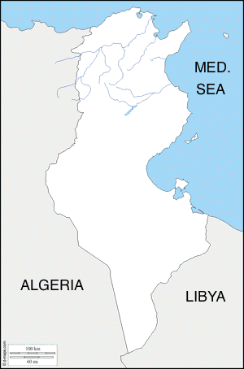
Question 9:
WHAT NORTH AFRICAN COUNTRY IS PICTURED TO THE RIGHT?

Slide 12
Question 10:
WHAT DO THE FLAGS OF THESE COUNTRIES HAVE IN COMMON?

Slide 13
The End
Answers will be provided shortly

Slide 14
Question 1:
WHAT COUNTRY'S NAME HAS NO VOWELS IN ITS FIRST 7 LETTERS EXCEPT FOR "Y"?
KYRGYSTAN

Slide 15
Question 2:
WHAT COUNTRY HAS A CAPITAL THAT THEY WOULD WRITE AS HÀ NỘI?
VIETNAM

Slide 16
Question 3:
WHAT COUNTRY CONTAINS OVER 1.4 BILLION PEOPLE?
CHINA

Slide 17
Question 4:
WHAT IS THE ONLY ASIAN COUNTRY IN NATO?
TURKEY

Slide 18
Question 5:
THE LARGEST U.N. BUILDING IS IN NEW YORK CITY. IN WHAT TRADITIONALLY NEUTRAL COUNTRY IS THE 2ND LARGEST U.N. BUILDING LOCATED?
SWITZERLAND

Slide 19
Question 6:
MARRAKESH IS LOCATED IN WHAT COUNTRY?
MOROCCO

Slide 20
Question 7:
IN AN ALPHABETICAL LIST OF COUNTRIES, AFGHANISTAN COMES 1ST. WHAT COMES 2ND?
ALBANIA

Slide 21
Question 8:
WHAT COUNTRY THE SIZE OF CONNECTICUT THAT USED TO BE PART OF YUGOSLAVIA IS JUST NORTHEAST OF THE ANSWER TO THE PREVIOUS QUESTION?
MONTENEGRO

Slide 22
Question 9:
WHAT NORTH AFRICAN COUNTRY IS PICTURED TO THE RIGHT?
TUNISIA

Slide 23
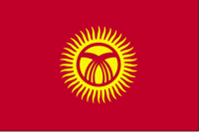
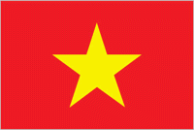
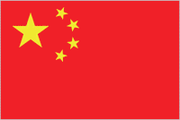
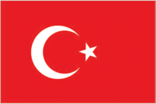

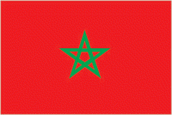

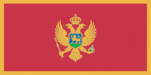

Question 10:
WHAT DO THE FLAGS OF THESE COUNTRIES HAVE IN COMMON?
THEY HAVE RED BACKGROUNDS

