Slide 1
WELCOME TO THURSDAY NIGHT TRIVIA AT THE ELUSIVE GRAPE

Slide 2
COMMON THREAD

Slide 3
Question 1:
WHAT IS THE NAME OF THE SHORTEST BEATLES SONG, ONLY 23 SECONDS LONG?

Slide 4
Question 2:
WHAT IS THE 4-LETTER TERM FOR SPIKING A VOLLEYBALL AND WINNING THE POINT?

Slide 5
Question 3:
WHAT TERM IN TENNIS MAY HAVE COME FROM THE FRENCH WORD FOR "EGG"?

Slide 6
Question 4:
UNDER WHAT NAME WAS THE VOLKSWAGEN PASSAT MARKETED IN THE U.S.?

Slide 7
Question 5:
IN WHAT BRITISH LOTTERY GAME DOES A PLAYER PICK 5 NUMBERS FROM 1-39 AND 1 NUMBER FROM 1-14?

Slide 8
Question 6:
WHAT U.S. GOVERNMENT AGENCY WAS PART OF THE TREASURY DEPT. UNTIL 2003, SINCE IT WAS FOUNDED TO COMBAT COUNTERFEITING?

Slide 9
Question 7:
WHAT COUNTRY WAS DISQUALIFIED FROM THE 2018 AND 2020 OLYMPICS DUE TO DOPING?

Slide 10
Question 8:
WHAT PRECIOUS STONE HAS THE HIGHEST THERMAL CONDUCTIVITY OF ANY NATURAL SUBSTANCE?

Slide 11
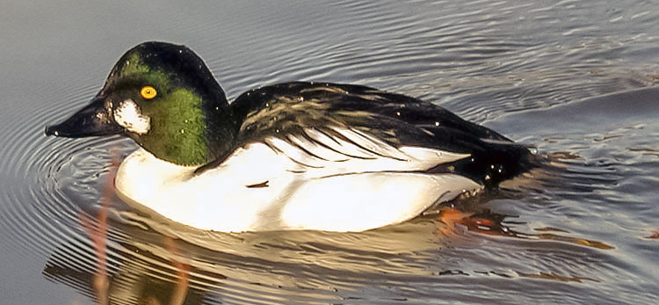
Question 9:
WHAT GENUS OF DUCK IS THIS?

Slide 12
Question 10:
WHAT DO ALL THESE ANSWERS HAVE IN COMMON?

Slide 13
The End
Answers will be provided shortly

Slide 14
Question 1:
WHAT IS THE NAME OF THE SHORTEST BEATLES SONG, ONLY 23 SECONDS LONG?
HER MAJESTY

Slide 15
Question 2:
WHAT IS THE 4-LETTER TERM FOR SPIKING A VOLLEYBALL AND WINNING THE POINT?
KILL

Slide 16
Question 3:
WHAT TERM IN TENNIS MAY HAVE COME FROM THE FRENCH WORD FOR "EGG"?
LOVE

Slide 17
Question 4:
UNDER WHAT NAME WAS THE VOLKSWAGEN PASSAT MARKETED IN THE U.S.?
QUANTUM

Slide 18
Question 5:
IN WHAT BRITISH LOTTERY GAME DOES A PLAYER PICK 5 NUMBERS FROM 1-39 AND 1 NUMBER FROM 1-14?
THUNDERBALL

Slide 19
Question 6:
WHAT U.S. GOVERNMENT AGENCY WAS PART OF THE TREASURY DEPT. UNTIL 2003, SINCE IT WAS FOUNDED TO COMBAT COUNTERFEITING?
SECRET SERVICE

Slide 20
Question 7:
WHAT COUNTRY WAS DISQUALIFIED FROM THE 2018 AND 2020 OLYMPICS DUE TO DOPING?
RUSSIA

Slide 21
Question 8:
WHAT PRECIOUS STONE HAS THE HIGHEST THERMAL CONDUCTIVITY OF ANY NATURAL SUBSTANCE?
DIAMONDS

Slide 22
Question 9:
WHAT GENUS OF DUCK IS THIS?
GOLDENEYE

Slide 23
Question 10:
WHAT DO ALL THESE ANSWERS HAVE IN COMMON?
WORDS IN TITLES OF JAMES BOND FILMS

