Slide 1
COMMON THREAD

Slide 2
Question 1:
WHAT BOY BAND WAS JUSTIN TIMBERLAKE A MEMBER OF?

Slide 3
Question 2:
WHAT COMIC DETECTIVE TV SHOW STARRED JAMES RODAY, DULÉ HILL, AND CORBIN BERNSEN?

Slide 4
Question 3:
IN GREEK MYTHOLOGY, WHAT RIVER SEPARATES THE EARTH FROM THE UNDERWORLD?

Slide 5
Question 4:
WHAT IS THE NAME OF THE ORLANDO-AREA BUS SYSTEM?

Slide 6
Question 5:
WHAT FRAGRANT GUM RESIN WAS ONE OF THE GIFTS OF THE MAGI?

Slide 7
Question 6:
WHAT IS THE ASTRONOMICAL TERM FOR AN ALIGNMENT OF 3 CELESTIAL OBJECTS (SUCH AS THE SUN, EARTH, AND ANOTHER PLANET)?

Slide 8
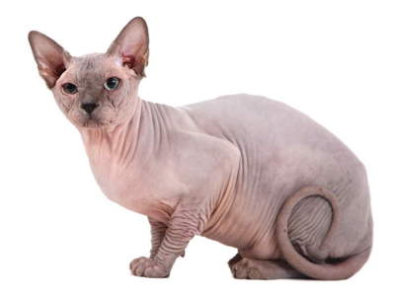
Question 7:
WHAT BREED OF CAT IS THIS?

Slide 9
Question 8:
DRYADS, MERMAIDS, MUSES, SIRENS, AND PLEIADES ARE ALL EXAMPLES OF WHAT?

Slide 10
Question 9:
WHAT BAND SANG "SWEET HOME ALABAMA"?

Slide 11
Question 10:
WHAT DO ALL THESE ANSWERS HAVE IN COMMON?

Slide 12
The End
Answers will be provided shortly

Slide 13
Question 1:
WHAT BOY BAND WAS JUSTIN TIMBERLAKE A MEMBER OF?
NSYNC

Slide 14
Question 2:
WHAT COMIC DETECTIVE TV SHOW STARRED JAMES RODAY, DULÉ HILL, AND CORBIN BERNSEN?
PSYCH

Slide 15
Question 3:
IN GREEK MYTHOLOGY, WHAT RIVER SEPARATES THE EARTH FROM THE UNDERWORLD?
STYX

Slide 16
Question 4:
WHAT IS THE NAME OF THE ORLANDO-AREA BUS SYSTEM?
LYNX

Slide 17
Question 5:
WHAT FRAGRANT GUM RESIN WAS ONE OF THE GIFTS OF THE MAGI?
MYRRH

Slide 18
Question 6:
WHAT IS THE ASTRONOMICAL TERM FOR AN ALIGNMENT OF 3 CELESTIAL OBJECTS (SUCH AS THE SUN, EARTH, AND ANOTHER PLANET)?
SYZYGY

Slide 19
Question 7:
WHAT BREED OF CAT IS THIS?
SPHYNX

Slide 20
Question 8:
DRYADS, MERMAIDS, MUSES, SIRENS, AND PLEIADES ARE ALL EXAMPLES OF WHAT?
NYMPHS

Slide 21
Question 9:
WHAT BAND SANG "SWEET HOME ALABAMA"?
LYNYRD SKYNYRD

Slide 22
Question 10:
WHAT DO ALL THESE ANSWERS HAVE IN COMMON?
THE ONLY VOWEL THEY CONTAIN IS "Y"

