Slide 1
COMMON THREAD

Slide 2
Question 1:
IN WHAT FILM DID JULIA ROBERTS PLAY TINKERBELL?

Slide 3
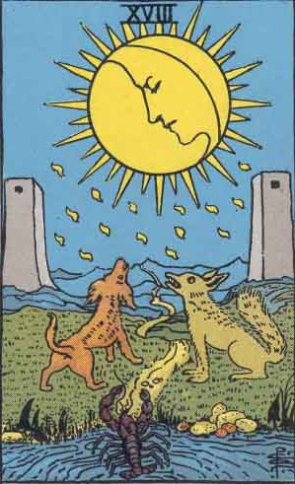
Question 2:
WHAT IS THE NAME OF THIS TAROT CARD?

Slide 4
Question 3:
WHAT IS THE NAME OF THE OLDEST CHILD IN THE COMIC STRIP "HI AND LOIS"?

Slide 5
Question 4:
ACCORDING TO SHAKESPEARE'S "MACBETH", WHAT "IS SUCH SWEET SORROW"?

Slide 6
Question 5:
WHAT TOM HANKS FILM FEATURED A FOOT-OPERATED "WALKING PIANO"?

Slide 7
Question 6:
LIKE VULCANS ON "STAR TREK", MANY LEECHES AND SKINKS HAVE GREEN WHAT?

Slide 8
Question 7:
WHICH ONE OF THE RICE KRISPIES CARTOON MASCOTS WEARS A CHEF'S HAT?

Slide 9
Question 8:
WHERE ARE THE 3 SMALLEST BONES IN THE HUMAN BODY LOCATED?

Slide 10
Question 9:
ACCORDING TO 1 SAMUEL 17, GOLIATH WAS ARMED WITH ARMOR AND JAVELIN, BUT DAVID ONLY HAD A STAFF AND WHAT?

Slide 11
Question 10:
WHAT DO ALL THESE ANSWERS HAVE IN COMMON?

Slide 12
The End
Answers will be provided shortly

Slide 13
Question 1:
IN WHAT FILM DID JULIA ROBERTS PLAY TINKERBELL?
HOOK

Slide 14
Question 2:
WHAT IS THE NAME OF THIS TAROT CARD?
MOON

Slide 15
Question 3:
WHAT IS THE NAME OF THE OLDEST CHILD IN THE COMIC STRIP "HI AND LOIS"?
CHIP

Slide 16
Question 4:
ACCORDING TO SHAKESPEARE'S "MACBETH", WHAT "IS SUCH SWEET SORROW"?
PARTING

Slide 17
Question 5:
WHAT TOM HANKS FILM FEATURED A FOOT-OPERATED "WALKING PIANO"?
BIG

Slide 18
Question 6:
LIKE VULCANS ON "STAR TREK", MANY LEECHES AND SKINKS HAVE GREEN WHAT?
BLOOD

Slide 19
Question 7:
WHICH ONE OF THE RICE KRISPIES CARTOON MASCOTS WEARS A CHEF'S HAT?
SNAP

Slide 20
Question 8:
WHERE ARE THE 3 SMALLEST BONES IN THE HUMAN BODY LOCATED?
EAR

Slide 21
Question 9:
ACCORDING TO 1 SAMUEL 17, GOLIATH WAS ARMED WITH ARMOR AND JAVELIN, BUT DAVID ONLY HAD A STAFF AND WHAT?
SLING

Slide 22
Question 10:
WHAT DO ALL THESE ANSWERS HAVE IN COMMON?
CAN BE FOLLOWED BY "SHOT"

