Slide 1
WELCOME TO THURSDAY NIGHT TRIVIA AT THE ELUSIVE GRAPE

Slide 2
COMMON THREAD

Slide 3

Question 1:
WHAT FLEETWOOD MAC DOUBLE ALBUM HAD THIS COVER?

Slide 4
Question 2:
WHAT PRESIDENT QUIPPED "IF ONE MORNING I WALKED ... ACROSS THE POTOMAC RIVER, THE HEADLINE THAT AFTERNOON WOULD READ: 'PRESIDENT CAN'T SWIM' "?

Slide 5
Question 3:
WHAT ARE SQUARE, REEF, PRUSIK, AND CLOVE HITCH?

Slide 6
Question 4:
WHAT FRUIT IS ALSO A TYPE OF SHARK?

Slide 7
Question 5:
WHAT CHESS PIECE CAN MOVE ONE SQUARE IN ANY DIRECTION?

Slide 8
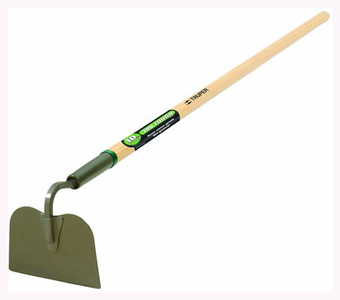
Question 6:
WHAT IS THIS TOOL?

Slide 9
Question 7:
WHAT IS THE NAME OF THE 4-YEAR COLLEGE IN WACO, TX?

Slide 10
Question 8:
WHEN REFERRING TO THE BRITISH POUND IN A CONTEXT WHERE IT MIGHT BE CONFUSED WITH ANOTHER CURRENCY, WHAT WORD IS APPENDED?

Slide 11
Question 9:
IN BRIDGE, WHAT NAME IS GIVEN TO THE SUIT WHICH OUTRANKS OTHERS FOR THAT HAND?

Slide 12
Question 10:
WHAT DO ALL THESE ANSWERS HAVE IN COMMON?

Slide 13
The End
Answers will be provided shortly

Slide 14
Question 1:
WHAT FLEETWOOD MAC DOUBLE ALBUM HAD THIS COVER?
TUSK

Slide 15
Question 2:
WHAT PRESIDENT QUIPPED "IF ONE MORNING I WALKED ... ACROSS THE POTOMAC RIVER, THE HEADLINE THAT AFTERNOON WOULD READ: 'PRESIDENT CAN'T SWIM' "?
JOHNSON

Slide 16
Question 3:
WHAT ARE SQUARE, REEF, PRUSIK, AND CLOVE HITCH?
KNOTS

Slide 17
Question 4:
WHAT FRUIT IS ALSO A TYPE OF SHARK?
LEMON

Slide 18
Question 5:
WHAT CHESS PIECE CAN MOVE ONE SQUARE IN ANY DIRECTION?
KING

Slide 19
Question 6:
WHAT IS THIS TOOL?
HOE

Slide 20
Question 7:
WHAT IS THE NAME OF THE 4-YEAR COLLEGE IN WACO, TX?
BAYLOR

Slide 21
Question 8:
WHEN REFERRING TO THE BRITISH POUND IN A CONTEXT WHERE IT MIGHT BE CONFUSED WITH ANOTHER CURRENCY, WHAT WORD IS APPENDED?
STERLING

Slide 22
Question 9:
IN BRIDGE, WHAT NAME IS GIVEN TO THE SUIT WHICH OUTRANKS OTHERS FOR THAT HAND?
TRUMP

Slide 23
Question 10:
WHAT DO ALL THESE ANSWERS HAVE IN COMMON?
LAST NAMES OF PEOPLE NAMED DON OR DONALD

