Slide 1
WELCOME TO THURSDAY NIGHT TRIVIA AT THE ELUSIVE GRAPE
ALL COMMON THREADS TONIGHT!

Slide 2
COMMON THREAD: WHAT CRIME-FIGHTING TV SHOWS HAD THESE CASTS?

Slide 3
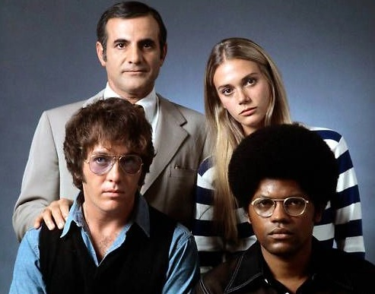
Question 1:

Slide 4
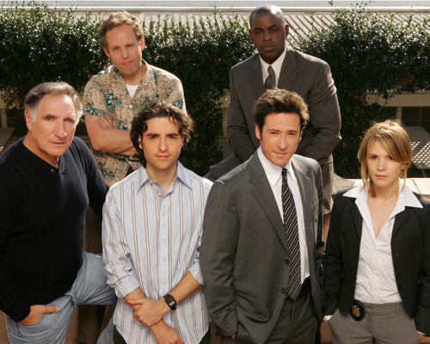
Question 2:

Slide 5

Question 3:

Slide 6
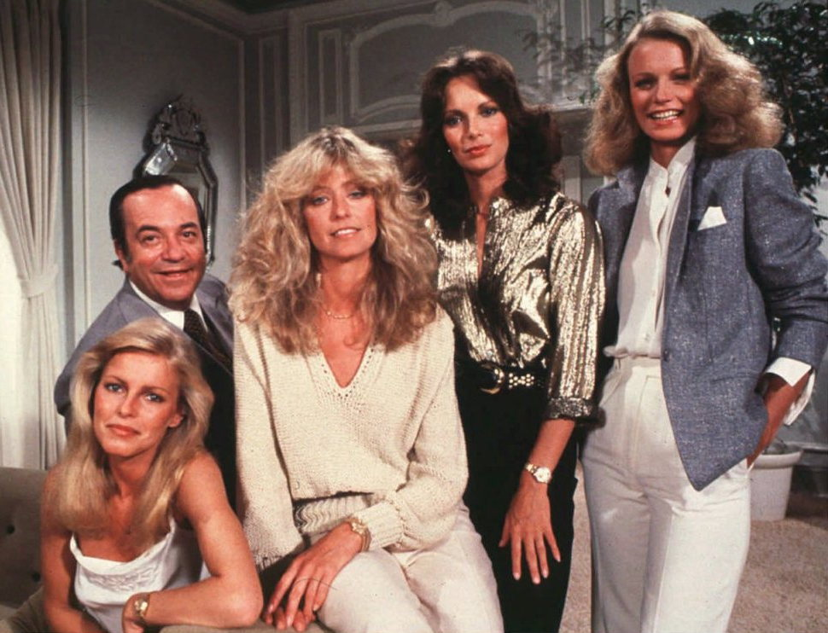
Question 4:

Slide 7
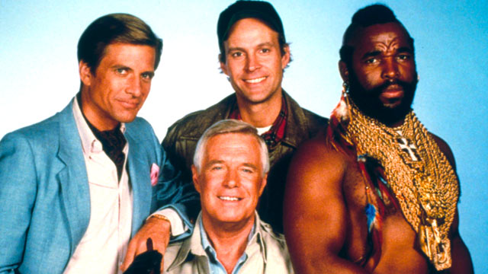
Question 5:

Slide 8
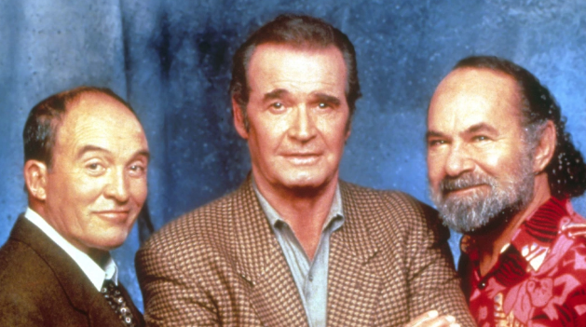
Question 6:

Slide 9
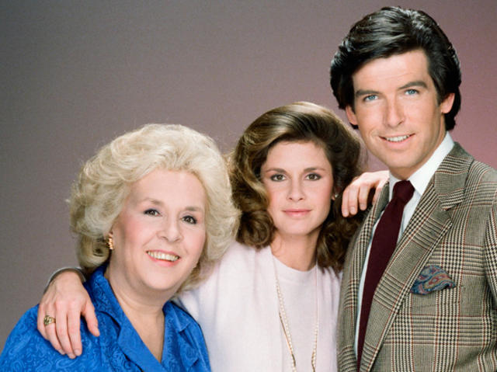
Question 7:

Slide 10
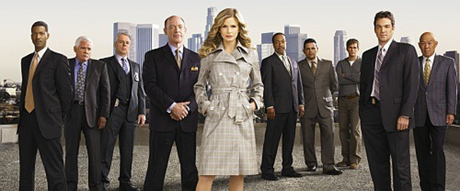
Question 8:

Slide 11
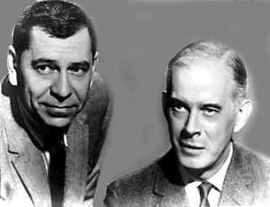
Question 9:

Slide 12
Question 10:
WHAT DO ALL THESE TV SHOWS HAVE IN COMMON?

Slide 13
The End
Answers will be provided shortly

Slide 14
Question 1:
THE MOD SQUAD

Slide 15
Question 2:
NUMB3RS

Slide 16
Question 3:
S.W.A.T.

Slide 17
Question 4:
CHARLIE'S ANGELS

Slide 18
Question 5:
THE A–TEAM

Slide 19
Question 6:
THE ROCKFORD FILES

Slide 20
Question 7:
REMINGTON STEELE

Slide 21
Question 8:
THE CLOSER

Slide 22
Question 9:
DRAGNET

Slide 23
Question 10:
WHAT DO ALL THESE TV SHOWS HAVE IN COMMON?
SET IN LOS ANGELES

