Slide 1
IDENTIFY THESE ACTORS AND ACTRESSES WHEN THEY WERE YOUNGER

Slide 2
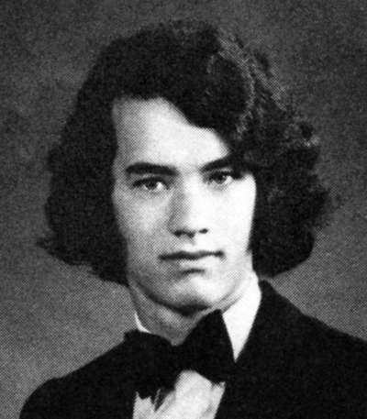
Question 1:

Slide 3
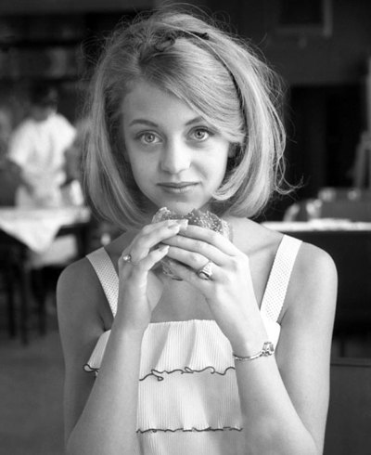
Question 2:

Slide 4
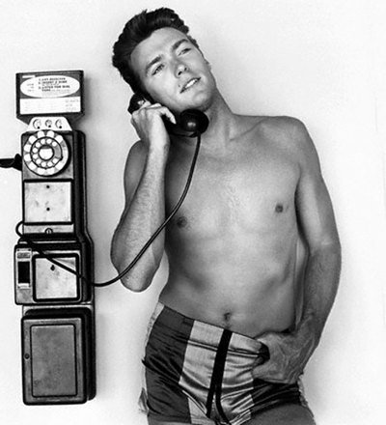
Question 3:

Slide 5
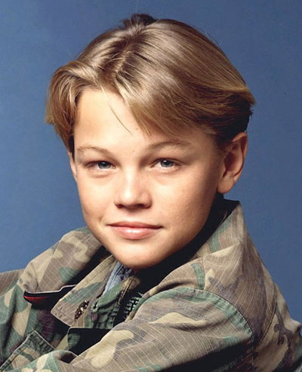
Question 4:

Slide 6
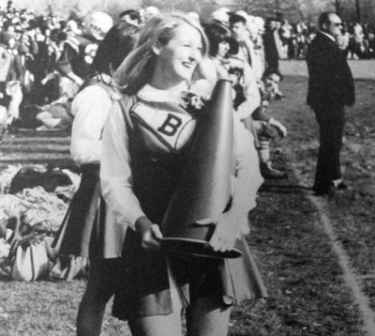
Question 5:

Slide 7
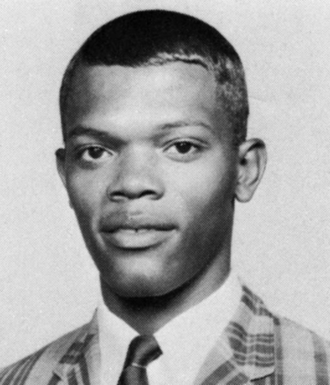
Question 6:

Slide 8
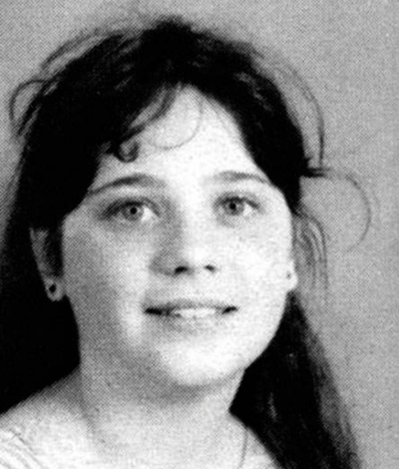
Question 7:

Slide 9
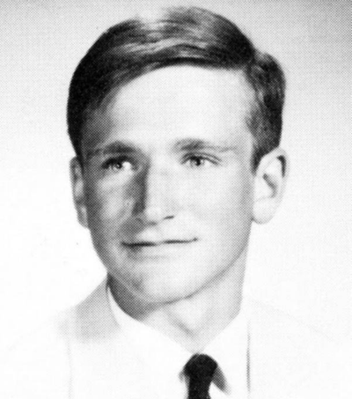
Question 8:

Slide 10
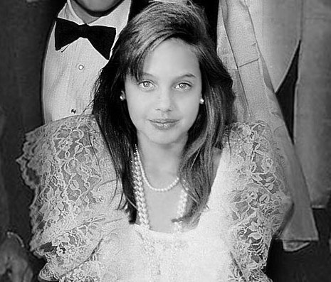
Question 9:

Slide 11
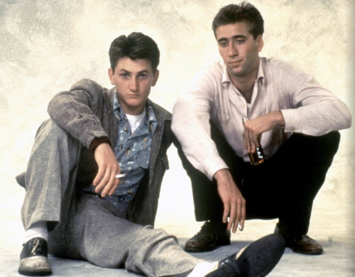
Question 10:

Slide 12
The End
Answers will be provided shortly

Slide 13
Question 1:
TOM HANKS

Slide 14
Question 2:
GOLDIE HAWN

Slide 15
Question 3:
CLINT EASTWOOD

Slide 16
Question 4:
LEONARDO DICAPRIO

Slide 17
Question 5:
MERYL STREEP

Slide 18
Question 6:
SAMUEL L. JACKSON

Slide 19
Question 7:
ZOOEY DESCHANEL

Slide 20
Question 8:
ROBIN WILLIAMS

Slide 21
Question 9:
ANGELINA JOLIE

Slide 22
Question 10:
SEAN PENN & NICHOLAS CAGE (ONE POINT FOR EACH)

