Slide 1
IN WHAT COUNTRIES CAN THESE FAMOUS FOUNTAINS BE FOUND?

Slide 2
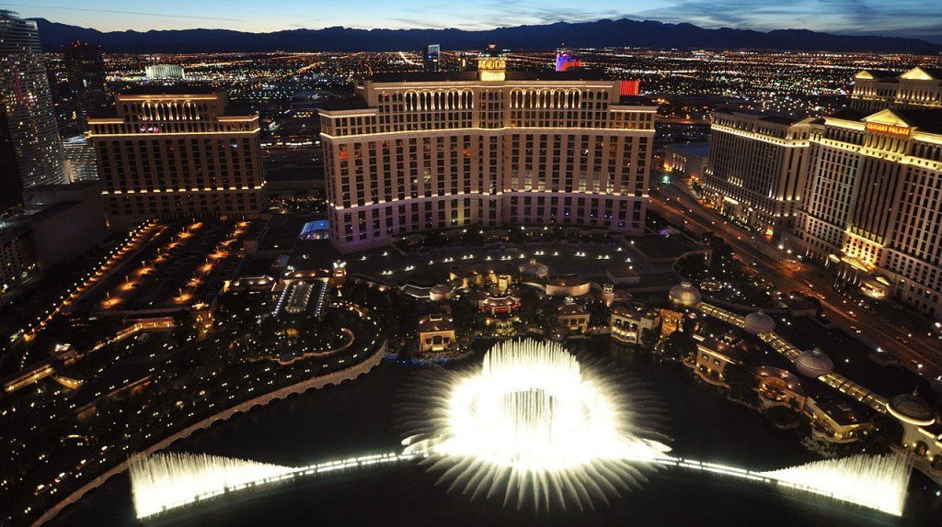
Question 1:
BELLAGIO FOUNTAIN?

Slide 3
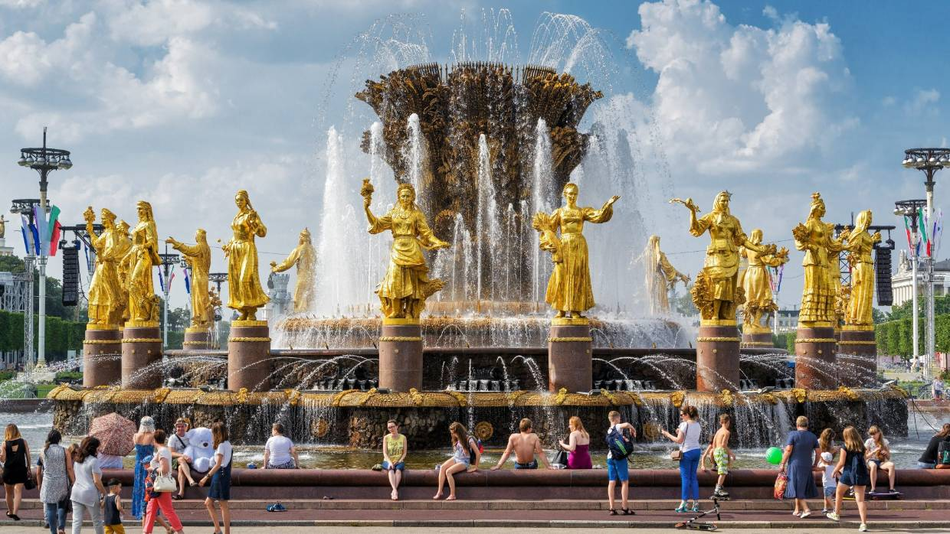
Question 2:
PEOPLE'S FRIENDSHIP FOUNTAIN?

Slide 4
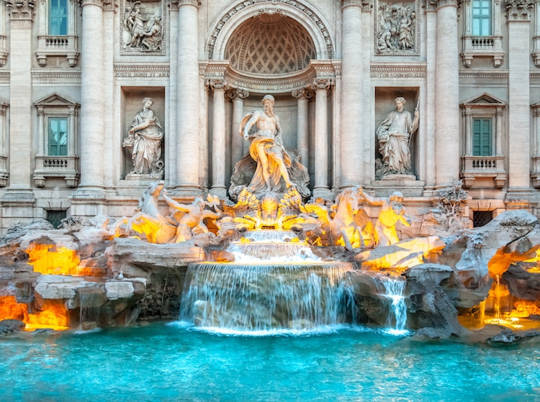
Question 3:
TREVI FOUNTAIN?

Slide 5
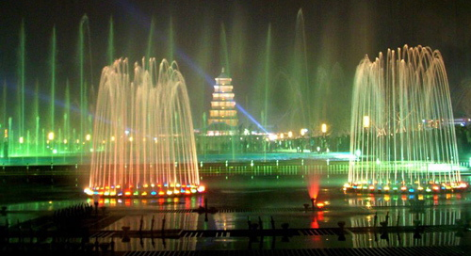
Question 4:
BIG WILD GOOSE PAGODA FOUNTAIN?

Slide 6
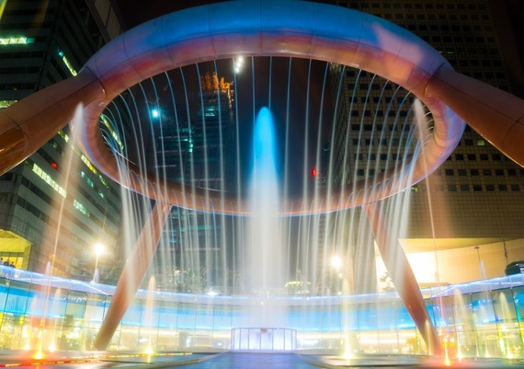
Question 5:
FOUNTAIN OF WEALTH?

Slide 7
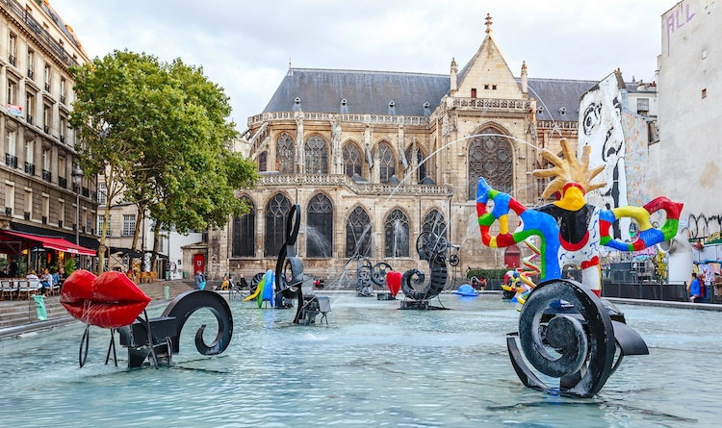
Question 6:
STRAVINSKY FOUNTAIN?

Slide 8
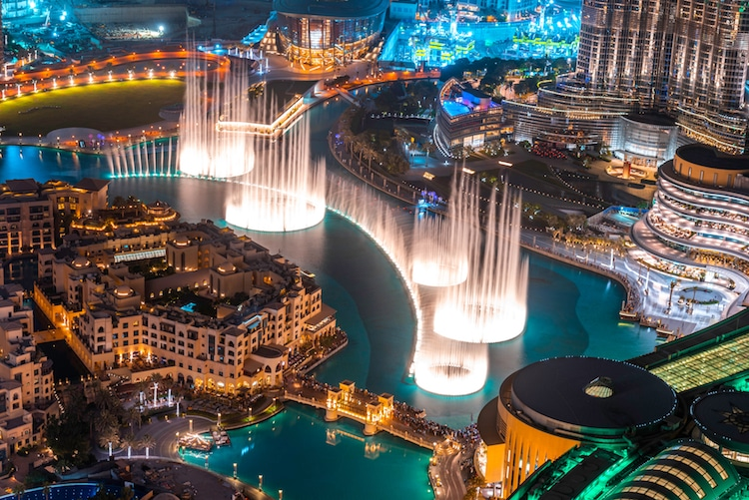
Question 7:
BURJ KHALIFA FOUNTAIN?

Slide 9
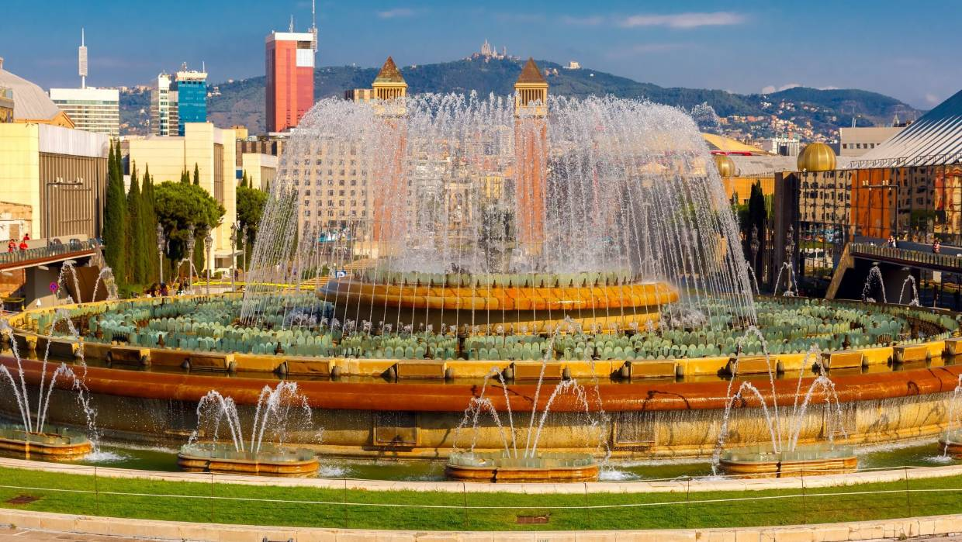
Question 8:
MAGIC FOUNTAIN OF MONTJUIC?

Slide 10
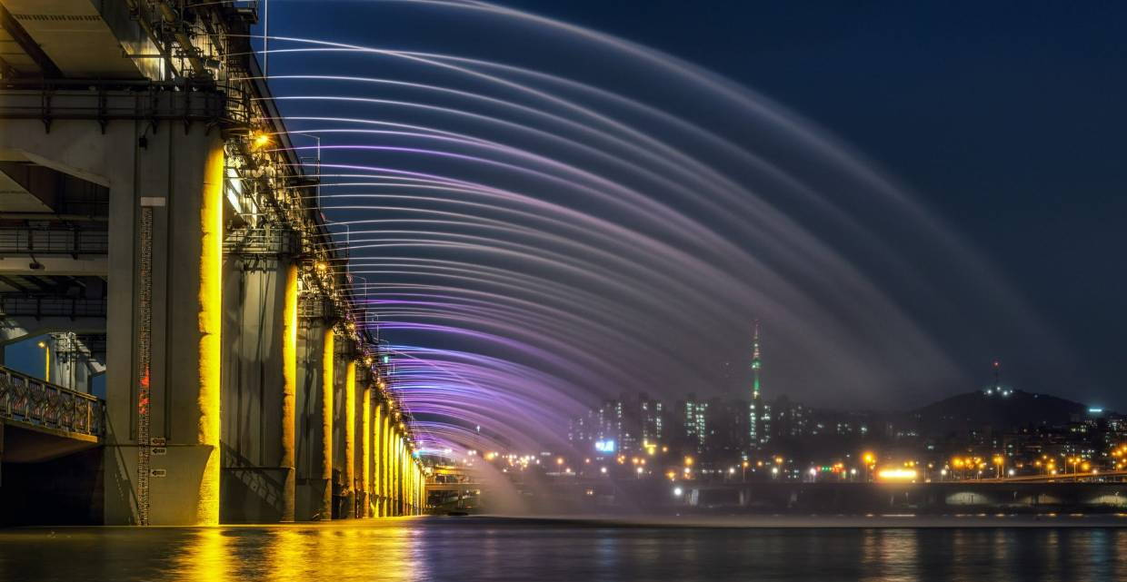
Question 9:
BANPO BRIDGE RAINBOW FOUNTAIN?

Slide 11
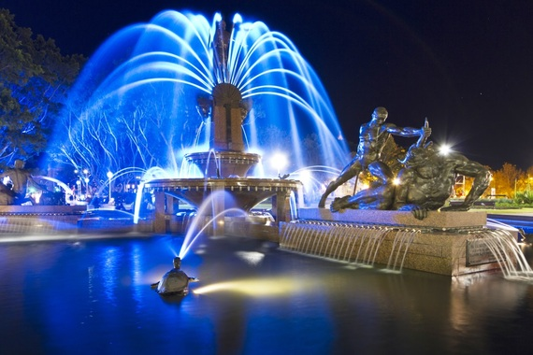
Question 10:
ARCHIBALD FOUNTAIN?

Slide 12
The End
Answers will be provided shortly

Slide 13
Question 1:
BELLAGIO FOUNTAIN?
USA (LAS VEGAS)

Slide 14
Question 2:
PEOPLE'S FRIENDSHIP FOUNTAIN?
RUSSIA (MOSCOW)

Slide 15
Question 3:
TREVI FOUNTAIN?
ITALY (ROME)

Slide 16
Question 4:
BIG WILD GOOSE PAGODA FOUNTAIN?
CHINA (XIAN)

Slide 17
Question 5:
FOUNTAIN OF WEALTH?
SINGAPORE

Slide 18
Question 6:
STRAVINSKY FOUNTAIN?
FRANCE (PARIS)

Slide 19
Question 7:
BURJ KHALIFA FOUNTAIN?
UAE (DUBAI)

Slide 20
Question 8:
MAGIC FOUNTAIN OF MONTJUIC?
SPAIN (BARCELONA)

Slide 21
Question 9:
BANPO BRIDGE RAINBOW FOUNTAIN?
SOUTH KOREA (SEOUL)

Slide 22
Question 10:
ARCHIBALD FOUNTAIN?
AUSTRALIA (SYDNEY)

