Slide 1
WHAT DO THE FLAGS OF THESE SETS OF COUNTRIES HAVE IN COMMON?

Slide 2
Question 1:
WHAT DO THE FLAGS OF SYRIA, PANAMA, CURACAO, SAINT KITTS AND NEVIS, AND SAO TOME AND PRINCIPE HAVE IN COMMON?

Slide 3
Question 2:
WHAT DO THE FLAGS OF SWITZERLAND, NEPAL, AND VATICAN CITY HAVE IN COMMON?

Slide 4
Question 3:
WHAT DO THE FLAGS OF ALGERIA, PAKISTAN, MALAYSIA, TURKEY, LIBYA, AND TUNISIA HAVE IN COMMON?

Slide 5
Question 4:
WHAT DO THE FLAGS OF BAHRAIN, KIRIBATI, AND QATAR HAVE IN COMMON?

Slide 6
Question 5:
WHAT DO THE FLAGS OF FINLAND, ISRAEL, GREECE, HONDURAS, MICRONESIA, AND SOMALIA HAVE IN COMMON?

Slide 7
Question 6:
WHAT DO THE FLAGS OF ICELAND, TONGA, AND GEORGIA HAVE IN COMMON?

Slide 8
Question 7:
WHAT DO THE FLAGS OF JAPAN, JAMAICA, ISRAEL, LAOS, PERU, AND MICRONESIA HAVE IN COMMON?

Slide 9
Question 8:
WHAT DO THE FLAGS OF DOMINICA, KAZAKHSTAN, PAPUA NEW GUINEA, UGANDA, AND ALBANIA HAVE IN COMMON?

Slide 10
Question 9:
WHAT DO THE FLAGS OF IRELAND, SENEGAL, ITALY, NIGERIA, AND SRI LANKA HAVE IN COMMON?

Slide 11
Question 10:
WHAT DO THE FLAGS OF KIRIBATI, MALAWI, AND ANTIGUA AND BARBUDA HAVE IN COMMON?

Slide 12
The End
Answers will be provided shortly

Slide 13
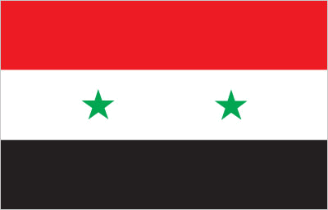
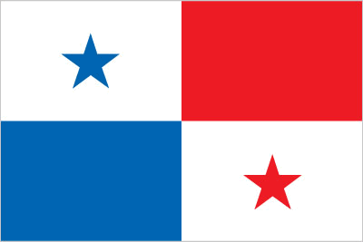
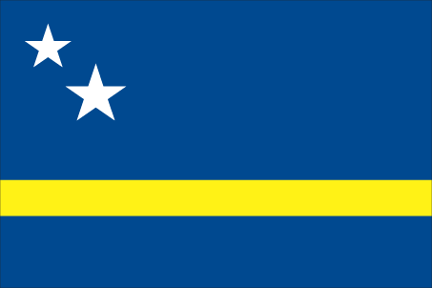
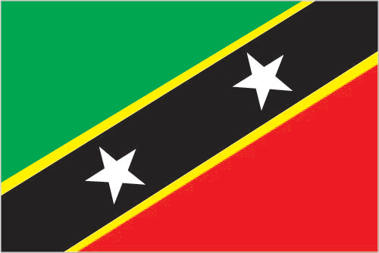
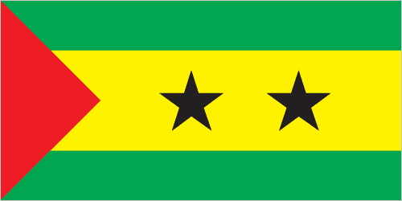
Question 1:
SYRIA, PANAMA, CURACAO, SAINT KITTS AND NEVIS, AND SAO TOME AND PRINCIPE?
CONTAIN EXACTLY 2 STARS

Slide 14

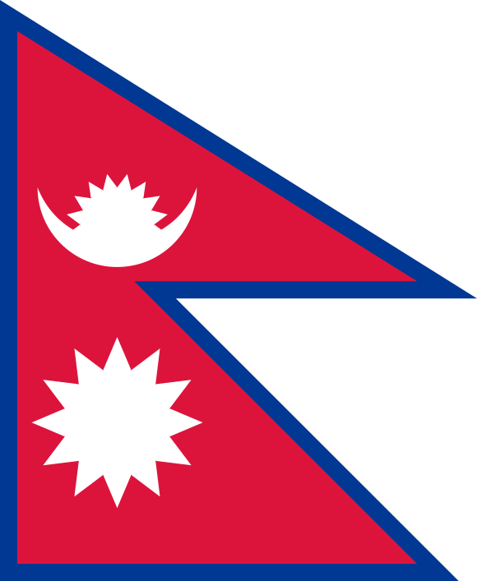
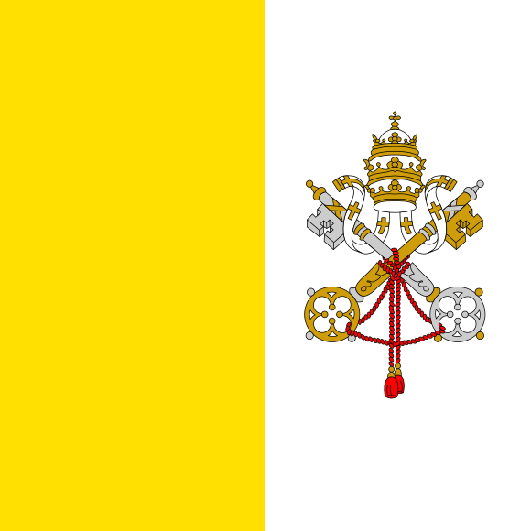
Question 2:
SWITZERLAND, NEPAL, AND VATICAN CITY?
NOT LONG RECTANGLES

Slide 15
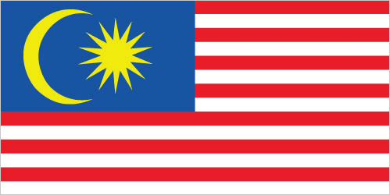
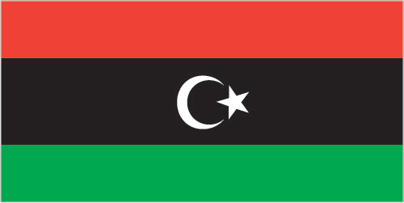
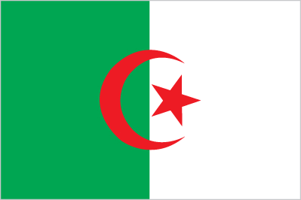
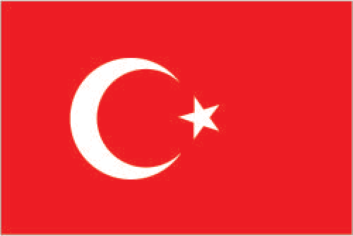

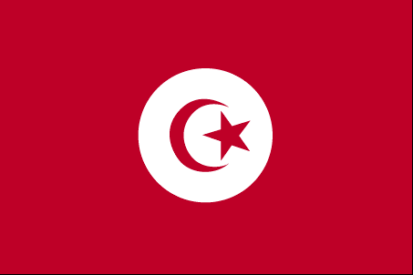
Question 3:
ALGERIA, PAKISTAN, MALAYSIA, TURKEY, LIBYA, AND TUNISIA?
CONTAIN CRESCENT MOON & STAR

Slide 16

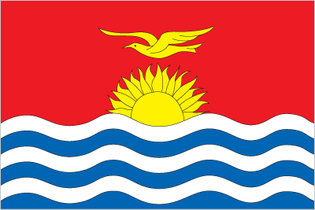

Question 4:
BAHRAIN, KIRIBATI, AND QATAR?
CONTAIN ZIGZAGS

Slide 17
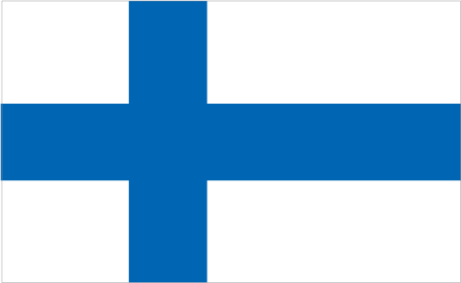
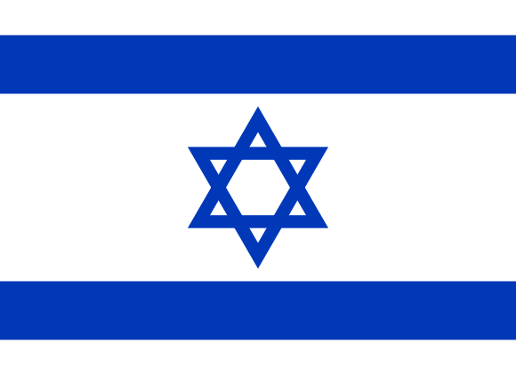
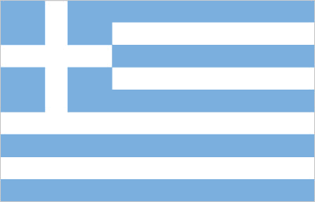
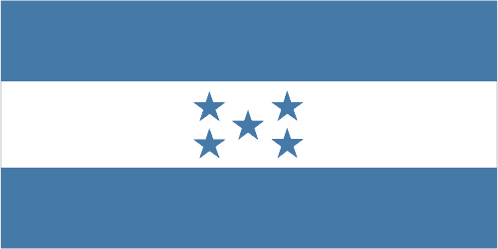
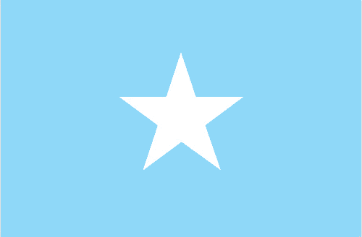
Question 5:
FINLAND, ISRAEL, GREECE, HONDURAS, AND SOMALIA?
ENTIRELY BLUE & WHITE

Slide 18
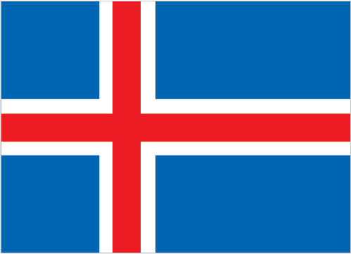
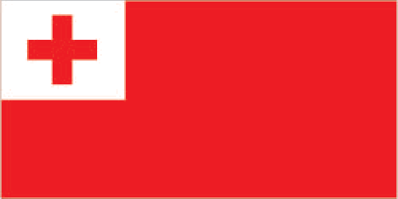
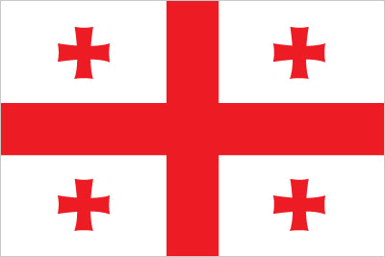
Question 6:
ICELAND, TONGA, AND GEORGIA?
CONTAIN RED CROSSES

Slide 19
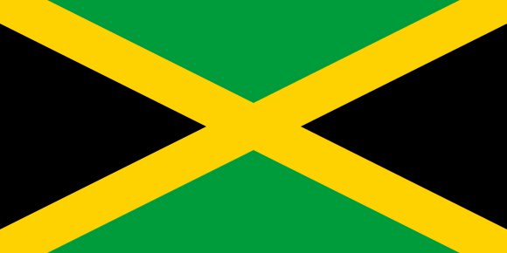
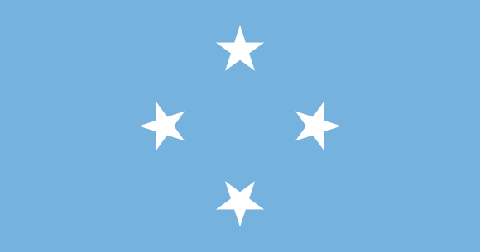
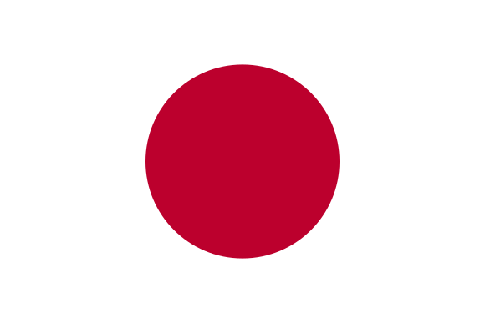
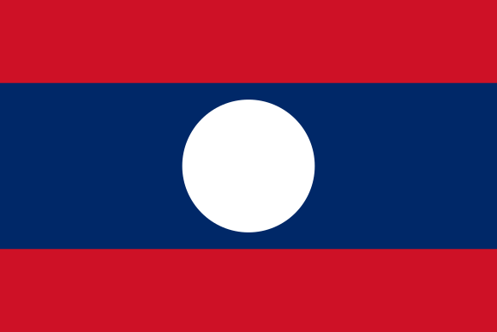
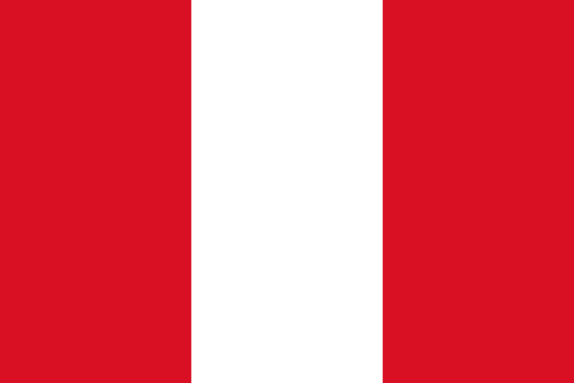
Question 7:
JAPAN, JAMAICA, ISRAEL, LAOS, PERU, AND MICRONESIA?
HAVE BOTH VERTICAL & HORIZONTAL SYMMETRY

Slide 20
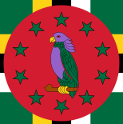
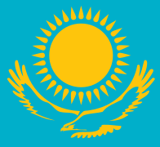
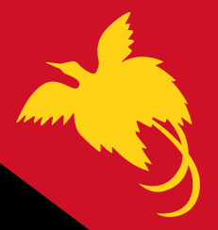
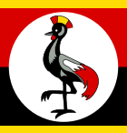
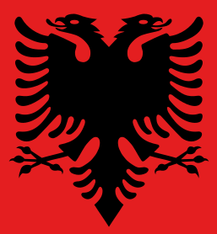
Question 8:
DOMINICA, KAZAKHSTAN, PAPUA NEW GUINEA, UGANDA, AND ALBANIA?
CONTAIN BIRDS

Slide 21
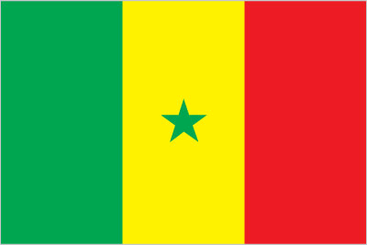
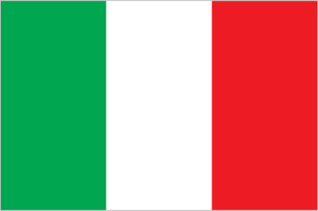
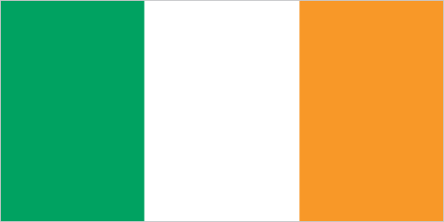
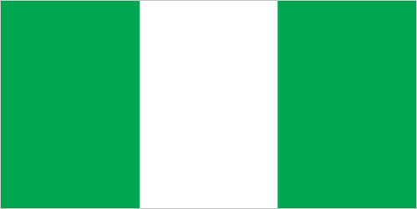
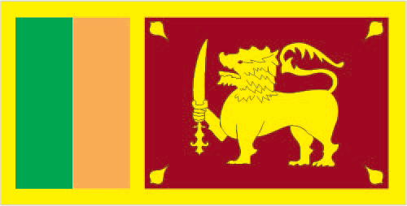
Question 9:
IRELAND, SENEGAL, ITALY, NIGERIA, AND SRI LANKA?
CONTAIN VERTICAL GREEN STRIPE

Slide 22
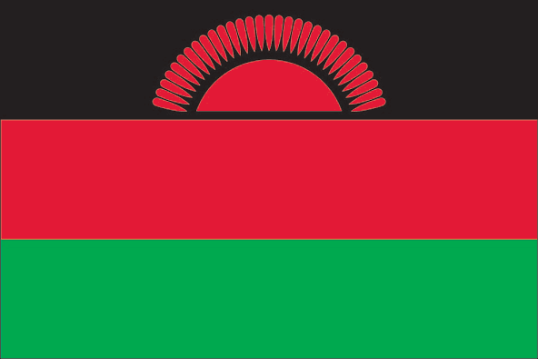
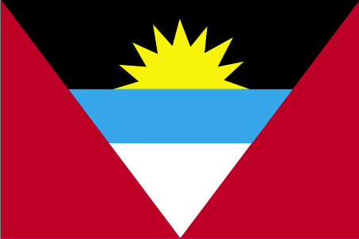
Question 10:
KIRIBATI, MALAWI, AND ANTIGUA AND BARBUDA?
CONTAIN A RISING SUN

