Slide 1
IDENTIFY THESE FAMOUS CRIMINALS

Slide 2
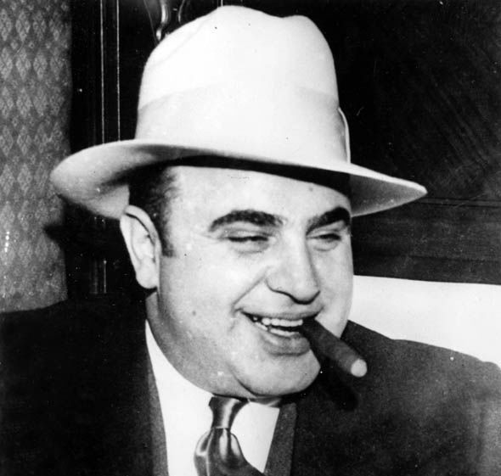
Question 1:

Slide 3
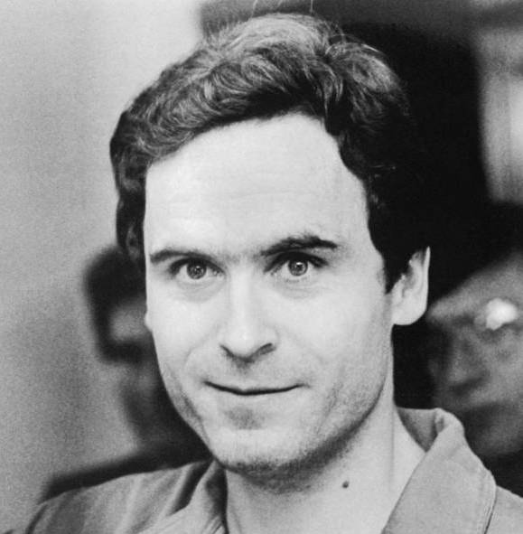
Question 2:

Slide 4
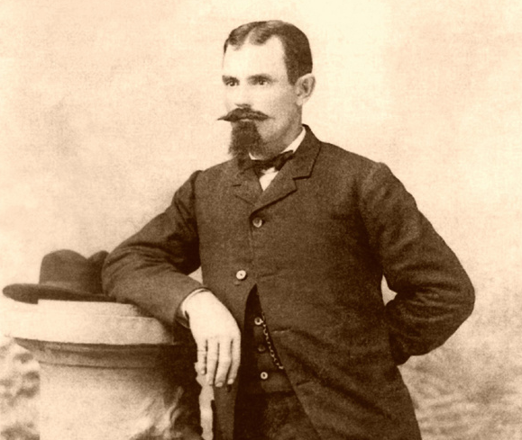
Question 3:

Slide 5
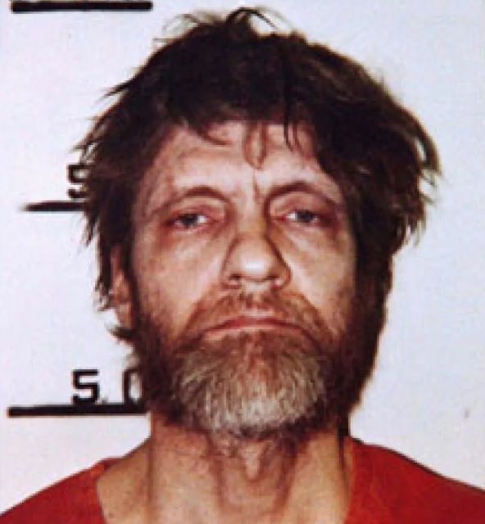
Question 4:

Slide 6
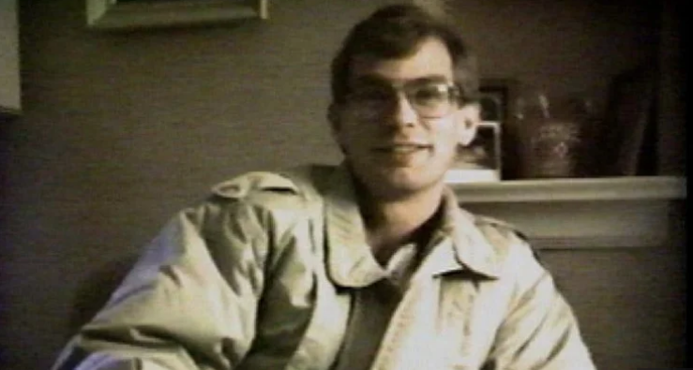
Question 5:

Slide 7
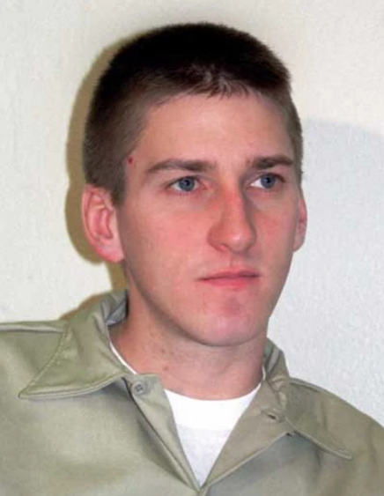
Question 6:

Slide 8
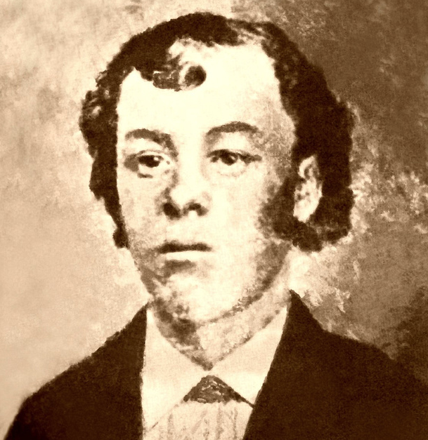
Question 7:

Slide 9
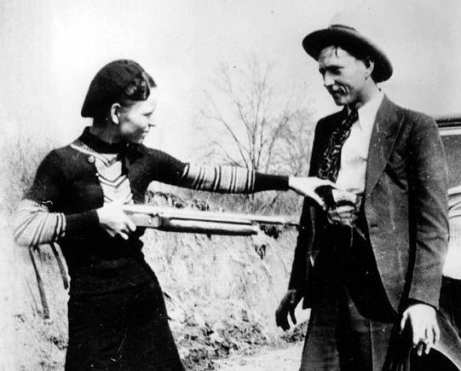
Question 8:

Slide 10
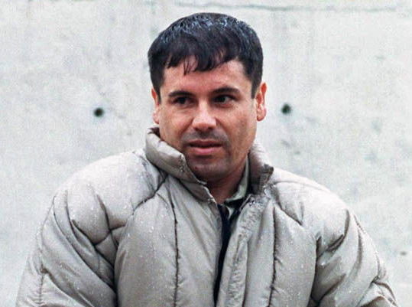
Question 9:

Slide 11
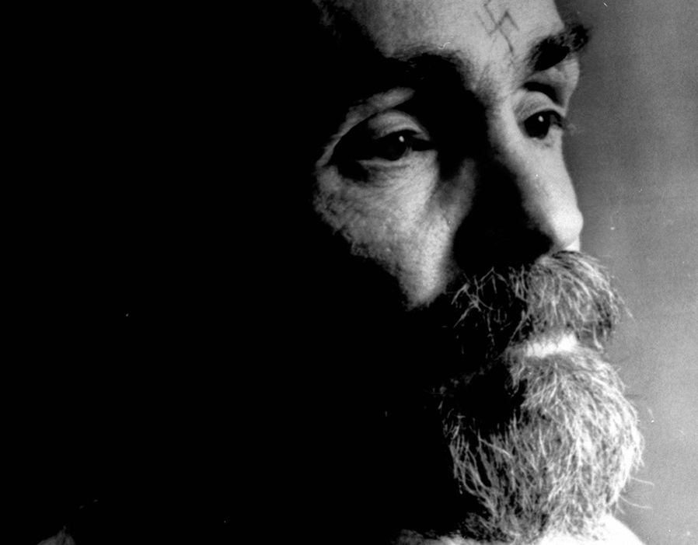
Question 10:

Slide 12
The End
Answers will be provided shortly

Slide 13
Question 1:
AL CAPONE

Slide 14
Question 2:
TED BUNDY

Slide 15
Question 3:
JESSE JAMES

Slide 16
Question 4:
TED KACZYNSKI (THE UNABOMBER)

Slide 17
Question 5:
JEFFREY DAHMER

Slide 18
Question 6:
TIMOTHY MCVEIGH

Slide 19
Question 7:
WILLIAM BONNEY (BILLY THE KID)

Slide 20
Question 8:
BONNIE (PARKER) & CLYDE (BARROW)

Slide 21
Question 9:
JOAQUIN GUZMAN LOERA (EL CHAPO)

Slide 22
Question 10:
CHARLES MANSON

