Slide 1
COMMON THREAD

Slide 2
Question 1:
  WHAT INSULT COMIC VOICED MR. POTATO HEAD IN THE "TOY STORY" FRANCHISE?

Slide 3
Question 2:
WHO PLAYED FLOWER CHILD JULIE BARNES IN TV'S "THE MOD SQUAD"?

Slide 4
Question 3:
WHAT CINCINNATI REDS PLAYER / MANAGER WAS BANNED FROM BASEBALL FOR GAMBLING?

Slide 5
Question 4:
WHICH FIRST LADY WAS THE FIRST TO ANNOUNCE SHE HAD A LONG-RUNNING BATTLE WITH ADDICTION?

Slide 6
Question 5:
WHAT HEROINE OF FRANCE WAS NICKNAMED "THE MAID OF ORLÉANS"?

Slide 7
Question 6:
WHAT MALE TENNIS PLAYER HAS WON THE MOST MAJOR TITLES?

Slide 8
Question 7:
WHO DIRECTED THE DOCUMENTARIES "THE CIVIL WAR", "BASEBALL", AND "PROHIBITION"?

Slide 9
Question 8:
WHAT ILLUSIONIST BORN EHRICH WEISS WAS NOTED FOR HIS SENSATIONAL ESCAPE ACTS AND DEBUNKING FAKE SPIRITUALISTS?

Slide 10
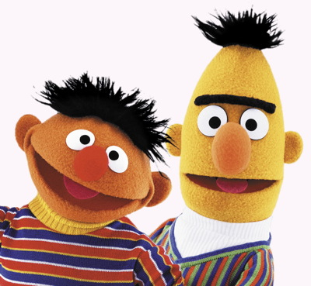
Question 9:
WHAT IS THE NAME OF THE TALLER OF THESE 2 MUPPETS?

Slide 11
Question 10:
WHAT DO ALL THESE ANSWERS HAVE IN COMMON?

Slide 12
ANSWERS WILL BE PROVIDED SHORTLY

Slide 13
Question 1:
  WHAT INSULT COMIC VOICED MR. POTATO HEAD IN THE "TOY STORY" FRANCHISE?
DON RICKLES

Slide 14
Question 2:
WHO PLAYED FLOWER CHILD JULIE BARNES IN TV'S "THE MOD SQUAD"?
PEGGY LIPTON

Slide 15
Question 3:
WHAT CINCINNATI REDS PLAYER / MANAGER WAS BANNED FROM BASEBALL FOR GAMBLING?
PETE ROSE

Slide 16
Question 4:
WHICH FIRST LADY WAS THE FIRST TO ANNOUNCE SHE HAD A LONG-RUNNING BATTLE WITH ADDICTION?
BETTY FORD

Slide 17
Question 5:
WHAT HEROINE OF FRANCE WAS NICKNAMED "THE MAID OF ORLÉANS"?
JOAN OF ARC

Slide 18
Question 6:
WHAT MALE TENNIS PLAYER HAS WON THE MOST MAJOR TITLES?
ROGER FEDERER

Slide 19
Question 7:
WHO DIRECTED THE DOCUMENTARIES "THE CIVIL WAR", "BASEBALL", AND "PROHIBITION"?
KEN BURNS

Slide 20
Question 8:
WHAT ILLUSIONIST BORN EHRICH WEISS WAS NOTED FOR HIS SENSATIONAL ESCAPE ACTS AND DEBUNKING FAKE SPIRITUALISTS?
HARRY HOUDINI

Slide 21
Question 9:
WHAT IS THE NAME OF THE TALLER OF THESE 2 MUPPETS?
BERT

Slide 22
Question 10:
WHAT DO ALL THESE ANSWERS HAVE IN COMMON?
CONTAIN FIRST NAMES OF CHARACTERS ON "MAD MEN"

