Slide 1
COMMON THREAD (THANKS MARGIE)

Slide 2
Question 1:
WHAT 4-LETTER WORD IS WORTH THE MOST POINTS IN SCRABBLE?

Slide 3
Question 2:
THE GOO GOO DOLLS HAVE HAD TWO #1 SONGS: "IRIS" AND WHAT?

Slide 4
Question 3:
WHAT ANCIENT PERCUSSION INSTRUMENT CAN BE USED TO SIGNAL A GRAND ENTRANCE?

Slide 5
Question 4:
WHAT IS THE NAME OF THE MIDRANGE IPAD MODEL, BETWEEN REGULAR AND PRO?

Slide 6
Question 5:
WHAT DOES THE "L STAND FOR IN "LED"?

Slide 7
Question 6:
WHAT IS THE FIRST NAME OF THE LA LAKER STAR WHO WAS, UNTIL RECENTLY, THEIR PRESIDENT OF OPERATIONS?

Slide 8
Question 7:
WHAT IS THE FIRST NAME OF PAUL SIMON'S MUSICAL PARTNER?

Slide 9
Question 8:
WHAT DOES THE "T" IN "NAFTA" STAND FOR?

Slide 10
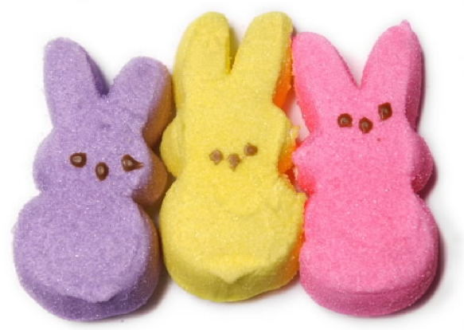
Question 9:
WHAT IS ONE OF THESE CANDIES CALLED?

Slide 11
Question 10:
WHAT DO ALL THESE ANSWERS HAVE IN COMMON?

Slide 12
ANSWERS WILL BE PROVIDED SHORTLY

Slide 13
Question 1:
WHAT 4-LETTER WORD IS WORTH THE MOST POINTS IN SCRABBLE?
QUIZ

Slide 14
Question 2:
THE GOO GOO DOLLS HAVE HAD TWO #1 SONGS: "IRIS" AND WHAT?
SLIDE

Slide 15
Question 3:
WHAT ANCIENT PERCUSSION INSTRUMENT CAN BE USED TO SIGNAL A GRAND ENTRANCE?
GONG

Slide 16
Question 4:
WHAT IS THE NAME OF THE MIDRANGE IPAD MODEL, BETWEEN REGULAR AND PRO?
AIR

Slide 17
Question 5:
WHAT DOES THE "L STAND FOR IN "LED"?
LIGHT (EMITTING DIODE)

Slide 18
Question 6:
WHAT IS THE FIRST NAME OF THE LA LAKER STAR WHO WAS, UNTIL RECENTLY, THEIR PRESIDENT OF OPERATIONS?
MAGIC (JOHNSON)

Slide 19
Question 7:
WHAT IS THE FIRST NAME OF PAUL SIMON'S MUSICAL PARTNER?
ART (GARFUNKEL)

Slide 20
Question 8:
WHAT DOES THE "T" IN "NAFTA" STAND FOR?
(NORTH ATLANTIC FREE) TRADE (ORGANIZATION)

Slide 21
Question 9:
WHAT IS ONE OF THESE CANDIES CALLED?
PEEP

Slide 22
Question 10:
WHAT DO ALL THESE ANSWERS HAVE IN COMMON?
TYPES OF SHOWS

