Slide 1
COMMON THREAD

Slide 2
Question 1:
WHAT COMIC STRIP'S THEME SONG FOR ITS ANIMATED TV SPECIALS IS CALLED "LINUS AND LUCY"?

Slide 3
Question 2:
IN MYTHOLOGY, WHAT PATRON OF EPIC POETRY DID OVID CALL THE "CHIEF OF ALL THE MUSES"?

Slide 4
Question 3:
WHAT ANIMAL IS THE SYMBOL FOR THE REPUBLICAN PARTY?

Slide 5
Question 4:
WHAT PRODUCT SUITE DID ADOBE INTRODUCE IN 1993 TO MANAGE ITS NEW PDF FILE FORMAT FOR DOCUMENTS?

Slide 6
Question 5:
ACCORDING TO THE FIRST LINE OF A J.R.R. TOLKIEN POEM, WHAT DID SAURON MAKE "FOR THE ELVEN-KINGS UNDER THE SKY"?

Slide 7
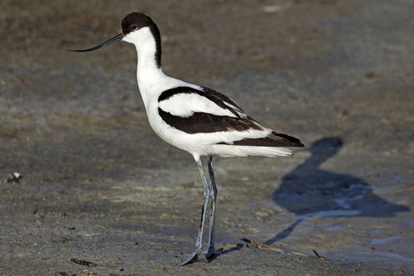
Question 6:
AVOCETS ARE IN WHAT FAMILY OF BIRDS?

Slide 8
Question 7:
WHAT IS THE BEST-SELLING BRAND OF IRISH CREAM LIQUOR?

Slide 9
Question 8:
IN STEPHEN KING'S NOVEL "IT", WHAT DOES "IT" USUALLY APPEAR TO BE?

Slide 10
Question 9:
WHAT ANIMAL IS THE SPORTS NICKNAME OF PENN STATE, LOYOLA MARYMOUNT, AND COLUMBIA?

Slide 11
Question 10:
WHAT DO ALL THESE ANSWERS HAVE IN COMMON?

Slide 12
ANSWERS WILL BE PROVIDED SHORTLY

Slide 13
Question 1:
WHAT COMIC STRIP'S THEME SONG FOR ITS ANIMATED TV SPECIALS IS CALLED "LINUS AND LUCY"?
PEANUTS

Slide 14
Question 2:
IN MYTHOLOGY, WHAT PATRON OF EPIC POETRY DID OVID CALL THE "CHIEF OF ALL THE MUSES"?
CALLIOPE

Slide 15
Question 3:
WHAT ANIMAL IS THE SYMBOL FOR THE REPUBLICAN PARTY?
ELEPHANT

Slide 16
Question 4:
WHAT PRODUCT SUITE DID ADOBE INTRODUCE IN 1993 TO MANAGE ITS NEW PDF FILE FORMAT FOR DOCUMENTS?
ACROBAT

Slide 17
Question 5:
ACCORDING TO THE FIRST LINE OF A J.R.R. TOLKIEN POEM, WHAT DID SAURON MAKE "FOR THE ELVEN-KINGS UNDER THE SKY"?
THREE RINGS

Slide 18
Question 6:
AVOCETS ARE IN WHAT FAMILY OF BIRDS?
STILTS

Slide 19
Question 7:
WHAT IS THE BEST-SELLING BRAND OF IRISH CREAM LIQUOR?
BAILEY'S

Slide 20
Question 8:
IN STEPHEN KING'S NOVEL "IT", WHAT DOES "IT" USUALLY APPEAR TO BE?
A CLOWN

Slide 21
Question 9:
WHAT ANIMAL IS THE SPORTS NICKNAME OF PENN STATE, LOYOLA MARYMOUNT, AND COLUMBIA?
LION

Slide 22
Question 10:
WHAT DO ALL THESE ANSWERS HAVE IN COMMON?
THINGS HAVING TO DO WITH THE CIRCUS

