Slide 1
COMMON THREAD

Slide 2
Question 1:
WHAT WAS THE NAME OF "THE CROCODILE HUNTER"?

Slide 3
Question 2:
WHAT 1997 COMEDY FILM STARRED ROWAN ATKINSON AS A CHARACTER HE PLAYED ON BRITISH TV FOR YEARS?

Slide 4
Question 3:
WHO WON THE NATIONAL COLLEGE BASKETBALL TOURNAMENT IN 1991, 1992, 2001, 2010, AND 2015?

Slide 5
Question 4:
WHAT IS THE NAME OF THE SPIN-OFF OF "THE BIG BANG THEORY"?

Slide 6
Question 5:
WHO IS GOVERNOR OF WISCONSIN?

Slide 7
Question 6:
"GONE WITH THE WIND" WAS THE BEST-SELLING FILM EVER, CORRECTING FOR INFLATION. WHO WROTE THE BOOK IT WAS BASED ON?

Slide 8
Question 7:
WHO IS THE CHIEF NEWS ANCHOR AT FOX NEWS?

Slide 9
Question 8:
WHO WROTE "THE HEART OF DARKNESS"?

Slide 10
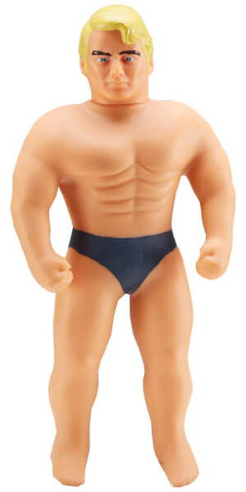
Question 9:
WHAT IS THE NAME OF THIS TOY?

Slide 11
Question 10:
WHAT DO ALL THESE ANSWERS HAVE IN COMMON?

Slide 12
ANSWERS WILL BE PROVIDED SHORTLY

Slide 13
Question 1:
WHAT WAS THE NAME OF "THE CROCODILE HUNTER"?
STEVE IRWIN

Slide 14
Question 2:
WHAT 1997 COMEDY FILM STARRED ROWAN ATKINSON AS A CHARACTER HE PLAYED ON BRITISH TV FOR YEARS?
BEAN

Slide 15
Question 3:
WHO WON THE NATIONAL COLLEGE BASKETBALL TOURNAMENT IN 1991, 1992, 2001, 2010, AND 2015?
DUKE UNIVERSITY

Slide 16
Question 4:
WHAT IS THE NAME OF THE SPIN-OFF OF "THE BIG BANG THEORY"?
YOUNG SHELDON

Slide 17
Question 5:
WHO IS GOVERNOR OF WISCONSIN?
SCOTT WALKER

Slide 18
Question 6:
"GONE WITH THE WIND" WAS THE BEST-SELLING FILM EVER, CORRECTING FOR INFLATION. WHO WROTE THE BOOK IT WAS BASED ON?
MARGARET MITCHELL

Slide 19
Question 7:
WHO IS THE CHIEF NEWS ANCHOR AT FOX NEWS?
SHEPARD SMITH

Slide 20
Question 8:
WHO WROTE "THE HEART OF DARKNESS"?
JOSEPH CONRAD

Slide 21
Question 9:
WHAT IS THE NAME OF THIS TOY?
STRETCH ARMSTRONG

Slide 22
Question 10:
WHAT DO ALL THESE ANSWERS HAVE IN COMMON?
CONTAIN LAST NAMES OF MEN WHO WALKED ON THE MOON

