Slide 1
BUSES

Slide 2
Question 1:
WHO SANG "MAGIC BUS"?

Slide 3
Question 2:
WHEN POLICEMEN ASK FOR A "BUS", WHAT ARE THEY REALLY ASKING FOR?

Slide 4
Question 3:
WHO STARRED IN THE 1956 ROMANCE FILM "BUS STOP" OPPOSITE DON MURRAY?

Slide 5
Question 4:
WHO ARRIVED AT THE 2012 IOWA STATE FAIR IN A BUS CALLED "GROUND FORCE ONE"?

Slide 6
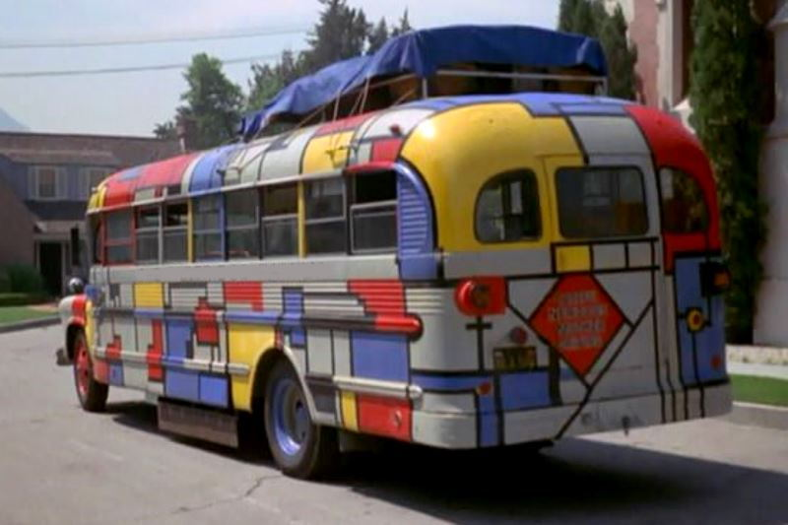
Question 5:
WHAT TV FAMILY OWNED THIS?

Slide 7
Question 6:
WHAT CIVIL RIGHTS LEADER FAMOUSLY REFUSED TO GIVE UP HER BUS SEAT IN 1955?

Slide 8
Question 7:
WHAT FRENCH MATHEMATICIAN MOST FAMOUS FOR HIS "ARITHMETICAL TRIANGLE" ALSO BEGAN THE FIRST BUS SERVICE IN 1662?

Slide 9
Question 8:
IN THE CHILDREN'S BOOKS AND CARTOONS, WHO DRIVES "THE MAGIC SCHOOL BUS"?

Slide 10
Question 9:
AFTER GREYHOUND, WHAT IS THE 2ND LARGEST BUS COMPANY IN THE U.S.? COACH USA, JEFFERSON LINES, OR TRAILWAYS?

Slide 11
Question 10:
WHAT 1994 FILM THAT TAKES PLACE MOSTLY ON A BUS HAD TAG LINE "GET READY FOR RUSH HOUR"?

Slide 12
ANSWERS WILL BE PROVIDED SHORTLY

Slide 13
Question 1:
WHO SANG "MAGIC BUS"?
THE WHO

Slide 14
Question 2:
WHEN POLICEMEN ASK FOR A "BUS", WHAT ARE THEY REALLY ASKING FOR?
AN AMBULANCE

Slide 15
Question 3:
WHO STARRED IN THE 1956 ROMANCE FILM "BUS STOP" OPPOSITE DON MURRAY?
MARILYN MONROE

Slide 16
Question 4:
WHO ARRIVED AT THE 2012 IOWA STATE FAIR IN A BUS CALLED "GROUND FORCE ONE"?
BARACK OBAMA

Slide 17
Question 5:
WHAT TV FAMILY OWNED THIS?
THE PARTRIDGE FAMILY

Slide 18
Question 6:
WHAT CIVIL RIGHTS LEADER FAMOUSLY REFUSED TO GIVE UP HER BUS SEAT IN 1955?
ROSA PARKS

Slide 19
Question 7:
WHAT FRENCH MATHEMATICIAN MOST FAMOUS FOR HIS "ARITHMETICAL TRIANGLE" ALSO BEGAN THE FIRST BUS SERVICE, IN 1662?
BLAISE PASCAL

Slide 20
Question 8:
IN THE CHILDREN'S BOOKS AND CARTOONS, WHO DRIVES "THE MAGIC SCHOOL BUS"?
VALERIE FRIZZLE

Slide 21
Question 9:
AFTER GREYHOUND, WHAT IS THE 2ND LARGEST BUS COMPANY IN THE U.S.? COACH USA, JEFFERSON LINES, OR TRAILWAYS?
JEFFERSON LINES

Slide 22
Question 10:
WHAT 1994 FILM THAT TAKES PLACE MOSTLY ON A BUS HAD TAG LINE "GET READY FOR RUSH HOUR"?
SPEED

