Slide 1
GOLD & SILVER

Slide 2
Question 1:
IS ONE OUNCE OF GOLD WORTH THE SAME AS 40, 80, OR 120 OUNCES OF SILVER?

Slide 3
Question 2:
WHAT IS THE NATURALLY OCCURRING ALLOY OF GOLD AND SILVER CALLED?

Slide 4
Question 3:
TRUE OR FALSE? GOLD APPEARS IMMEDIATELY UNDERNEATH SILVER IN THE PERIODIC TABLE?

Slide 5
Question 4:
WHICH WERE MINTED FIRST IN THE U.S. AS CURRENCY, GOLD COINS OR SILVER COINS?

Slide 6
Question 5:
WHO WON THE MOST GOLD MEDALS IN OLYMPIC HISTORY?

Slide 7
Question 6:
ASIDE FROM GOLD AND SILVER, WHAT TWO PRECIOUS METALS ARE TRADED THE MOST AS INVESTMENTS?

Slide 8
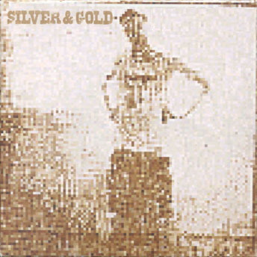
Question 7:
WHAT CANADIAN MUSICAL ARTIST RELEASED THIS ALBUM IN 2000?

Slide 9
Question 8:
THE CHRISTMAS SONG "SILVER BELLS" WAS FIRST PERFORMED AS A DUET BY MARILYN MAXWELL AND WHAT COMIC ACTOR?

Slide 10
Question 9:
HOW LONG WOULD ALL THE GOLD IN FORT KNOX FUND THE U.S. GOVERNMENT? A WEEK, A MONTH, OR A YEAR?

Slide 11
Question 10:
GOLD IS HEAVIER THAN SILVER. IS IT MORE THAN TWICE AS HEAVY?

Slide 12
ANSWERS WILL BE PROVIDED SHORTLY

Slide 13
Question 1:
IS ONE OUNCE OF GOLD WORTH THE SAME AS 40, 80,
OR 120 OUNCES OF SILVER?
80

Slide 14
Question 2:
WHAT IS THE NATURALLY OCCURRING ALLOY OF GOLD AND SILVER CALLED?
ELECTRUM

Slide 15
Question 3:
TRUE OR FALSE? GOLD APPEARS IMMEDIATELY UNDERNEATH SILVER IN THE PERIODIC TABLE?
TRUE

Slide 16
Question 4:
WHICH WERE MINTED FIRST IN THE U.S. AS CURRENCY, GOLD COINS OR SILVER COINS?
SILVER COINS

Slide 17
Question 5:
WHO WON THE MOST GOLD MEDALS IN OLYMPIC HISTORY?
MICHAEL PHELPS

Slide 18
Question 6:
ASIDE FROM GOLD AND SILVER, WHAT TWO PRECIOUS METALS ARE TRADED THE MOST AS INVESTMENTS?
PLATINUM & PALLADIUM

Slide 19
Question 7:
WHAT CANADIAN MUSICAL ARTIST RELEASED THIS ALBUM IN 2000?
NEIL YOUNG

Slide 20
Question 8:
THE CHRISTMAS SONG "SILVER BELLS" WAS FIRST PERFORMED AS A DUET BY MARILYN MAXWELL AND WHAT COMIC ACTOR?
BOB HOPE

Slide 21
Question 9:
HOW LONG WOULD ALL THE GOLD IN FORT KNOX FUND THE U.S. GOVERNMENT? A WEEK, A MONTH, OR A YEAR?
A MONTH

Slide 22
Question 10:
GOLD IS HEAVIER THAN SILVER. IS IT MORE THAN TWICE AS HEAVY?
NO

