Slide 1
COMMON THREAD: IDENTIFY THESE FAMOUS PEOPLE

Slide 2
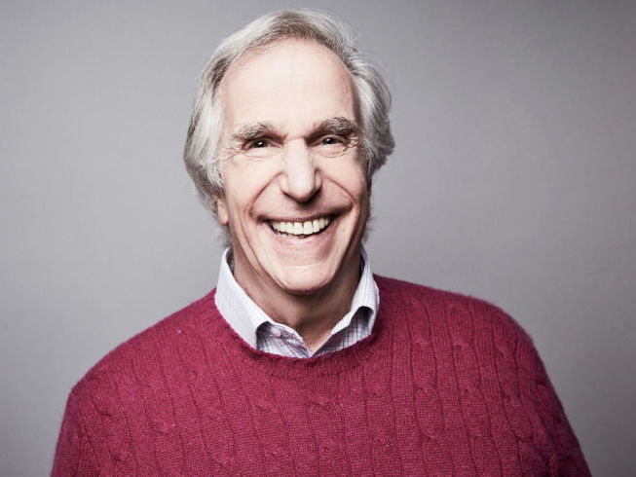
Question 1:

Slide 3
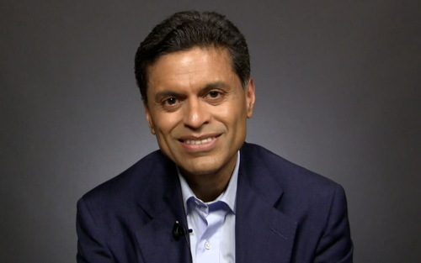
Question 2:

Slide 4
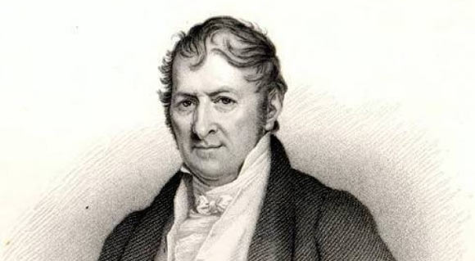
Question 3:

Slide 5
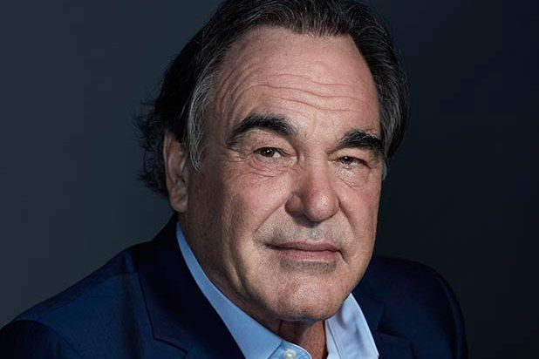
Question 4:

Slide 6
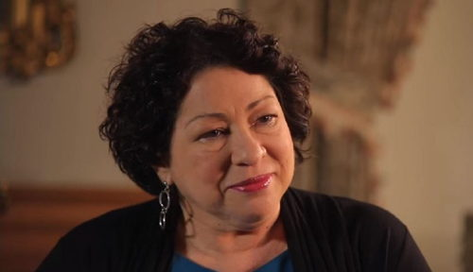
Question 5:

Slide 7
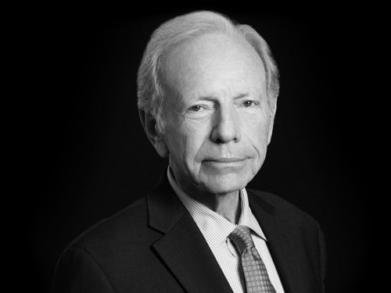
Question 6:

Slide 8
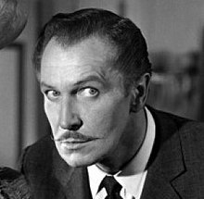
Question 7:

Slide 9
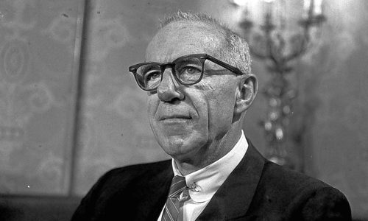
Question 8:

Slide 10
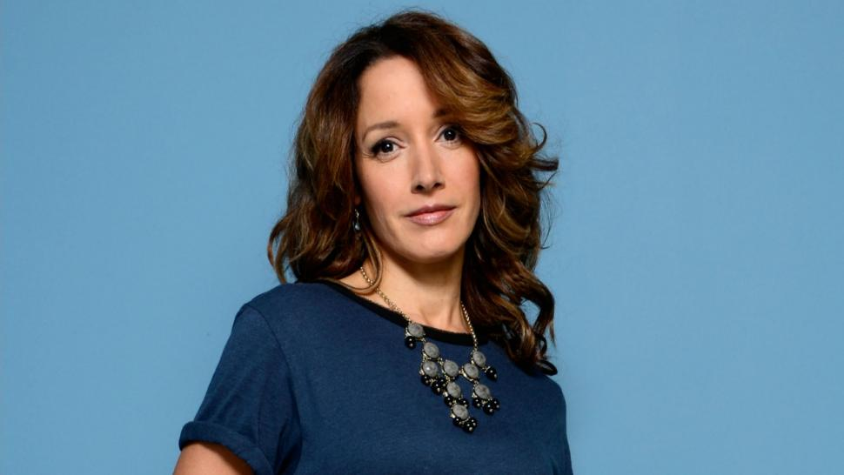
Question 9:

Slide 11
Question 10:
WHAT DO ALL THESE PEOPLE HAVE IN COMMON?

Slide 12
ANSWERS WILL BE PROVIDED SHORTLY

Slide 13
Question 1:
HENRY WINKLER

Slide 14
Question 2:
FAREED ZAKARIA

Slide 15
Question 3:
ELI WHITNEY

Slide 16
Question 4:
OLIVER STONE

Slide 17
Question 5:
SONYA SOTOMAYOR

Slide 18
Question 6:
JOSEPH LIEBERMAN

Slide 19
Question 7:
VINCENT PRICE

Slide 20
Question 8:
DR. BENJAMIN SPOCK

Slide 21
Question 9:
JENNIFER BEALS

Slide 22
Question 10:
WHAT DO ALL THESE PEOPLE HAVE IN COMMON?
THEY ARE ALL GRADUATES OF YALE UNIVERSITY

