Slide 1
COMMON THREAD

Slide 2
Question 1:
WHAT IS THE NAME OF THE BACKUP BAND OF HUEY LEWIS?

Slide 3
Question 2:
WHAT REALITY SHOW ABOUT EXPOSING INFIDELITY HAS BEEN RUNNING FOR ALMOST 20 YEARS?

Slide 4
Question 3:
WHAT LETTERS IN SCRABBLE ARE WORTH THE MOST POINTS, ALONG WITH THE Q'S?

Slide 5
Question 4:
IN WHAT CHILDREN'S CARD GAME DOES ONE ASK QUESTIONS LIKE "DO YOU HAVE ANY 4'S"?

Slide 6
Question 5:
WHILE USED COMMONLY NOW, WHAT WORD WAS TRADEMARKED BY THE WHAM-O TOY COMPANY IN 1957?

Slide 7
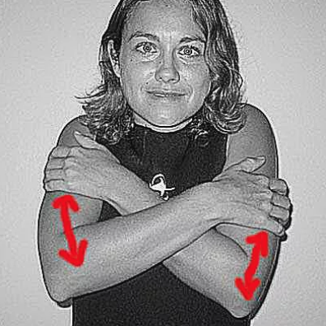
Question 6:
WHAT WORD IS REPRESENTED BY THIS SCUBA DIVING SIGNAL?

Slide 8
Question 7:
WHAT SHAPE BE SEEN ATOP TIMES SQUARE ALL YEAR LONG, BUT ONLY GETS USED THE LAST DAY OF THE YEAR?

Slide 9
Question 8:
ARIES, LEO, AND SAGITTARIUS ARE KNOWN AS WHAT SORT OF ZODIAC SIGNS?

Slide 10
Question 9:
WHAT HORSERACING BET WILL PAY OFF IF YOUR HORSE COMES IN 1ST, 2ND, OR 3RD?

Slide 11
Question 10:
WHAT DO ALL THESE ANSWERS HAVE IN COMMON?

Slide 12
ANSWERS WILL BE PROVIDED SHORTLY

Slide 13
Question 1:
WHAT IS THE NAME OF THE BACKUP BAND OF HUEY LEWIS?
THE NEWS

Slide 14
Question 2:
WHAT REALITY SHOW ABOUT EXPOSING INFIDELITY HAS BEEN RUNNING FOR ALMOST 20 YEARS?
CHEATERS

Slide 15
Question 3:
WHAT LETTERS IN SCRABBLE ARE WORTH THE MOST POINTS, ALONG WITH THE Q'S?
Z'S

Slide 16
Question 4:
IN WHAT CHILDREN'S CARD GAME DOES ONE ASK QUESTIONS LIKE "DO YOU HAVE ANY 4'S"?
FISH

Slide 17
Question 5:
WHILE USED COMMONLY NOW, WHAT WORD WAS TRADEMARKED BY THE WHAM-O TOY COMPANY IN 1957?
FRISBEE

Slide 18
Question 6:
WHAT WORD IS REPRESENTED BY THIS SCUBA DIVING SIGNAL?
COLD

Slide 19
Question 7:
WHAT SHAPE BE SEEN ATOP TIMES SQUARE ALL YEAR LONG, BUT ONLY GETS USED THE LAST DAY OF THE YEAR?
BALL

Slide 20
Question 8:
ARIES, LEO, AND SAGITTARIUS ARE KNOWN AS WHAT SORT OF ZODIAC SIGNS?
FIRE

Slide 21
Question 9:
WHAT HORSERACING BET WILL PAY OFF IF YOUR HORSE COMES IN 1ST, 2ND, OR 3RD?
SHOW

Slide 22
Question 10:
WHAT DO ALL THESE ANSWERS HAVE IN COMMON?
THINGS YOU CAN CATCH

