Slide 1
COMMON THREAD

Slide 2
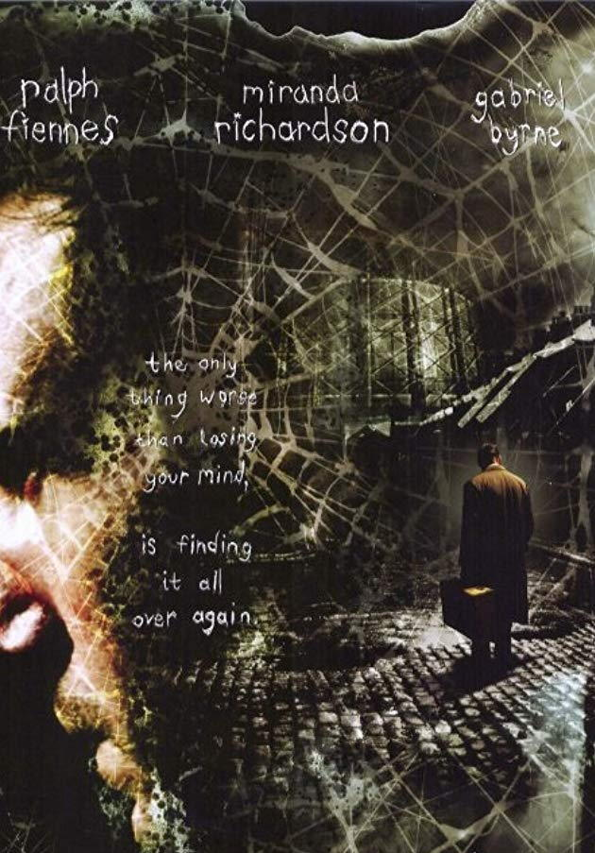
Question 1:
WHAT 2002 THRILLER FILM HAD THIS MOVIE POSTER?

Slide 3
Question 2:
IN WHAT GAME IS A "RINGER" WORTH 3 POINTS, A "LEANER" WORTH 2 POINTS, AND A "CLOSER" WORTH 1 POINT?

Slide 4
Question 3:
WHAT HEBREW PROPHET WAS SUPPOSEDLY SWALLOWED BY A WHALE?

Slide 5
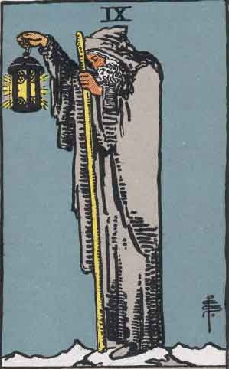
Question 4:
WHAT TAROT CARD IMPLIES YOU ARE IN OR NEED A PERIOD OF INNER REFLECTION?

Slide 6
Question 5:
WHAT IS THE LAST NAME OF THE SINGER OF "POETRY MAN"?

Slide 7
Question 6:
WHAT IMPERIAL UNIT OF MASS IS EQUAL TO 14 POUNDS?

Slide 8
Question 7:
WHAT JONI MITCHELL ALBUM DID NPR CHOOSE AS THE GREATEST ALBUM OF ALL TIME BY A WOMAN?

Slide 9
Question 8:
WHAT WAS THE HIGHEST RANKING PLAYING CARD UNTIL THE 16TH CENTURY?

Slide 10
Question 9:
WHAT IS THE FIRST WORD IN THE TITLE OF THE MUSICAL THAT CONTAINS THE SONG "IF I WERE A RICH MAN"?

Slide 11
Question 10:
WHAT DO ALL THESE ANSWERS HAVE IN COMMON?

Slide 12
ANSWERS WILL BE PROVIDED SHORTLY

Slide 13
Question 1:
WHAT 2002 THRILLER FILM HAD THIS MOVIE POSTER?
SPIDER

Slide 14
Question 2:
IN WHAT GAME IS A "RINGER" WORTH 3 POINTS, A "LEANER" WORTH 2 POINTS, AND A "CLOSER" WORTH 1 POINT?
HORSESHOES

Slide 15
Question 3:
WHAT HEBREW PROPHET WAS SUPPOSEDLY SWALLOWED BY A WHALE?
JONAH

Slide 16
Question 4:
WHAT TAROT CARD IMPLIES YOU ARE IN OR NEED A PERIOD OF INNER REFLECTION?
THE HERMIT

Slide 17
Question 5:
WHAT IS THE LAST NAME OF THE SINGER OF "POETRY MAN"?
(PHOEBE) SNOW

Slide 18
Question 6:
WHAT IMPERIAL UNIT OF MASS IS EQUAL TO 14 POUNDS?
STONE

Slide 19
Question 7:
WHAT JONI MITCHELL ALBUM DID NPR CHOOSE AS THE GREATEST ALBUM OF ALL TIME BY A WOMAN?
BLUE

Slide 20
Question 8:
WHAT WAS THE HIGHEST RANKING PLAYING CARD UNTIL THE 16TH CENTURY?
KING

Slide 21
Question 9:
WHAT IS THE FIRST WORD IN THE TITLE OF THE MUSICAL THAT CONTAINS THE SONG "IF I WERE A RICH MAN"?
FIDDLER (ON THE ROOF)

Slide 22
Question 10:
WHAT DO ALL THESE ANSWERS HAVE IN COMMON?
TYPES OF CRAB

