Slide 1
MUSICAL COMMON THREAD

Slide 2
Question 1:
WHO WAS THE FATHER OF NORAH JONES?

Slide 3
Question 2:
WHO IS BEST KNOWN FOR AN 18-MINUTE SONG ABOUT EVENTS THAT HAPPENED ON THANKSGIVING DAY, 1965?

Slide 4
Question 3:
WHO SANG "LOVE IS JUST A FOUR-LETTER WORD" AND "SWEET SIR GALAHAD"?

Slide 5
Question 4:
WHAT LATIN ROCK GROUP IS TIED WITH MICHAEL JACKSON IN WINNING THE MOST (8) GRAMMYS IN ONE EVENING?

Slide 6
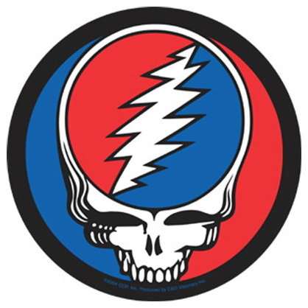
Question 5:
WHAT GROUP HAD THIS ALBUM COVER?

Slide 7
Question 6:
WHAT MUSICAL ARTIST DIED 3 MONTHS BEFORE THE RELEASE OF HER ALBUM "PEARL", HER NICKNAME?

Slide 8
Question 7:
KEITH MOON PLAYED DRUMS FOR WHAT BAND?

Slide 9
Question 8:
WHO SANG "AND WHEN I DIE" AND "SPINNING WHEEL"?

Slide 10
Question 9:
WHO IS DESCRIBED BY THE ROCK AND ROLL HALL OF FAME AS "ARGUABLY THE GREATEST INSTRUMENTALIST IN THE HISTORY OF ROCK AND ROLL"?

Slide 11
Question 10:
WHAT DO ALL THESE ANSWERS HAVE IN COMMON?

Slide 12
ANSWERS WILL BE PROVIDED SHORTLY

Slide 13
Question 1:
WHO WAS THE FATHER OF NORAH JONES?
RAVI SHANKAR

Slide 14
Question 2:
WHO IS BEST KNOWN FOR AN 18-MINUTE SONG ABOUT EVENTS THAT HAPPENED ON THANKSGIVING DAY, 1965?
ARLO GUTHRIE

Slide 15
Question 3:
WHO SANG "LOVE IS JUST A FOUR-LETTER WORD" AND "SWEET SIR GALAHAD"?
JOAN BAEZ

Slide 16
Question 4:
WHAT LATIN ROCK GROUP IS TIED WITH MICHAEL JACKSON IN WINNING THE MOST (8) GRAMMYS IN ONE EVENING?
SANTANA

Slide 17
Question 5:
WHAT GROUP HAD THIS ALBUM COVER?
GRATEFUL DEAD

Slide 18
Question 6:
WHAT MUSICAL ARTIST DIED 3 MONTHS BEFORE THE RELEASE OF HER ALBUM "PEARL", HER NICKNAME?
JANIS JOPLIN

Slide 19
Question 7:
KEITH MOON PLAYED DRUMS FOR WHAT BAND?
THE WHO

Slide 20
Question 8:
WHO SANG "AND WHEN I DIE" AND "SPINNING WHEEL"?
BLOOD, SWEAT & TEARS

Slide 21
Question 9:
WHO IS DESCRIBED BY THE ROCK AND ROLL HALL OF FAME AS "ARGUABLY THE GREATEST INSTRUMENTALIST IN THE HISTORY OF ROCK AND ROLL"?
JIMI HENDRIX

Slide 22
Question 10:
WHAT DO ALL THESE ANSWERS HAVE IN COMMON?
THEY PLAYED AT WOODSTOCK

