Slide 1
COMMON THREAD

Slide 2
Question 1:
WHAT IS THE NAME OF THE 1977 FILM ABOUT THE LIFE OF MUHAMMAD ALI IN WHICH ALI PLAYS HIMSELF?

Slide 3
Question 2:
WHAT IS THE NAME OF JON BON JOVI'S FIRST SOLO ALBUM, INSPIRED BY THE FILM "YOUNG GUNS II"?

Slide 4

Question 3:
WHAT DOES THIS ICON INDICATE IN THE GAME OF MINECRAFT?

Slide 5
Question 4:
WHAT ARE THE 2 MOST-USED PRONOUNS, BOTH IN WRITTEN AND SPOKEN ENGLISH?

Slide 6
Question 5:
WHAT IS THE MOST FAMOUS QUOTE OF RONALD REAGAN DURING HIS LAST PRESIDENTIAL DEBATE WITH JIMMY CARTER?

Slide 7
Question 6:
WHAT SHOWTIME SERIES STARS CLAIRE DANES AS A CIA OFFICER WITH BIPOLAR DISORDER?

Slide 8
Question 7:
WHAT COLOR ARE THE MOST EXPENSIVE SLIPPERS EVER USED IN A FILM?

Slide 9
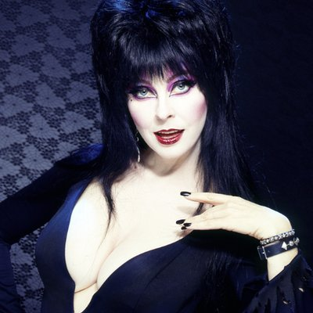
Question 8:
WHAT HORROR HOSTESS WAS PORTRAYED BY CASSANDRA PETERSON?

Slide 10
Question 9:
AN ENGLISH BARON SHOULD BE ADDRESSED AS "LORD". WHAT SHOULD A BARONESS BE ADDRESSED AS?

Slide 11
Question 10:
WHAT DO ALL THESE ANSWERS HAVE IN COMMON?

Slide 12
ANSWERS WILL BE PROVIDED SHORTLY

Slide 13
Question 1:
WHAT IS THE NAME OF THE 1977 FILM ABOUT THE LIFE OF MUHAMMAD ALI IN WHICH ALI PLAYS HIMSELF?
THE GREATEST

Slide 14
Question 2:
WHAT IS THE NAME OF JON BON JOVI'S FIRST SOLO ALBUM, INSPIRED BY THE FILM "YOUNG GUNS II"?
BLAZE OF GLORY

Slide 15
Question 3:
WHAT DOES THIS ICON INDICATE IN THE GAME OF MINECRAFT?
BURIED TREASURE

Slide 16
Question 4:
WHAT ARE THE 2 MOST-USED PRONOUNS, BOTH IN WRITTEN AND SPOKEN ENGLISH?
YOU AND I

Slide 17
Question 5:
WHAT IS THE MOST FAMOUS QUOTE OF RONALD REAGAN DURING HIS LAST PRESIDENTIAL DEBATE WITH JIMMY CARTER?
THERE YOU GO AGAIN

Slide 18
Question 6:
WHAT SHOWTIME SERIES STARS CLAIRE DANES AS A CIA OFFICER WITH BIPOLAR DISORDER?
HOMELAND

Slide 19
Question 7:
WHAT COLOR ARE THE MOST EXPENSIVE SLIPPERS EVER USED IN A FILM?
RUBY

Slide 20
Question 8:
WHAT HORROR HOSTESS WAS PORTRAYED BY CASSANDRA PETERSON?
ELVIRA

Slide 21
Question 9:
AN ENGLISH BARON SHOULD BE ADDRESSED AS "LORD". WHAT SHOULD A BARONESS BE ADDRESSED AS?
LADY

Slide 22
Question 10:
WHAT DO ALL THESE ANSWERS HAVE IN COMMON?
TITLES OF KENNY ROGERS SONGS

