Slide 1
WHAT LOGOS HAVE THESE UNUSUAL O'S?

Slide 2

Question 1:

Slide 3
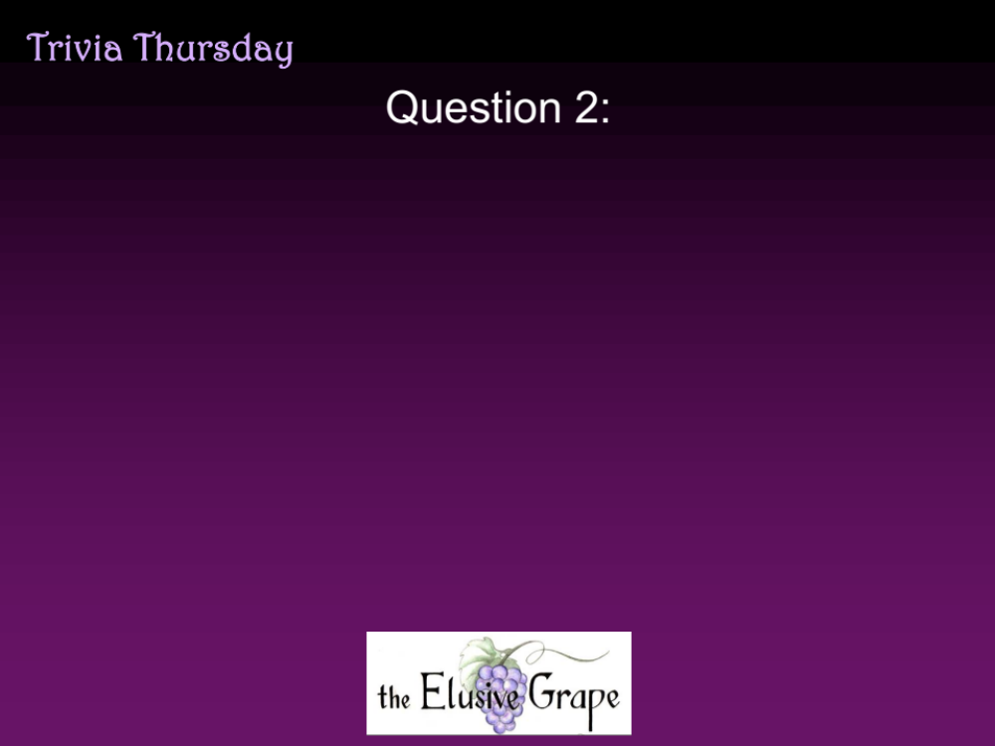

Question 2:

Slide 4

Question 3:

Slide 5

Question 4:

Slide 6

Question 5:

Slide 7

Question 6:

Slide 8

Question 7:

Slide 9

Question 8:

Slide 10

Question 9:

Slide 11

Question 10:

Slide 12
ANSWERS WILL BE PROVIDED SHORTLY

Slide 13

Question 1:

Slide 14

Question 2:

Slide 15

Question 3:

Slide 16

Question 4:

Slide 17

Question 5:

Slide 18

Question 6:

Slide 19

Question 7:

Slide 20

Question 8:

Slide 21

Question 9:

Slide 22

Question 10:

